Slide 1
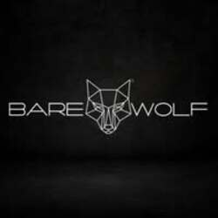
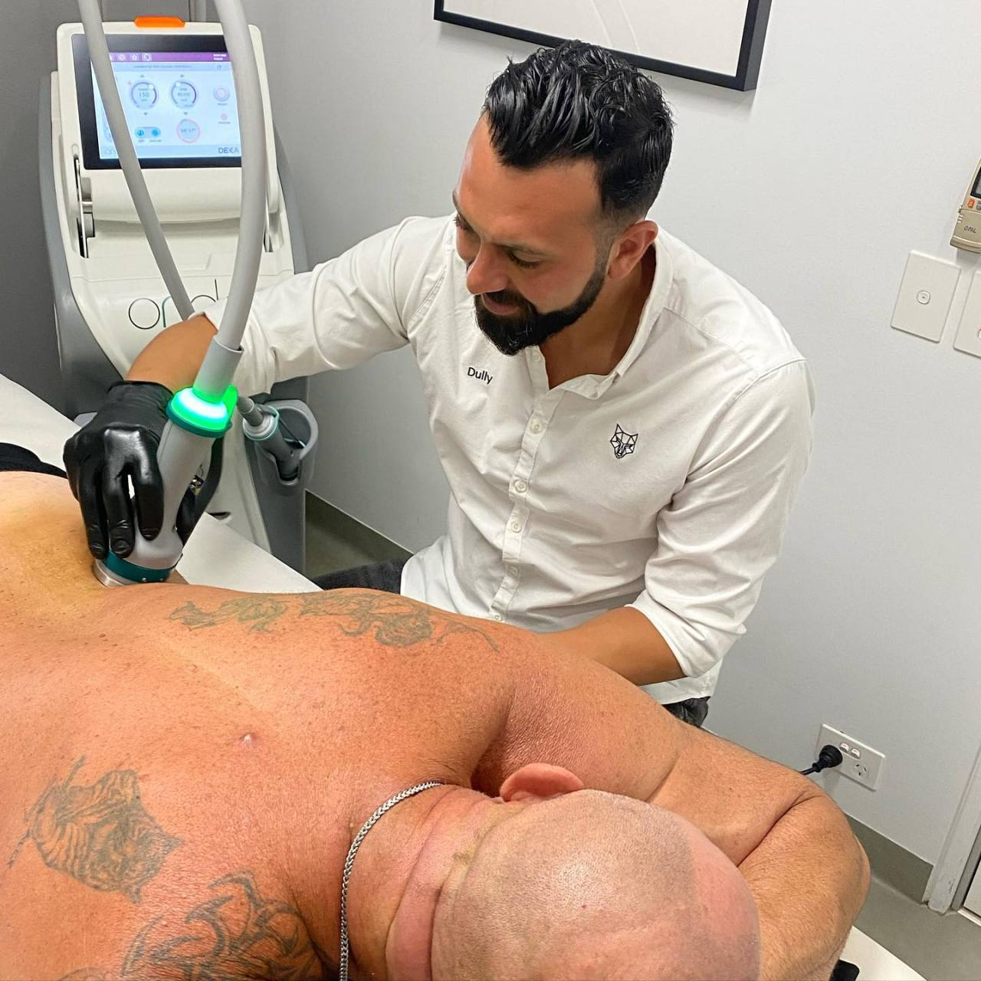
Men’s Tattoo Removal in Sydney and Men Facial in Rushcutters Bay at Barewolf Sydney CBD

Slide 2
At Barewolf Sydney CBD, we work with men every day who want to feel confident in their own skin. Some want to remove old tattoos that no longer fit their life. Others want simple, effective skincare that actually works for men. That is where Men’s Tattoo Removal in Sydney and Men Facial in Rushcutters Bay services come together under one roof, guided by real experience and honest advice.
Why Men Are Choosing Tattoo Removal Today
Tattoos can mean different things at different stages of life. What felt right years ago may not reflect who you are now. With Men’s Tattoo Removal in Sydney, we focus on safe, gradual removal using medical-grade laser technology designed for male skin.
We always explain the process clearly. Tattoo removal is not instant, and results depend on ink depth, colour, and skin type. Our role is to guide you with realistic expectations and steady progress.
What we focus on during treatment
Skin safety and comfort
Controlled laser sessions to reduce irritation
Clear timelines based on tattoo size and colour
Aftercare support between sessions
Men trust us because we speak plainly and treat every case differently.

Slide 3
Why Men Need Professional Facials Too
The skin is daily exposed to stressors such as shaving, sun exposure, sweating, and pollution. That is why Men Facial in Rushcutters Bay services are becoming part of regular self-care for many men.
Our facials are practical, not cosmetic fluff. We focus on skin health, clarity, and long-term results. Whether you struggle with blocked pores, dryness, or uneven tone, our treatments are built around what your skin actually needs.
What Our Men Facial Treatments Focus On
At Barewolf Sydney CBD, every facial starts with a proper skin assessment.
Our approach includes:
Deep cleansing to remove oil and buildup
Gentle exfoliation for smoother skin
Hydration to support skin recovery
Calming techniques for post-shave irritation
Men who book Men Facial in Rushcutters Bay often notice better skin texture and fewer shaving issues after regular sessions.
Expert Care Built for Men
We built Barewolf Sydney CBD as a space where men feel comfortable asking questions and getting straight

Slide 4
answers. From Men’s Tattoo Removal in Sydney to Men Facial in Rushcutters Bay, our treatments are designed by professionals who understand male skin and male concerns.
We do not rush sessions or overpromise results. Instead, we focus on:
Honest advice
Proven techniques
Personal care plans
Long-term skin confidence
Start Your Journey with Barewolf Sydney CBD
If you are ready to clear unwanted ink or take better care of your skin, we are here to help. Our experience with Men’s Tattoo Removal in Sydney and Men Facial in Rushcutters Bay allows us to support men at every stage of their grooming journey.
Book a consultation with us and let us help you feel comfortable, confident, and looked after—without pressure or confusion.

Slide 5
For More Details Contact Us :
Name: Barewolf
Address: 128 Castlereagh St, Sydney NSW 2000, Australia
Telephone: 61450385395
Email id: info@barewolf.com.au
Website: https://maps.app.goo.gl/kaqLf9n5Yei5rKDn7

