Slide 1

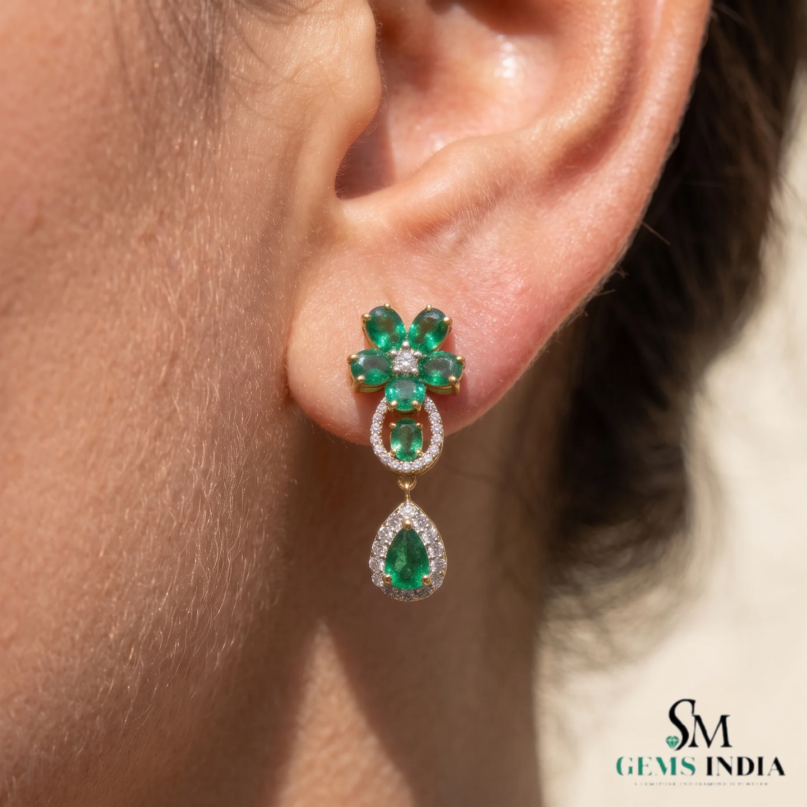




Emerald Earrings for Women
Elegant earrings created to complement every modern woman.
Lightweight & Comfortable
Premium Finish
Classic & Fashionable

Slide 2






Welcome to SM Gems India
SM Gems India offers premium handcrafted emerald jewellery made with certified natural gemstones — combining traditional craftsmanship with modern elegance for customers worldwide.
Certified Natural Emeralds
Premium Craftsmanship
Worldwide Shipping
Secure Payments
Elegant Designs
Trusted Globally

Slide 3
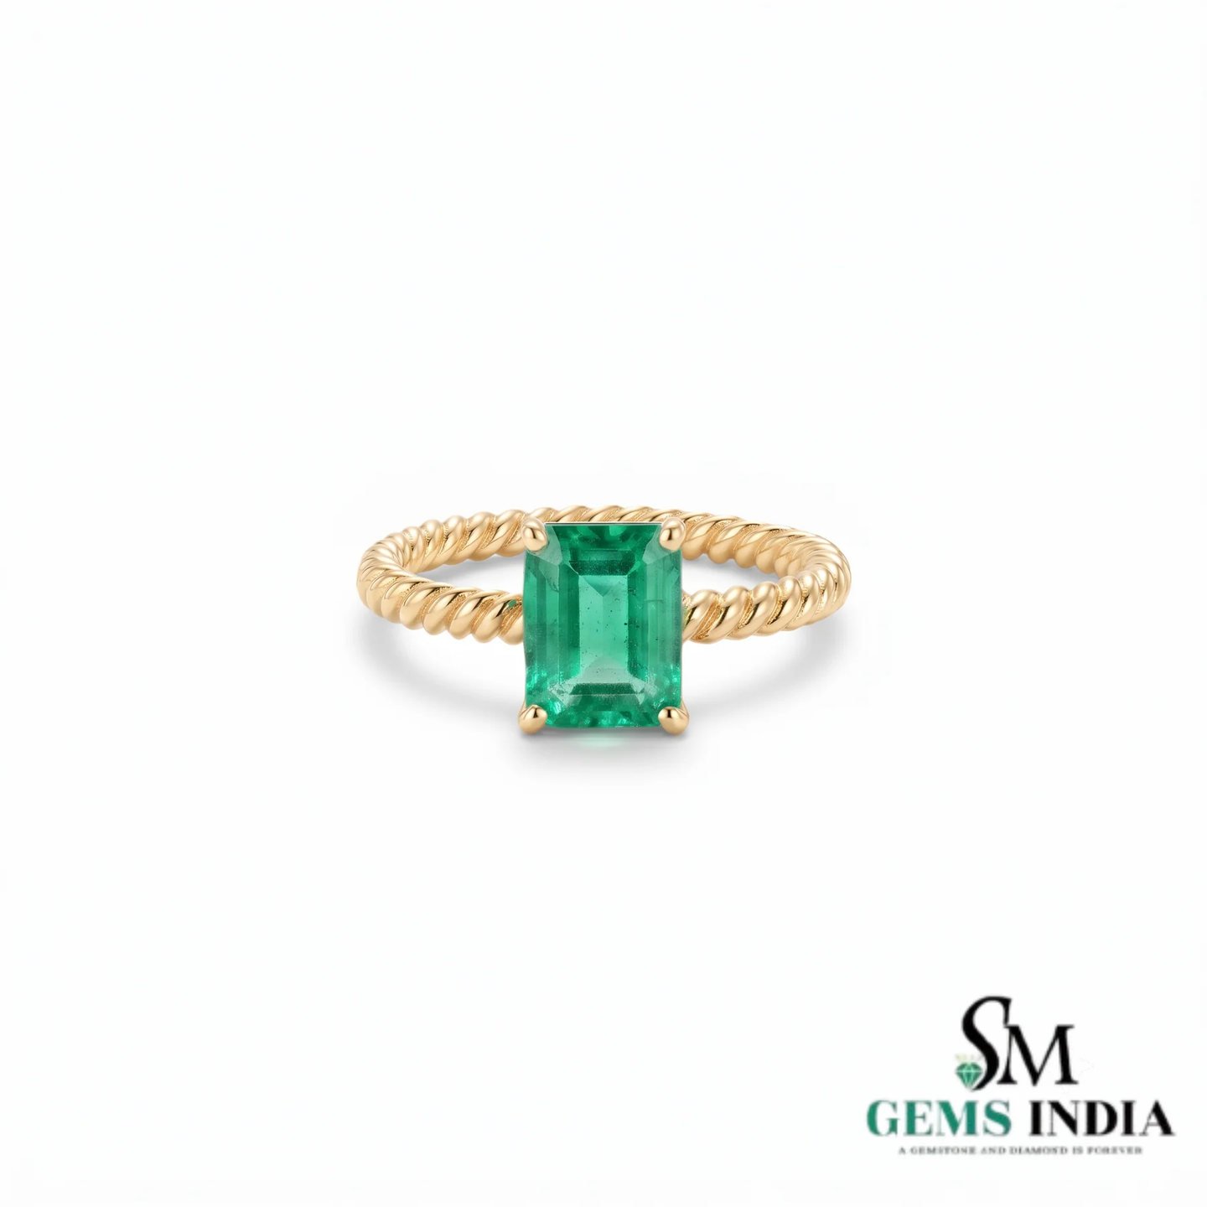


Buy Emerald Ring Online
Find beautifully crafted emerald rings designed for luxury and everyday elegance.
Natural Emerald Stones
14K & 18K Gold
Engagement & Wedding Rings
Statement & Custom Designs

Slide 4
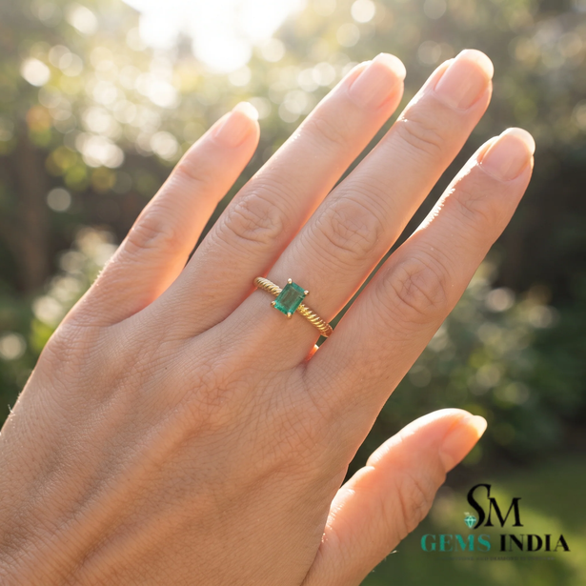
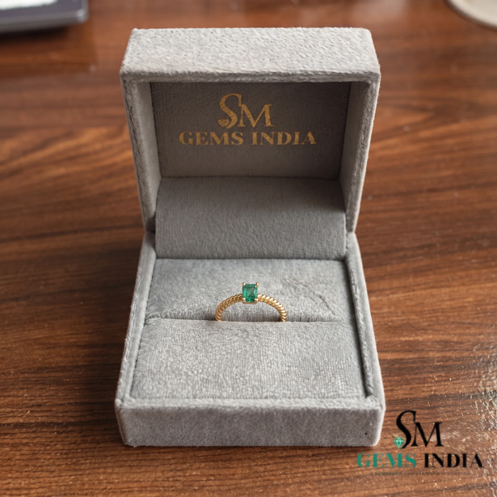
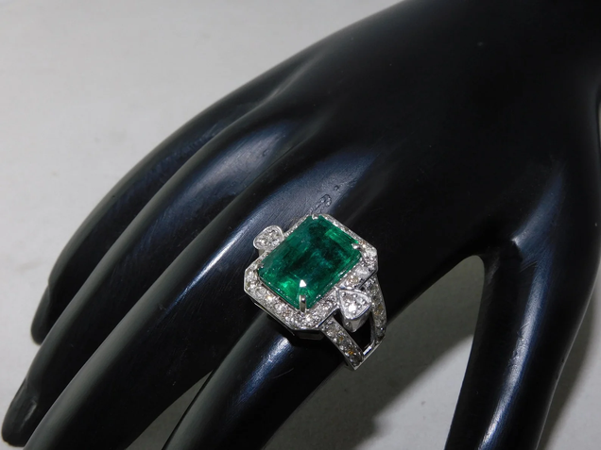
Emerald Ring for Women
Celebrate timeless beauty with handcrafted emerald rings specially designed for women.
Daily Wear & Fashion
Anniversary & Birthday Gifts
Wedding & Special Occasions
Perfect for everyday luxury and fashion-forward styling.
A meaningful gift for life's most cherished moments.
Stunning rings for weddings and special occasions.

Slide 5
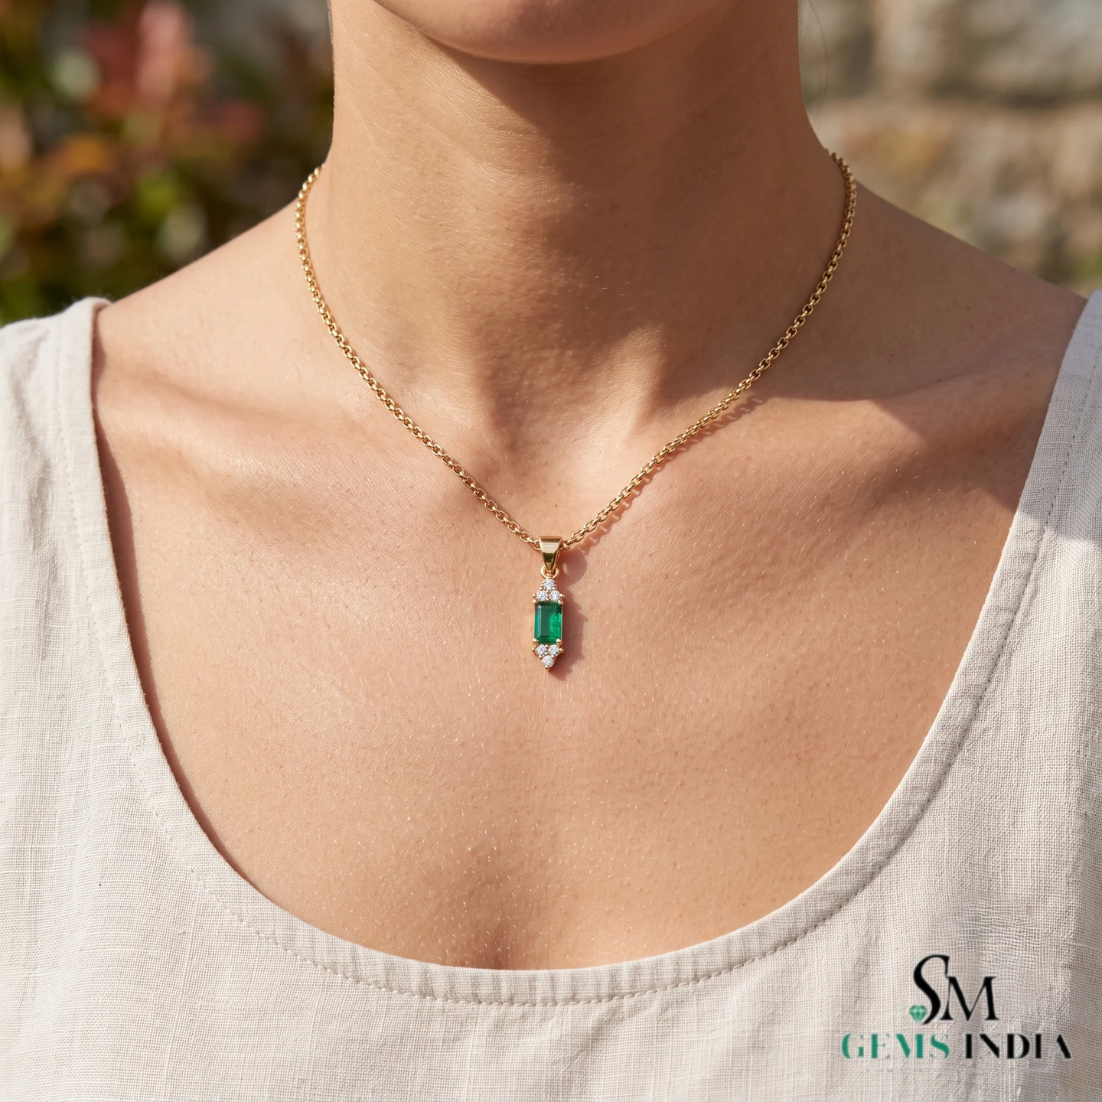

Emerald Pendant Online
Highlights
Modern & Vintage Designs
Certified Emeralds
Lightweight & Premium Finish
Elegant emerald pendants that enhance every outfit with natural brilliance.

Slide 6
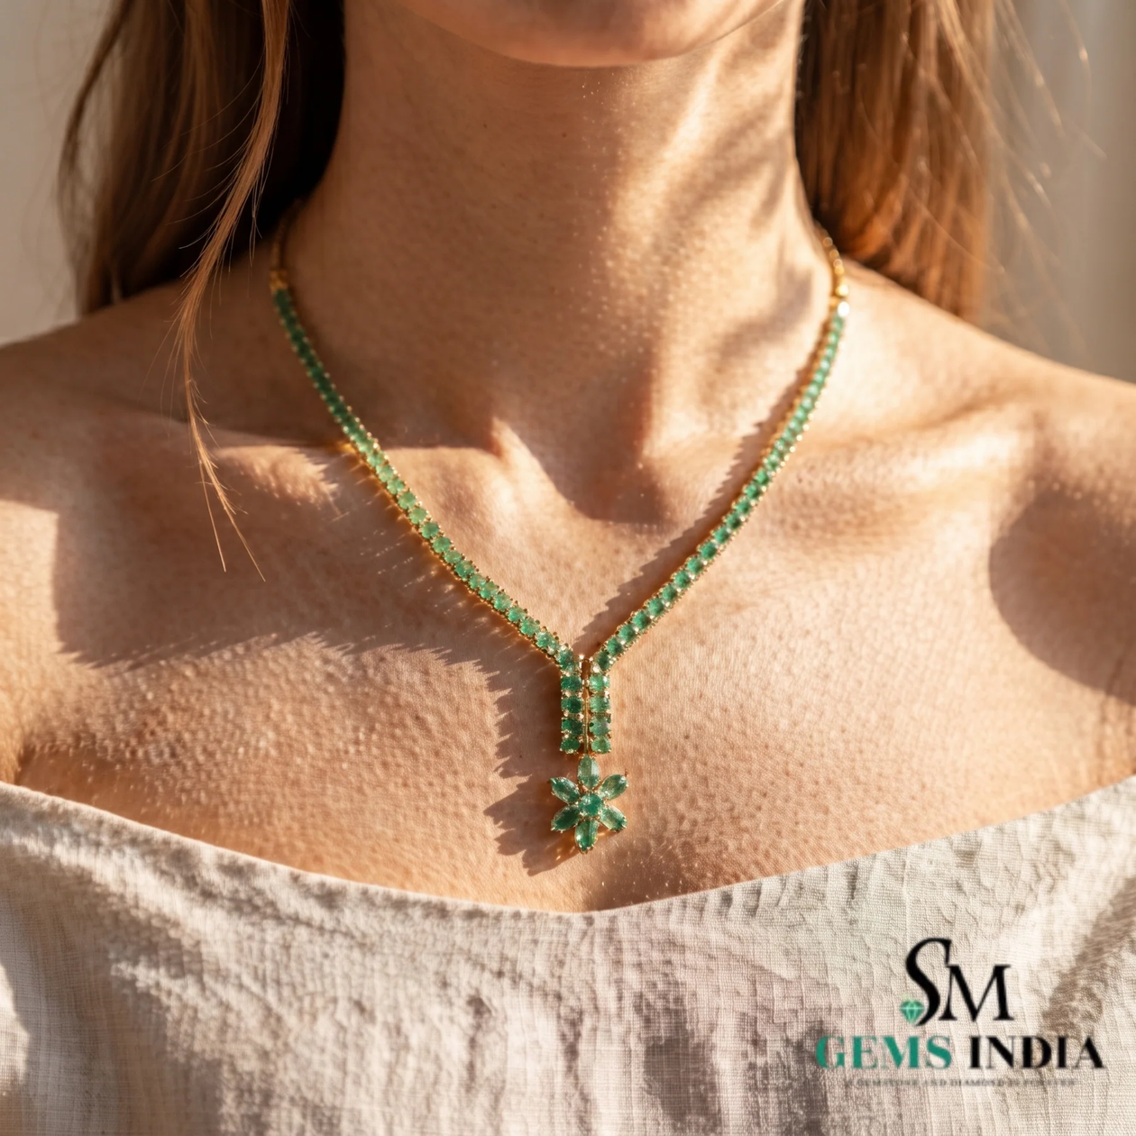
Emerald Pendant for Women
A perfect combination of elegance and sophistication — suitable for every occasion.
Office & Party Wear
Wedding Jewellery
Everyday Luxury
Gift Collection

Slide 7
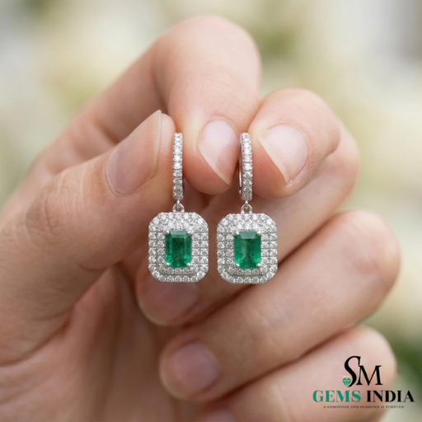
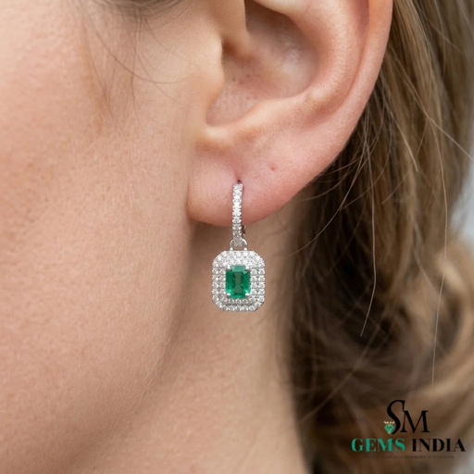
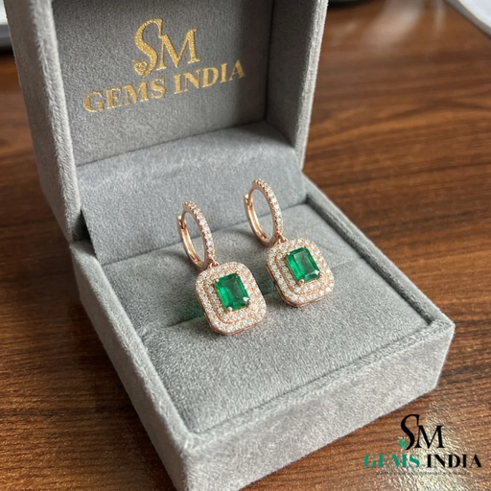
Emerald Earring Online
Discover luxury emerald earrings crafted with precision.
Stud & Drop Earrings
Hoop & Halo Earrings
Diamond Emerald Earrings
Classic styles for everyday elegance.
Bold designs that make a statement.
Premium fusion of emerald and diamond brilliance.

Slide 8
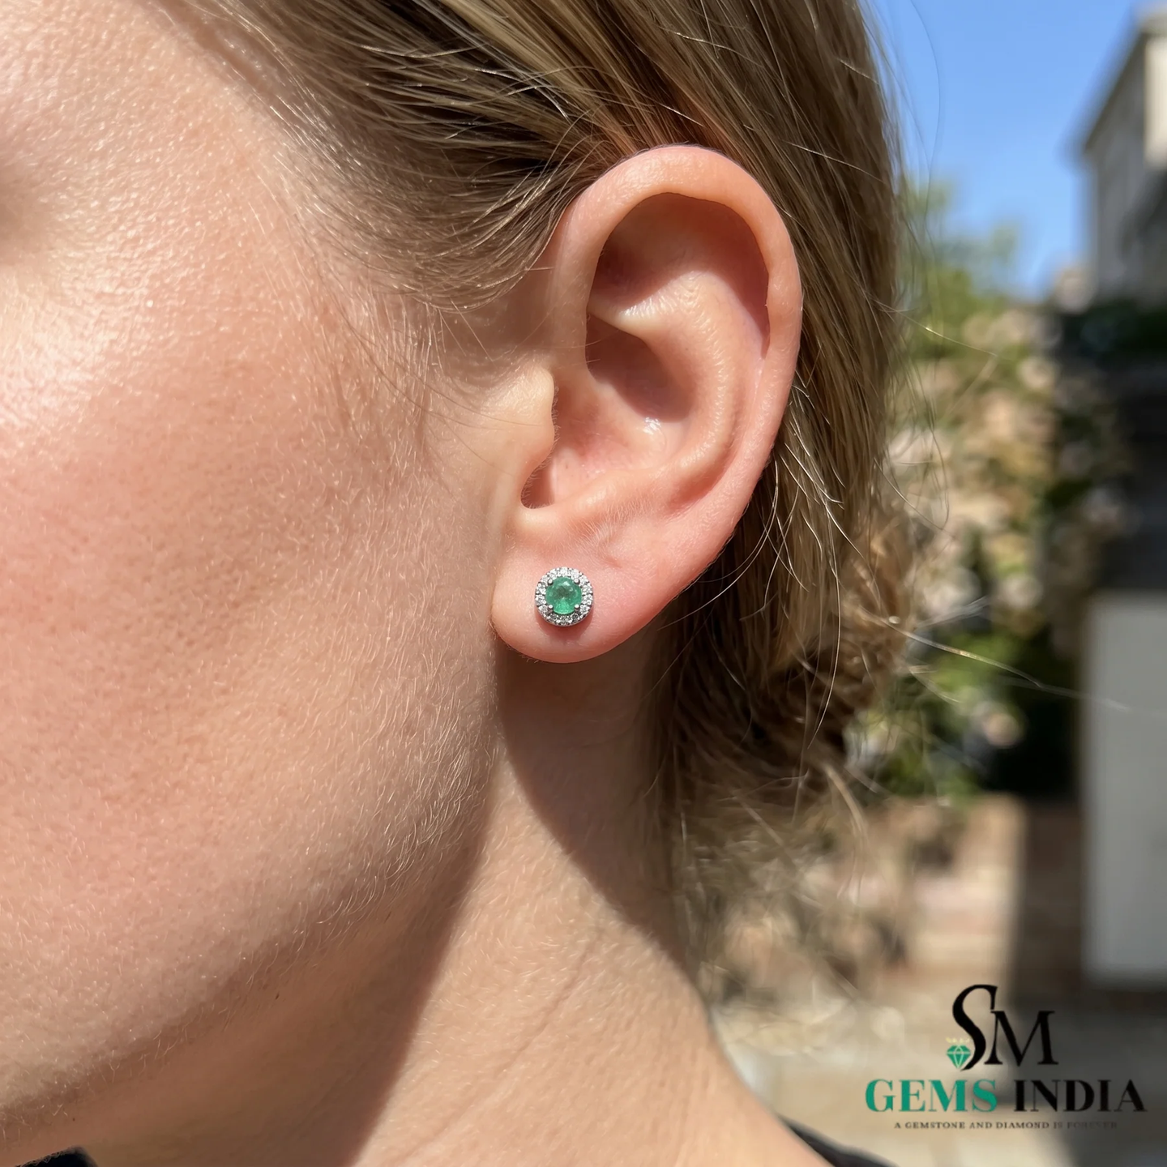
Emerald Earrings for Women
Elegant earrings created to complement every modern woman.
Lightweight & Comfortable
Premium Finish
Classic & Fashionable

Slide 9
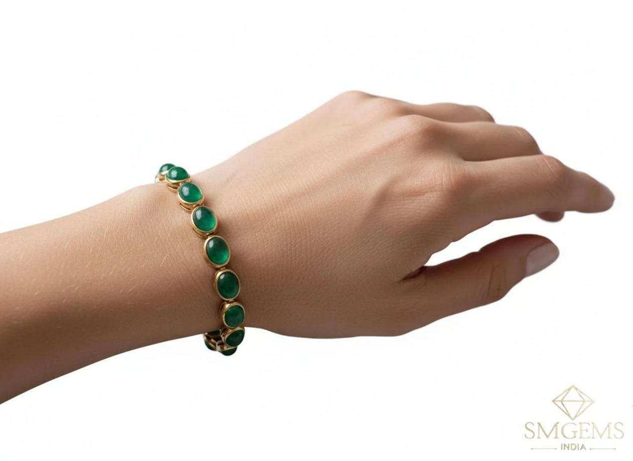
Emerald Bracelet & Contact Us
Emerald Bracelet Collection
Beautiful emerald bracelets crafted with exceptional attention to detail — perfect for luxury fashion, daily wear, weddings, and anniversary gifts.
Contact SM Gems India
📍 Plot No. 1A, Inderpuri Colony, Kosalya Marg, Brahmpuri, Jaipur – 302002, Rajasthan, India
📞 +91 70144 10817 |
✉️ SALE@SMGEMSINDIA.COM
🌐 smgemsindia.com
🕙 Mon–Sat: 10:00 AM – 7:00 PM | Sunday: Closed
We look forward to helping you find the perfect emerald jewellery.

