Slide 1


Quora Web Solution
Website Design and
Development
Company
Web Design & Web Development
Company in Bangalore, India
www.quorawebsolution.com
+91 9986 056 909
info@quorawebsolutions.com
24A, 1st Main Rd, Chandra Reddy
Layout, Koramangala 4th Block,
Koramangala, Bengaluru,
Karnataka 560034

Slide 2

Top 10 Features That Every Modern Business Website Needs – And How Design and Development Teams Build Them
In today’s hyper-digital world, a business’s website is more than just a virtual brochure—it’s often the first impression and main touchpoint for potential customers. An expertly crafted website often determines whether a potential client chooses your business or moves on to a competitor.
www.quorawebsolution.com

Slide 3
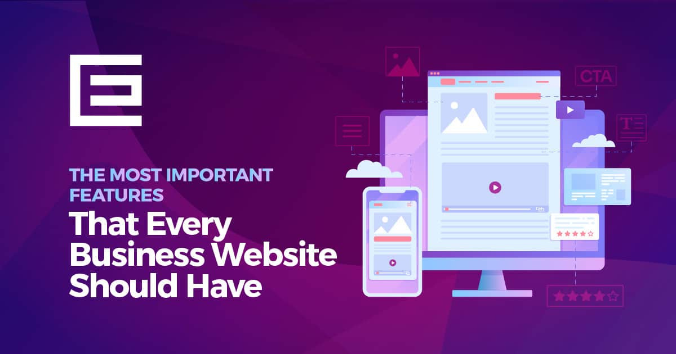
So, what features make a modern business website stand out?
Below are the 10 must-have features for any professional business website in 2025—and how expert design and development teams bring them to life.
1. Responsive and Mobile-Friendly Design
Why It Matters:
www.quorawebsolution.com

Slide 4
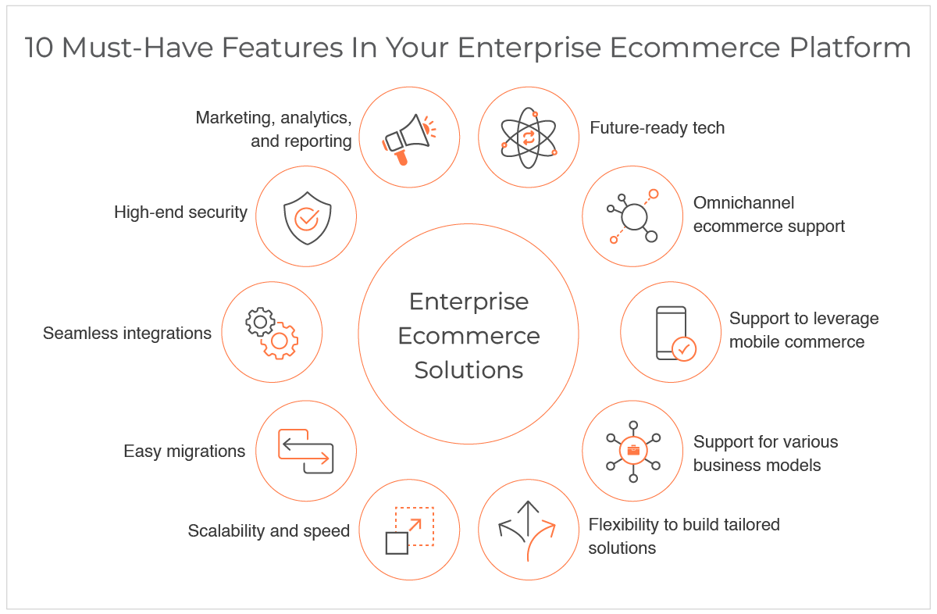
More than 60% of internet users access websites via mobile devices today. If your site doesn’t perform well on smartphones and tablets, you're losing leads.
How It’s Built:
www.quorawebsolution.com

Slide 5

Design teams use responsive frameworks like Bootstrap or CSS Grid, while developers implement media queries to ensure seamless rendering across all screen sizes.
2. Fast Loading Speed
Why It Matters:
Modern users anticipate websites to load within just 2 to 3 seconds for a smooth experience. Any longer, and bounce rates increase dramatically.
www.quorawebsolution.com

Slide 6
How It’s Built:
Development teams use image optimization, code minification, lazy loading, and CDNs (Content Delivery Networks) to speed things up. PageSpeed tools help measure performance.
3. Clear Call-to-Actions (CTAs)
Why It Matters:
A beautiful website means nothing if users don’t know what to do next. CTAs help steer users toward meaningful actions—such as reaching out, scheduling a demo, or completing a purchase.
How It’s Built:
Designers place CTAs prominently using color contrast and typography hierarchy. Developers integrate click tracking and A/B testing tools like Google Optimize for performance analysis.
www.quorawebsolution.com

Slide 7
4. SEO-Optimized Structure
Why It Matters:
Even the most stunning website serves little purpose if potential customers can’t discover it online.? SEO helps your site rank on Google, bringing in organic traffic.
How It’s Built:
Developers use semantic HTML, clean URLs, and meta tags. Design teams create an intuitive site structure with internal linking and keyword-optimized content layout.
5. Secure and GDPR-Compliant
Why It Matters:
www.quorawebsolution.com

Slide 8
Security builds trust. Users are more likely to engage with websites that protect their data and follow legal standards.
How It’s Built:
Developers install SSL certificates (HTTPS), enable firewalls, and ensure data encryption. GDPR compliance includes adding cookie consent pop-ups and clear privacy policies.
6. Intuitive Navigation and UX Design
Why It Matters:
If users can’t find what they’re looking for quickly, they’ll leave. Effective UX design plays a critical role in capturing attention and maintaining user interest throughout their visit.
www.quorawebsolution.com

Slide 9
How It’s Built:
Designers create clean navigation menus, breadcrumbs, and logical page hierarchies. Developers implement smooth transitions and scroll behaviors for better interactivity.
7. CMS Integration (Content Management System)
Why It Matters:
Businesses need to update content frequently—blogs, service pages, portfolios, etc. A CMS makes that easy.
How It’s Built:
Developers integrate platforms like WordPress, Webflow, or custom-built CMS solutions. Design teams ensure consistent styling for CMS-driven content.
www.quorawebsolution.com

Slide 10
8. Contact Forms and Live Chat Options
Why It Matters:
Your website should encourage user interaction. Easy-to-use contact methods improve lead generation.
How It’s Built:
Designers use form best practices (minimal fields, clean design). Developers add form validation, CAPTCHAs, and integrate with CRM tools or live chat software like Tawk.to or Intercom.
9. Analytics and Tracking Tools
Why It Matters:
You can’t improve what you don’t measure. Data helps businesses understand how users behave and where improvements are needed.
www.quorawebsolution.com

Slide 11
How It’s Built:
Development teams implement tools like Google Analytics, Google Tag Manager, Hotjar, and Mixpanel to gather actionable insights and monitor user behavior effectively. These tools track traffic, conversions, and heatmaps.
10. Social Media Integration and Shareability
Why It Matters:
Your audience is active on social platforms. Make it easy for them to find and share your content.
How It’s Built:
Designers include branded icons and share buttons. Developers connect feeds (e.g., Instagram API) and enable Open Graph metadata for better sharing previews.
www.quorawebsolution.com

Slide 12
✅ Final Thoughts
A modern business website is the product of collaboration between creative designers and technical developers. When these teams align, the result is a high-performing, user-friendly site that works as a full-time marketing and sales machine.
Want to upgrade your business website or build one from scratch?
Get in touch with our expert team today. Let’s create something extraordinary.
How a Well-Designed and Professionally Developed Website Can Transform Your Online Presence
www.quorawebsolution.com

Slide 13
In today’s digital-first world, your website is more than just a digital business card—it’s the cornerstone of your brand’s online identity. Whether you’re a startup or an established business, the quality of your website design and development directly influences how your audience perceives you, interacts with your brand, and ultimately, whether they choose to do business with you.
Here’s how a well-crafted website can completely transform your online presence:
1. First Impressions That Last
Your website frequently serves as the initial point of contact between your brand and potential customers. Within seconds, they form an opinion—based on visuals, layout, speed, and content.
Professional design ensures:
A clean, modern aesthetic that reflects your brand
Consistent color schemes, typography, and imagery
www.quorawebsolution.com

Slide 14
Immediate visual credibility
A professionally developed site enhances that impression with fast load times, smooth interactions, and intuitive navigation—ensuring that visitors don’t just land on your page, but stay there.
2. Enhanced User Experience (UX)
A sleek design means little if users can't find what they’re looking for. Thoughtful UX design ensures that every visitor enjoys a seamless, frustration-free experience.
Key benefits include:
Easy-to-navigate menus and structure
Clear calls-to-action (CTAs) that guide the user
Responsive layouts that adapt seamlessly across smartphones, tablets, and desktop screens
Good UX leads to higher engagement rates, lower bounce rates, and more conversions.
www.quorawebsolution.com

Slide 15
3. Boosted Credibility and Trust
Users are more likely to trust and do business with a company that has a polished, professional web presence.
What builds trust online?
Secure browsing (SSL certificates and HTTPS)
Professional branding and messaging
Testimonials, case studies, and client logos
Clean, bug-free functionality
A great site subtly communicates: “We care about our business—and yours.”
4. Improved SEO and Online Visibility
No matter how stunning your website looks, it’s ineffective if people can’t find it. From the initial codebase to content structure, a professionally built website is designed with SEO best practices integrated at every level.
www.quorawebsolution.com

Slide 16
SEO enhancements include:
Clean code and fast-loading pages
Optimized content with target keywords
Meta tags, schema markup, and sitemaps
Mobile-first development
With these in place, search engines are more likely to rank your site higher—bringing in more organic traffic and qualified leads.
5. Seamless Integration With Marketing Tools
A modern website doesn’t operate in isolation. It integrates with your broader marketing stack to support campaigns and sales funnels.
Smart integration includes:
Email marketing platforms (like Mailchimp or ConvertKit)
www.quorawebsolution.com

Slide 17
CRM systems (like HubSpot or Salesforce)
Analytics and tracking tools (Google Analytics, Hotjar)
Live chat and chatbot support
These integrations streamline lead capture, customer follow-ups, and performance tracking—helping you market smarter.
6. Scalability for Future Growth
A custom-developed website isn’t just about today’s needs. It’s built to evolve with your business.
Scalable websites allow you to:
Add new features and pages easily
Update content without code (via CMS)
Handle growing traffic and user demands
www.quorawebsolution.com

Slide 18
Support multi-language or multi-location expansions
With a solid foundation, your website becomes an asset that grows with you.
7. Competitive Advantage
In industries where products and services are similar, your website can be a major differentiator. A unique, engaging, and professional digital presence sets you apart from competitors stuck with outdated or generic sites.
A standout site communicates:
Innovation and leadership
Attention to detail
Commitment to customer experience
All of which can help you win more trust—and more business.
www.quorawebsolution.com

Slide 19
✅ Final Thoughts
Your website is more than just a digital platform—it’s your brand’s front door, your 24/7 salesperson, and your most powerful marketing tool. Investing in expert design and development pays dividends in the form of increased credibility, higher engagement, better rankings, and stronger conversions.
So if your current website is holding you back, it’s time for a change.
Partner with a professional team and unlock the full potential of your online presence.
www.quorawebsolution.com

Slide 20
Quora Web Solution: Quora Web Solution is a trusted website development company based in Bangalore, India, offering a wide array of services to not only domestic but global clientele. Be it Website Design and Development, SEO services, Digital Marketing, Branding, App Development, Ecommerce Solution, and Logo Creation . Quora Web Solution has the best website developers offering top quality services and that is the reason why we are well known as one of the best Website Development Companies in Bangalore, India.
Visit Us - www.quorawebsolution.com
Call Us - +91 9986 056 909
Mail Us - info@quorawebsolutions.com
www.quorawebsolution.com

Slide 21

WORDPRESS DEVELOPMENT
ECOMMERCE DEVELOPMENT
PHP DEVELOPMENT
CMS DEVELOPMENT
DRUPAL DEVELOPMENT
WEBSITE SERVICES
WEBPORTAL DEVELOPMENT
MAGENTO DEVELOPMENT
WEBSITE DEVELOPMENT
JOOMLA DEVELOPMENT
SMALL BUSINESS DEVELOPMENT
CHEAP WEBSITE DEVELOPMENT
STATIC WEBSITE DEVELOPMENT
DYNAMIC WEBSITE DEVELOPMENT
WEBSITE DESIGN COMPANY
TOUR AND TRAVEL WEBSITE DEVELOPMENT
Services

