Slide 1

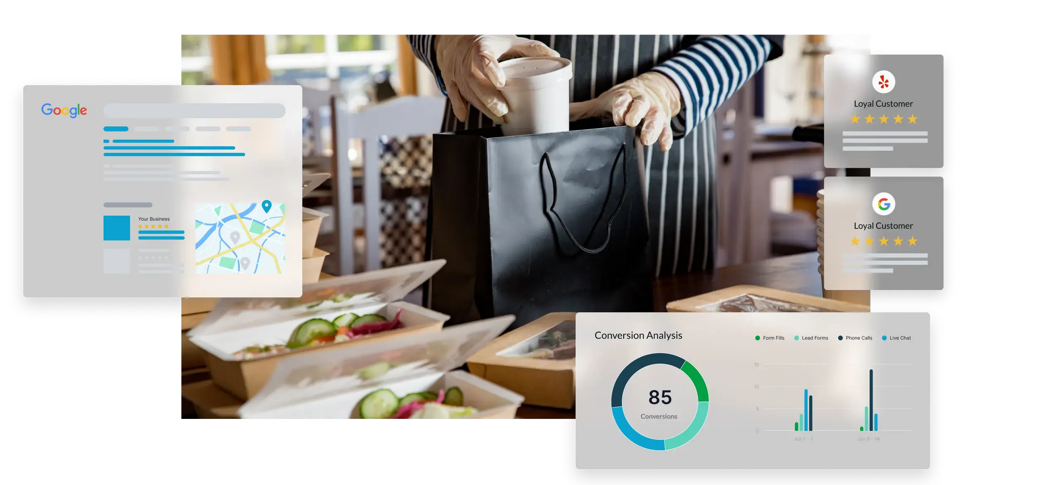
Quora Web Solution
Website Design and
Development
Company
Web Design & Web Development
Company in Bangalore, India
www.quorawebsolution.com
+91 9986 056 909
info@quorawebsolutions.com
24A, 1st Main Rd, Chandra Reddy
Layout, Koramangala 4th Block,
Koramangala, Bengaluru,
Karnataka 560034

Slide 2
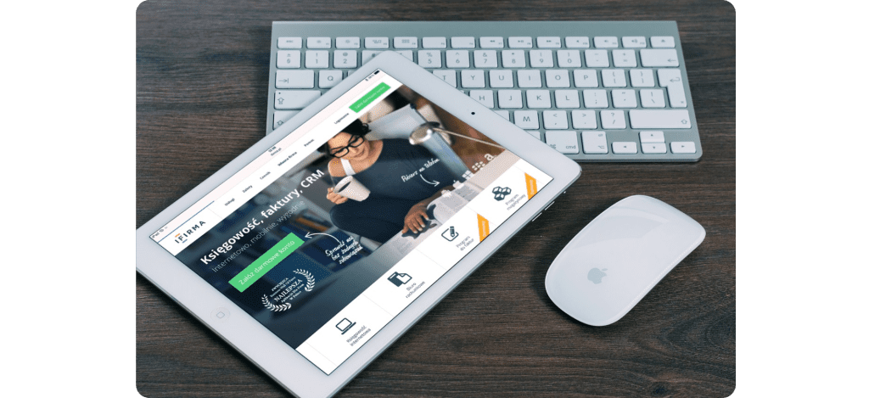
Bringing Your Brand to Life Online: How Great Web Design Tells Your Story Visually and Strategically
In the modern digital landscape, your website serves as the primary gateway through which customers experience and judge your brand. It's not just about having a sleek design or flashy animations—it's about creating a strategic, visually compelling experience that reflects your brand’s personality, values, and mission.
www.quorawebsolution.com

Slide 3
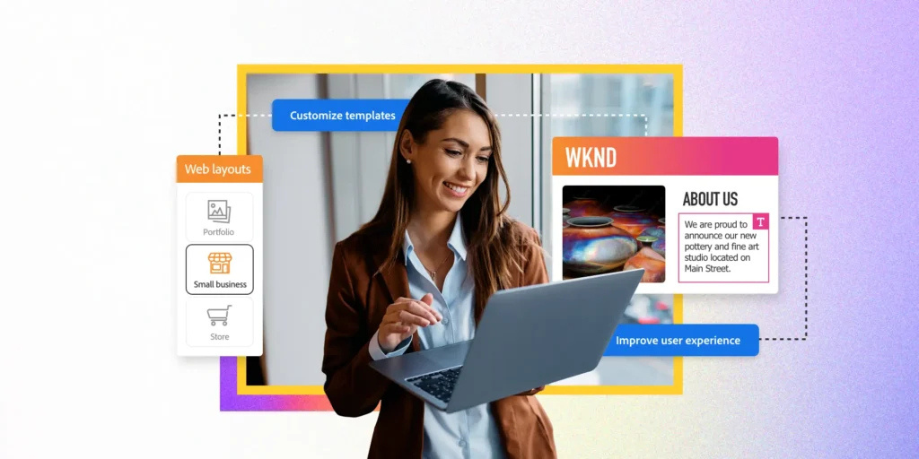
A great website does more than look good. It tells your story.
1. Understanding Your Brand Identity
Before a single pixel is placed, great web design starts with understanding your brand:
What do you stand for?
www.quorawebsolution.com

Slide 4
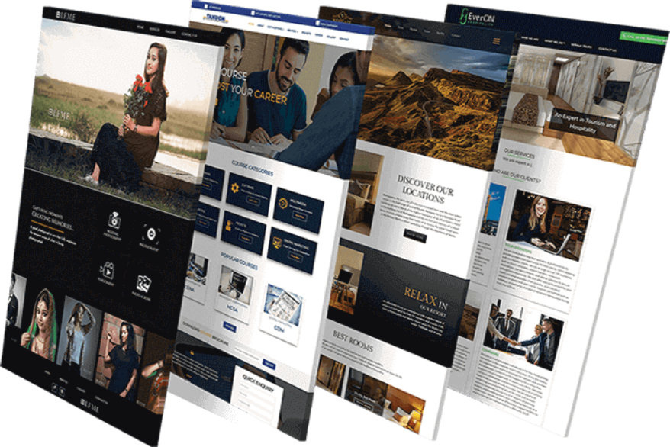
Who are your ideal customers?
What emotions do you want to evoke?
What’s your voice—professional, playful, bold, elegant?
www.quorawebsolution.com

Slide 5
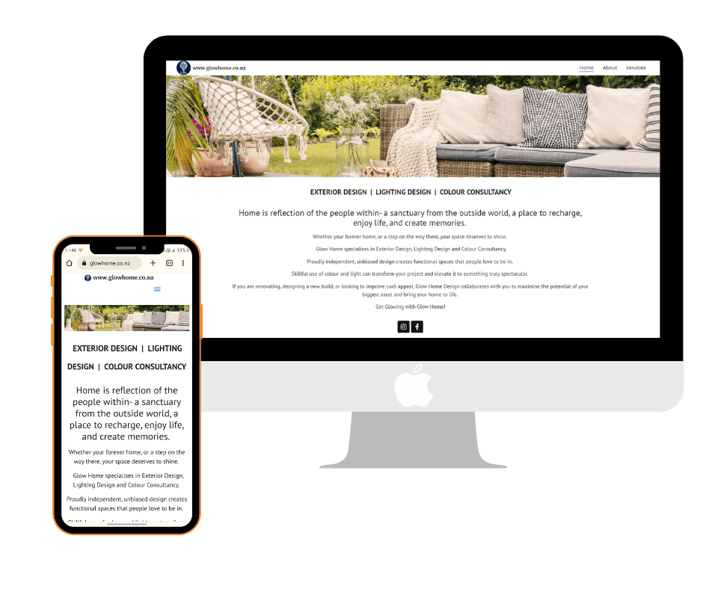
Your website is your digital storefront, and every design element—from typography to color palette—should be a reflection of your brand’s soul.
2. Visual Storytelling: Design That Speaks Without Words
The best websites use visuals to guide the user journey and communicate what the brand is all about.
www.quorawebsolution.com

Slide 6
Here's how visual storytelling plays a role:
Hero Images or Videos: The first image or video your visitors see sets the tone instantly.
Icons & Illustrations: These translate complex concepts into easily digestible visuals that strengthen your brand’s message.
Color Psychology: The right color palette can influence emotions and behavior.
Typography: Fonts should feel like your brand. Bold and modern? Classic and refined?
Every design decision supports your story—even subconsciously.
3. Strategic Structure: Design That Drives Action
A beautiful design is only half the equation. Thoughtfully planned layout and user experience (UX) are key drivers of meaningful user engagement:
www.quorawebsolution.com

Slide 7
Clear Navigation: Ensure users can effortlessly locate the information or services they're seeking.
Call-to-Actions (CTAs): Guide users toward actions—buy, contact, subscribe—with buttons that are impossible to ignore.
Content Hierarchy: Important messages should stand out immediately.
Mobile Responsiveness: Your story should shine on every screen, big or small.
A strategic structure aligns with user behavior, guiding them along a journey that ends in connection or conversion.
4. Authentic Content That Resonates
Your written content plays a vital role in your overall design:
Tone and Language: Speak the way your audience listens.
www.quorawebsolution.com

Slide 8
About Page: Tell your brand story—how you started, what you believe in, what you offer.
Testimonials and Case Studies: Let your success stories do the talking.
Blog or Resources: Show thought leadership and build trust over time.
Every word on your site should feel like it belongs to your brand and your brand alone.
5. Consistency Across All Touchpoints
Your website shouldn’t be an island—it should feel like an extension of your brand across all platforms:
Social media
Email campaigns
Print materials
Packaging
www.quorawebsolution.com

Slide 9
Consistency builds trust, recognition, and loyalty.
6. Real-World Examples: Brands Who Got It Right
Apple – Clean, minimalist design reflecting innovation and premium quality.
Airbnb – Warm visuals and storytelling make users feel emotionally connected.
Glossier – Youthful, modern, and fresh—perfect for their target audience.
These brands recognize that web design isn’t merely functional—it’s a powerful medium for storytelling.
7. Working With the Right Web Design Partner
To bring your story to life online, you need a web design company that:
Takes time to understand your brand deeply.
Offers both creative design and strategic UX planning.
www.quorawebsolution.com

Slide 10
Builds for performance—fast, secure, and SEO-friendly.
Believes in collaboration.
When the right team understands your story, they can turn it into a digital experience that converts visitors into believers.
Final Thoughts
Your brand is unique. Your website should be too.
A great website doesn’t just inform—it connects, inspires, and converts. With strategic, visual storytelling, you can bring your brand to life online in a way that feels personal, powerful, and unforgettable.
How a Well-Designed Website Can Transform Your Business Growth Strategy in the Digital Era
www.quorawebsolution.com

Slide 11
In an age where digital presence is non-negotiable, your website isn’t just a nice-to-have—it’s a core component of your business growth strategy. Whether you’re a startup, a scaling company, or a well-established brand, a well-designed website can be the catalyst that accelerates growth, builds trust, and expands your reach like never before.
Here’s how your website can become the growth engine your business needs in today’s hyper-connected world.
1. First Impressions Drive Business Decisions
You only get one shot at a first impression—and online, that happens in less than 3 seconds. A professionally designed website helps:
Establish immediate credibility and trust
Showcase your brand identity and values clearly
Engage visitors long enough to explore your offering
www.quorawebsolution.com

Slide 12
When a potential client or customer lands on your site, they’re asking themselves, “Can I trust this business?” A sleek, modern, and user-friendly design says “yes” without a word.
2. User Experience (UX) Fuels Engagement and Retention
A well-structured site isn’t just beautiful—it’s intuitive. When users can find what they’re looking for quickly and navigate effortlessly, they’re more likely to:
Stay longer on your site
Explore more pages
Convert into customers or leads
Responsive design, fast load times, mobile optimization, and accessibility are all parts of creating a website that keeps visitors interested and coming back.
3. Your Always-On Digital Salesperson
www.quorawebsolution.com

Slide 13
Think of your website as your hardest-working employee—one that never sleeps, never calls in sick, and is always available to your customers. It can:
Capture leads through forms or chatbots
Sell products via eCommerce
Book appointments or consultations
Educate visitors through blogs, FAQs, or videos
This kind of automation and scalability frees up your team and helps your business grow without growing your overhead.
4. Boosts Visibility Through Search Engine Optimization (SEO)
A well-designed site is not just about looks—it’s built with search in mind. Great web design supports SEO by:
www.quorawebsolution.com

Slide 14
Using clean, semantic HTML
Optimizing images and load speeds
Organizing content for easy crawling
Making your site mobile-friendly (a major influence on how Google ranks pages)
The result? More organic traffic, more qualified visitors, and more chances to convert.
5. Strengthens Your Brand and Market Positioning
In competitive markets, differentiation is everything. A thoughtfully designed website:
Expresses your unique voice and vision
Reinforces your brand values through visuals and messaging
Creates a memorable experience that builds loyalty
www.quorawebsolution.com

Slide 15
From fonts and colors to tone of voice and layout, design becomes a tool to position your brand exactly where it needs to be in your customer’s mind.
6. Enables Data-Driven Growth
The beauty of a digital platform is the insight it provides. Your website allows you to:
Track user behavior with tools like Google Analytics or Hotjar
A/B test calls-to-action and landing pages
Measure conversion rates, bounce rates, and funnel drop-offs
This data empowers you to optimize performance continually and fine-tune your growth strategy in real time.
7. Builds Trust and Social Proof
www.quorawebsolution.com

Slide 16
Trust is at the heart of every successful business, and your website plays a vital role in establishing and reinforcing that trust. By incorporating the right features, your website can:
Display testimonials and client logos
Share case studies or success stories
Highlight certifications or partnerships
Embed reviews from trusted platforms
These features don’t just decorate your site—they convert uncertainty into confidence.
8. Adapts with Your Business Growth
A scalable website evolves with your company. As your services, team, or audience expand, your site can:
Add new product pages
www.quorawebsolution.com

Slide 17
Support more traffic
Integrate with marketing platforms or CRMs
Expand multilingual support for global reach
With a solid foundation in place, your website evolves alongside your business—supporting growth rather than holding it back.
Final Thoughts: Your Website is Your Growth Partner
In today’s digital era, a well-designed website isn’t just a digital brochure—it’s your most valuable business asset. It’s where first impressions are made, conversions are nurtured, and your brand comes to life.
www.quorawebsolution.com

Slide 18
Whether you're trying to generate leads, drive sales, attract investors, or build a community, your website should be built to serve your goals—and scale your impact.
Invest in smart, strategic design now—and you’ll reap the benefits for years to come.
www.quorawebsolution.com

Slide 19
Quora Web Solution: Quora Web Solution is a trusted website development company based in Bangalore, India, offering a wide array of services to not only domestic but global clientele. Be it Website Design and Development, SEO services, Digital Marketing, Branding, App Development, Ecommerce Solution, and Logo Creation . Quora Web Solution has the best website developers offering top quality services and that is the reason why we are well known as one of the best Website Development Companies in Bangalore, India.
Visit Us - www.quorawebsolution.com
Call Us - +91 9986 056 909
Mail Us - info@quorawebsolutions.com
www.quorawebsolution.com

Slide 20

WORDPRESS DEVELOPMENT
ECOMMERCE DEVELOPMENT
PHP DEVELOPMENT
CMS DEVELOPMENT
DRUPAL DEVELOPMENT
WEBSITE SERVICES
WEBPORTAL DEVELOPMENT
MAGENTO DEVELOPMENT
WEBSITE DEVELOPMENT
JOOMLA DEVELOPMENT
SMALL BUSINESS DEVELOPMENT
CHEAP WEBSITE DEVELOPMENT
STATIC WEBSITE DEVELOPMENT
DYNAMIC WEBSITE DEVELOPMENT
WEBSITE DESIGN COMPANY
TOUR AND TRAVEL WEBSITE DEVELOPMENT
Services

