Slide 1


Quora Web Solution
Website Design and
Development
Company
Web Design & Web Development
Company in Bangalore, India
www.quorawebsolution.com
+91 9986 056 909
info@quorawebsolutions.com
24A, 1st Main Rd, Chandra Reddy
Layout, Koramangala 4th Block,
Koramangala, Bengaluru,
Karnataka 560034

Slide 2

Why Your Business Needs a Custom Website: The Benefits of Professional Web Design and Development
Introduction
In today's digital world, a strong online presence is essential for any business looking to grow and succeed.
www.quorawebsolution.com

Slide 3
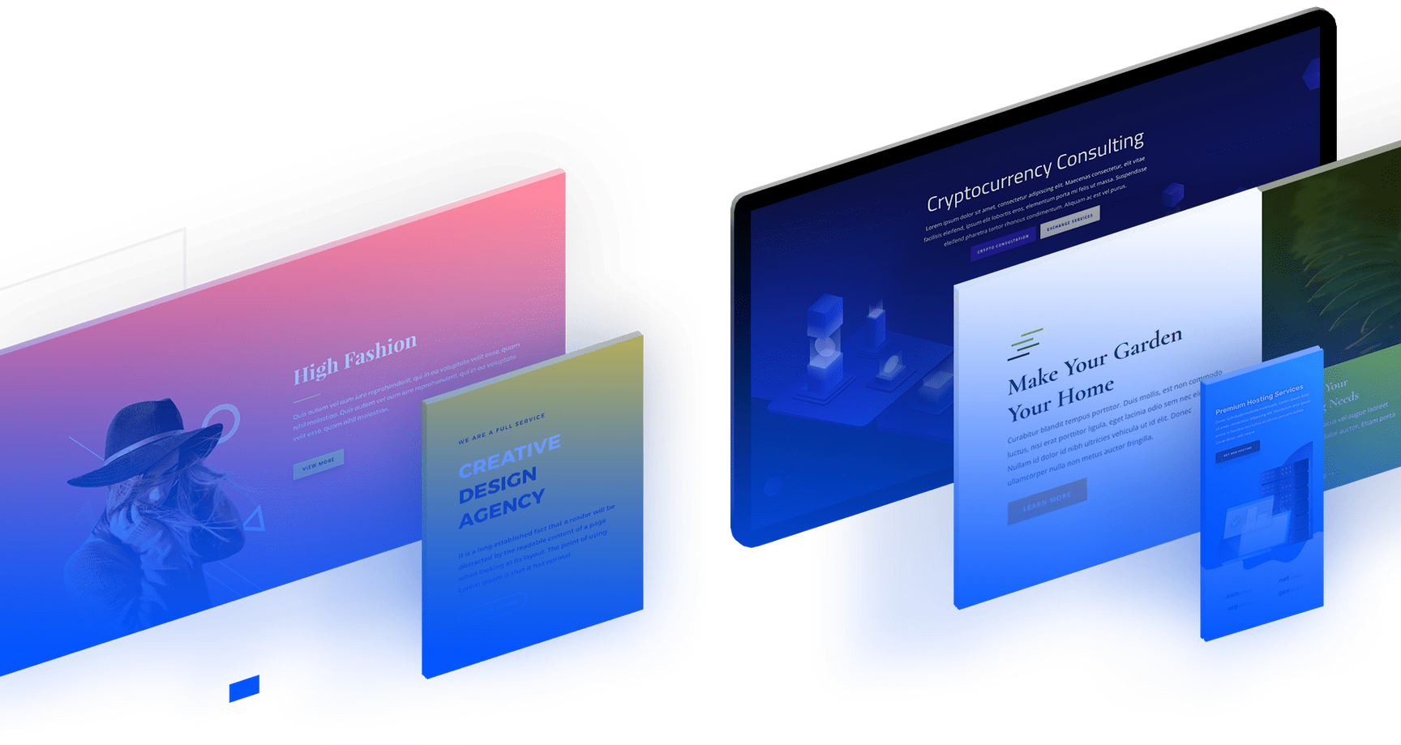
While many companies rely on generic website templates or DIY website builders, a custom website designed and developed by professionals can provide a significant competitive advantage.
A well-crafted website is more than just an online brochure—it’s a powerful tool for branding, customer engagement, lead generation, and sales conversion.
www.quorawebsolution.com

Slide 4
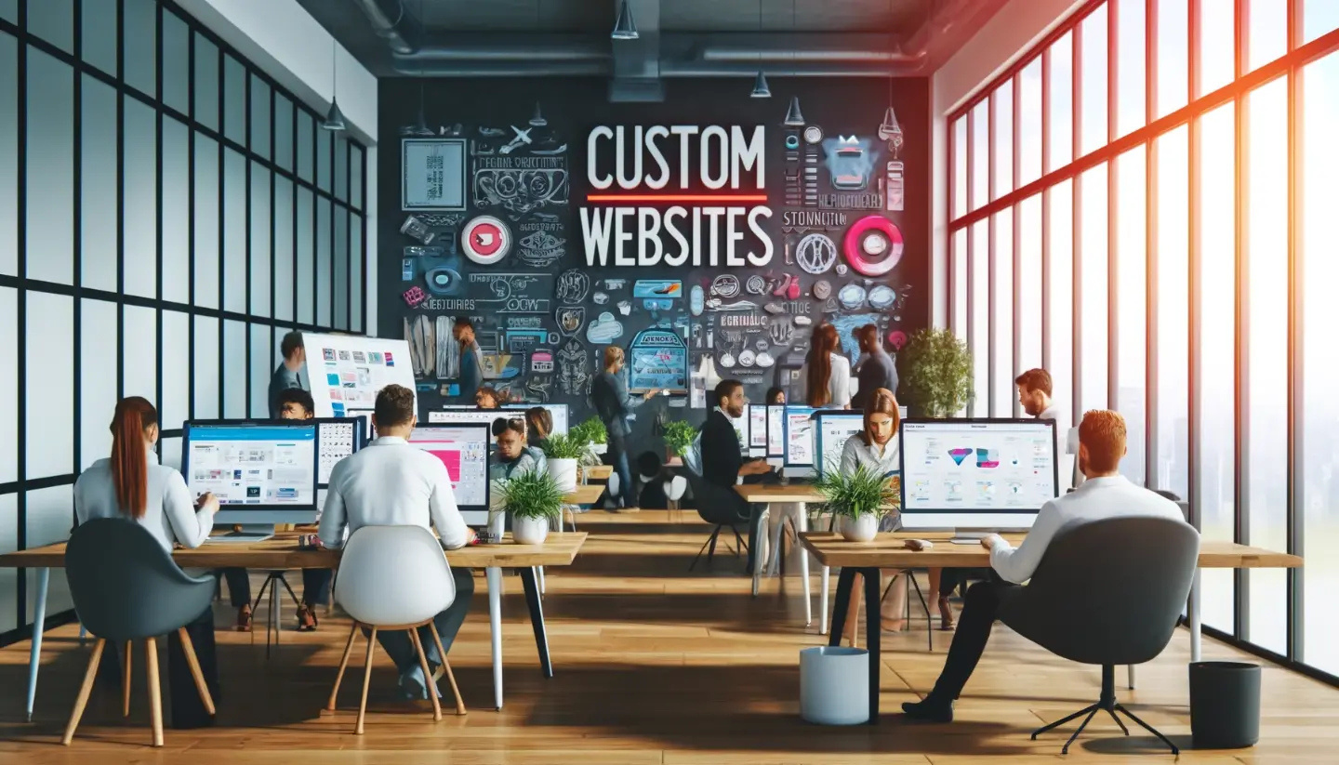
This article explores the key reasons why investing in a custom website is one of the best decisions you can make for your business.
1. Unique Brand Identity & Professional Design
Your website serves as a digital reflection of your brand's identity.
www.quorawebsolution.com

Slide 5
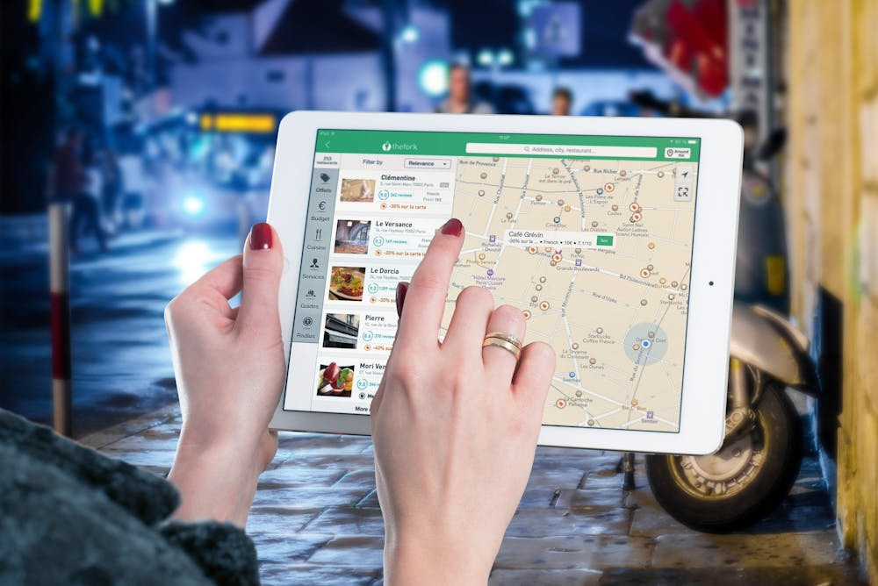
A custom website allows you to create a unique brand identity that sets you apart from competitors. Unlike pre-made templates that thousands of other businesses might use, a custom web design ensures that every aspect of your website aligns with your brand’s colors, fonts, imagery, and overall message.
www.quorawebsolution.com

Slide 6
With professional web design, you get:
✅ A visually appealing, user-friendly interface
✅ Brand consistency across all digital platforms
✅ A website tailored to your target audience’s preferences
2. Better User Experience (UX) & Higher Engagement
User experience (UX) plays a vital role in shaping the effectiveness of web design. A well-structured website enhances navigation, ensuring that visitors can easily find the information they need.
A custom-built website ensures:
✔ Fast loading speeds for optimal performance
✔ Mobile-friendly and responsive design for all devices
www.quorawebsolution.com

Slide 7
✔ Intuitive navigation to keep users engaged
✔ Enhanced accessibility for all users
By improving UX, you can reduce bounce rates, increase engagement, and encourage more conversions.
3. Improved SEO for Higher Search Rankings
A custom website is built with search engine optimization (SEO) in mind. Unlike generic templates that may lack proper optimization, a professionally developed site ensures:
🔹 SEO-friendly coding and structure
🔹 Optimized page speed for better rankings
🔹 Proper use of meta tags, headers, and keyword placement
www.quorawebsolution.com

Slide 8
🔹 Mobile responsiveness, a key factor in Google’s ranking algorithm
A well-optimized website helps your business rank higher on Google, driving more organic traffic and increasing visibility.
4. Scalability & Future Growth
As your business grows, your website should progress and adapt accordingly. A custom website offers scalability, meaning it can be easily expanded with new features, pages, and integrations as needed.
Some benefits of scalability include:
✅ Adding new services or products without redesigning the entire website
✅ Seamless integration with third-party tools (CRM, analytics, payment gateways)
www.quorawebsolution.com

Slide 9
✅ The ability to implement future technologies like AI chatbots or automation
Unlike template-based sites that may have limitations, a custom site grows with your business.
5. Enhanced Security & Data Protection
Businesses of all sizes face an increasing risk from cybersecurity threats. Custom website development provides advanced security features to protect sensitive customer data.
🔒 Custom-built security measures reduce vulnerabilities
🔒 SSL encryption ensures safe browsing
🔒 Regular updates and maintenance prevent cyber attacks
🔒 Custom backend development minimizes risks compared to open-source platforms
By investing in a secure website, you build trust with customers and reduce the risk of data breaches.
www.quorawebsolution.com

Slide 10
6. Higher Conversion Rates & Better ROI
A custom website is designed to maximize conversions by guiding visitors through a seamless user journey.
🎯 Strategic call-to-action (CTA) placements
🎯 Optimized landing pages for lead generation
🎯 Personalized user experiences based on behavior tracking
Higher engagement and conversion rates lead to better ROI, making a custom website a smart long-term investment.
7. Competitive Advantage Over Rivals
A generic website won’t help you stand out in a crowded market. A custom website, on the other hand, gives you a competitive edge by offering:
✅ Unique branding that reflects your company’s identity
www.quorawebsolution.com

Slide 11
✅ Advanced features tailored to your audience
✅ Superior performance compared to competitors using basic templates
Investing in professional web design and development ensures that you don’t just keep up with competitors—you stay ahead of them.
Conclusion
Your website is one of the most powerful marketing tools your business has. A custom-designed website not only enhances your brand image but also improves user experience, SEO rankings, security, and conversion rates.
While a DIY website or template might seem like a cost-effective solution, the long-term benefits of professional web design and development far outweigh the initial investment.
www.quorawebsolution.com

Slide 12
If you want to create a strong online presence and ensure future business growth, a custom website is the way to go.
🚀 Ready to take your business to the next level with a custom website? Contact a professional website design and development company today!
Top Website Design Trends for 2025: What Businesses Need to Know to Stay Ahead
www.quorawebsolution.com

Slide 13
Introduction
The digital landscape is constantly evolving, and staying up to date with the latest website design trends is crucial for businesses looking to remain competitive. As we move into 2025, user expectations are higher than ever, and modern web design is about more than just aesthetics—it’s about performance, user experience, and functionality.
In this article, we’ll explore the top website design trends for 2025 and how businesses can leverage them to enhance user engagement, improve SEO, and drive conversions.
1. AI-Powered Personalization
Artificial Intelligence (AI) is transforming website experiences by offering personalized content and recommendations based on user behavior. In 2025, businesses will increasingly use AI to:
www.quorawebsolution.com

Slide 14
✅ Provide dynamic content tailored to individual visitors
✅ Optimize user journeys through behavior tracking
✅ Improve chatbot interactions for better customer support
Personalization leads to higher engagement and conversion rates, making it an essential feature for modern websites.
2. Minimalist & Clean Design
Simplicity remains a key principle in web design. In 2025, we’ll see more businesses embracing minimalist layouts that focus on:
✔ White space for better readability
✔ Bold typography for impact
www.quorawebsolution.com

Slide 15
✔ Simple, intuitive navigation
A clean design ensures that users can easily find information without distractions, improving the overall user experience (UX).
3. Dark Mode & Adaptive Themes
Dark mode has been a growing trend, and in 2025, adaptive themes will take it to the next level. Businesses will allow users to switch between light and dark modes based on personal preference or time of day.
🔹 Benefits of dark mode:
Reduces eye strain
Enhances visual appeal
Extends battery life on OLED displays
www.quorawebsolution.com

Slide 16
By integrating this feature, businesses can provide a more customizable and user-friendly experience.
4. Motion UI & Micro-Interactions
Subtle animations and micro-interactions will be a game-changer in keeping users engaged. Expect to see:
🎯 Animated button hovers
🎯 Smooth scrolling effects
🎯 Interactive page transitions
These elements enhance user experience by making websites feel more dynamic and engaging, leading to longer session durations.
5. Voice Search Optimization
www.quorawebsolution.com

Slide 17
With the rise of voice assistants like Siri and Alexa, optimizing websites for voice search is crucial in 2025. Businesses should:
🔹 Use natural language keywords
🔹 Implement FAQ sections for voice queries
🔹 Ensure fast-loading mobile pages
Voice search optimization can improve SEO and make it easier for users to find your business online.
6. Augmented Reality (AR) Integration
AR is making waves in e-commerce, real estate, and interactive websites. Businesses can use AR for:
www.quorawebsolution.com

Slide 18
✅ Virtual product try-ons (fashion & beauty)
✅ 3D product previews (furniture, automotive)
✅ Interactive storytelling experiences
AR creates immersive experiences that boost engagement and increase online sales.
7. Mobile-First & Responsive Design
With mobile traffic surpassing desktop usage, a mobile-first design is no longer optional. In 2025, websites must be:
✔ Fully responsive across all devices
✔ Optimized for fast mobile load times
✔ Touchscreen-friendly with easy navigation
Google prioritizes mobile-friendly websites in rankings, making this a must-have trend for SEO success.
www.quorawebsolution.com

Slide 19
8. Advanced Cybersecurity Features
With increasing cyber threats, businesses must prioritize website security in 2025 by:
🔒 Implementing multi-factor authentication (MFA)
🔒 Using SSL encryption for secure transactions
🔒 Regularly updating security patches
A secure website builds customer trust and protects business data.
9. Interactive & Data-Driven Content
Engagement is key in 2025, and businesses will use interactive elements like:
📊 Live polls and quizzes
📊 Interactive infographics
📊 AI-generated dynamic content
www.quorawebsolution.com

Slide 20
This trend boosts user engagement, increases time spent on site, and enhances brand interaction.
10. Sustainable & Eco-Friendly Web Design
As businesses focus on sustainability, websites will adopt eco-friendly practices, such as:
🌱 Energy-efficient hosting solutions
🌱 Lightweight coding for lower energy consumption
🌱 Minimalistic design to reduce data load
Sustainable web design aligns with corporate social responsibility (CSR) initiatives and attracts eco-conscious consumers.
www.quorawebsolution.com

Slide 21
Conclusion
The future of website design in 2025 is all about enhancing user experience, optimizing for AI and voice search, improving security, and focusing on sustainability. By adopting these trends, businesses can stay ahead of the competition, boost engagement, and increase conversions.
🚀 Want to upgrade your website with the latest trends? Contact a professional website design and development company today!
www.quorawebsolution.com

Slide 22
Quora Web Solution: Quora Web Solution is a trusted website development company based in Bangalore, India, offering a wide array of services to not only domestic but global clientele. Be it Website Design and Development, SEO services, Digital Marketing, Branding, App Development, Ecommerce Solution, and Logo Creation . Quora Web Solution has the best website developers offering top quality services and that is the reason why we are well known as one of the best Website Development Companies in Bangalore, India.
Visit Us - www.quorawebsolution.com
Call Us - +91 9986 056 909
Mail Us - info@quorawebsolutions.com
www.quorawebsolution.com

Slide 23

WORDPRESS DEVELOPMENT
ECOMMERCE DEVELOPMENT
PHP DEVELOPMENT
CMS DEVELOPMENT
DRUPAL DEVELOPMENT
WEBSITE SERVICES
WEBPORTAL DEVELOPMENT
MAGENTO DEVELOPMENT
WEBSITE DEVELOPMENT
JOOMLA DEVELOPMENT
SMALL BUSINESS DEVELOPMENT
CHEAP WEBSITE DEVELOPMENT
STATIC WEBSITE DEVELOPMENT
DYNAMIC WEBSITE DEVELOPMENT
WEBSITE DESIGN COMPANY
TOUR AND TRAVEL WEBSITE DEVELOPMENT
Services

