Slide 1



QUALITY SERVICE GROUP
ENSURING EXCELLENCE IN MANUFACTURING: HOW QUALITY SERVICE GROUP DELIVERS RELIABLE INSPECTION AND SORTING SOLUTIONS
In today’s fast-paced manufacturing environment, product quality is no longer optional—it is a critical business requirement.
Automotive manufacturers and suppliers must meet strict quality standards while maintaining efficiency, safety, and customer satisfaction. This is where Quality Service Group stands apart, offering specialized solutions that help manufacturers maintain consistency and compliance at every stage of production. With proven expertise in Automotive Parts Inspection Tennessee and Parts Quality Sorting Services, Quality Service Group supports automotive businesses in reducing risk, minimizing defects, and
protecting their brand reputation. _{Quality Service Group}

Slide 2

THE GROWING IMPORTANCE OF
QUALITY CONTROL IN THE
AUTOMOTIVE INDUSTRY
The automotive industry relies on precision. Even the smallest defect in a component can lead to costly recalls, safety concerns, and damaged customer trust. As supply chains grow more complex and production volumes increase, manufacturers must ensure every part meets exact specifications before it reaches assembly lines or end users.
Quality Service Group understands these challenges and provides hands-on quality assurance solutions designed specifically for automotive manufacturers and suppliers. Through structured inspection processes and experienced technicians, the company helps businesses identify issues early, preventing defective parts from moving further down the supply chain.
Quality Service Group

Slide 3


EXPERTISE THAT SETS
QUALITY SERVICE
GROUP APART
Quality Service Group brings deep industry knowledge and practical experience to every project. Their trained inspectors follow detailed quality protocols to evaluate automotive components for defects such as dimensional inaccuracies, surface imperfections, material flaws, and assembly errors. This approach is especially valuable for manufacturers seeking dependable Automotive Parts Inspection Tennessee services that align with industry standards and customer requirements.
By combining attention to detail with scalable workforce solutions, Quality Service Group can adapt to short-term surges, ongoing production needs, or emergency quality concerns. This flexibility allows manufacturers to maintain productivity without compromising on quality.
Quality Service Group

Slide 4
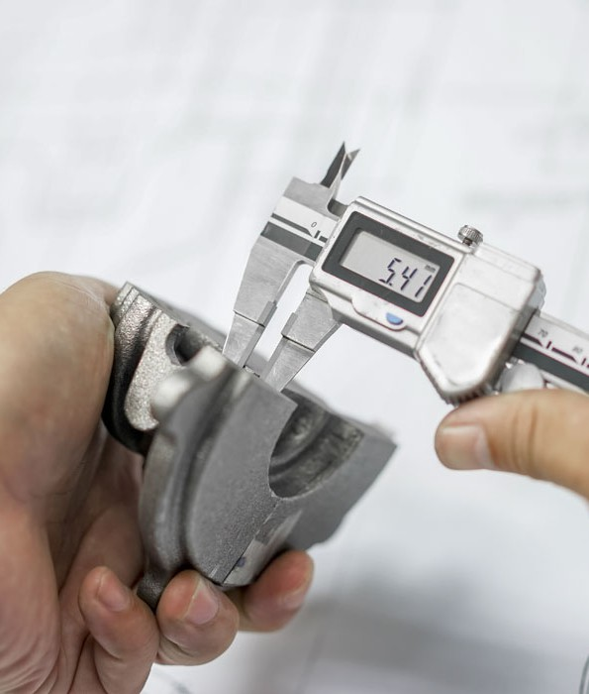
COMPREHENSIVE INSPECTION
SOLUTIONS TAILORED TO
YOUR NEEDS
Every manufacturing operation is unique, and Quality Service Group recognizes that one-size-fits-all solutions rarely work. Their inspection services are customized to match each client’s production process, quality benchmarks, and compliance requirements. Whether inspections are performed at a supplier facility, warehouse, or production floor, the goal remains the same: identify nonconforming parts before they become costly problems.
Quality Service Group

Slide 5

REDUCING RISK
THROUGH PROFESSIONAL
SORTING SERVICES
When defects are discovered, swift and accurate sorting becomes essential. Quality Service Group’s Parts Quality Sorting Services are designed to quickly separate acceptable components from nonconforming ones, minimizing downtime and preventing production delays. These services are especially valuable during supplier transitions, launch phases, or unexpected quality issues.
SUPPORTING COMPLIANCE AND CUSTOMER CONFIDENCE
Automotive manufacturers operate under strict regulatory and customer-driven quality standards. Failure to meet these requirements can result in penalties, lost contracts, and reputational damage. Quality Service Group supports compliance by providing detailed inspection documentation, traceability, and corrective action support.
Manufacturers relying on Automotive Parts Inspection Tennessee solutions from Quality Service Group benefit from consistent quality checks that align with OEM and Tier 1 expectations. This not only improves internal processes but also builds confidence with
customers who demand reliability and transparency.
Quality Service Group

Slide 6
CONCLUSION
Quality Service Group
In an industry where precision and reliability are essential, Quality Service Group delivers the expertise and flexibility manufacturers need to stay competitive. Through customized inspection solutions and efficient sorting services, they help automotive businesses maintain high standards while adapting to changing demands. By choosing Quality Service Group, manufacturers invest in quality assurance that protects their products, their customers, and their reputation—today and for the future.

Slide 7
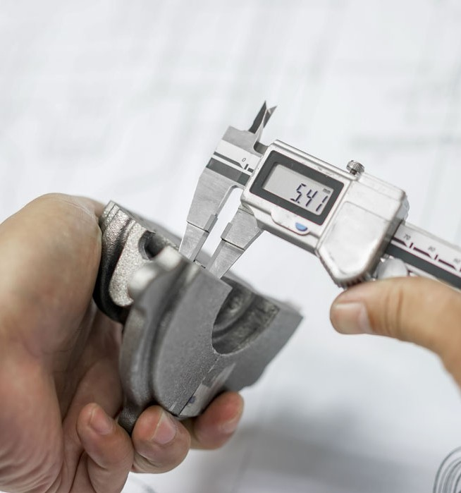
THANK YOU!
FOR YOUR ATTENTION
Contact Us -
Business Name - Quality Service Group Phone No: 931-646-7100
Email ID: info@qsg.com
Address: 325 Iris Drive, Sparta, TN, 38583
Quality Service Group

