Slide 1
Certified Collision Center
Experience expert repairs at a certified collision center where skilled technicians restore dents, scratches, and damage with precision, care, and quality.

Slide 2
Insurance Approved Auto Repairs
Need insurance approved auto repairs in Detroit? Trust CarDome for certified collision care, expert service, & reliable solutions to get you back on the road.

Slide 3
Quality Collision Repair
Need expert care for your car? Choose our skilled technicians for quality collision repair and fast, reliable service to restore your vehicle’s beauty & value.

Slide 4
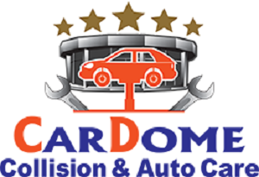
Contact Us
CarDome Collision & Auto Care provides expert mechanical, collision, and body repair services with a focus on high-quality, reliable solutions for your vehicle.
24600 Grand River Avenue, Detroit, MI, United States
https://www.cardomeautorepair.com/

