Slide 1
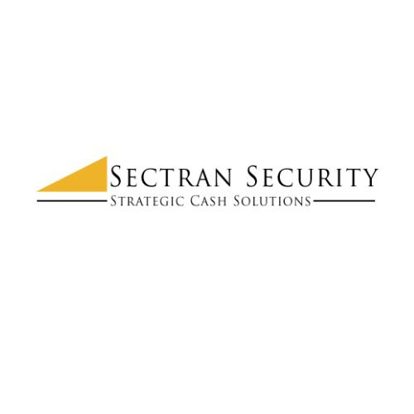

How Smart Safe Cash Management Supports Growing Businesses

Slide 2

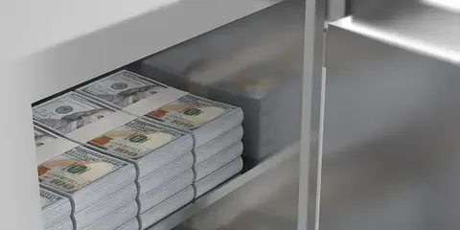
The stress of handling cash
Anyone who has managed a store, restaurant, or retail chain knows the stress. Counting bills late at night. Driving deposits to the bank. Worrying about staff errors or losses. All of these take time and energy that should be used to build the business instead of chasing cash.

Slide 3
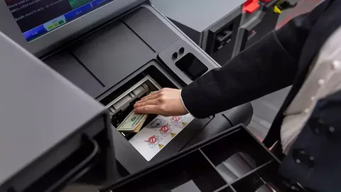
How smart safes change the game
A smart safe is more than a metal box. It accepts cash, counts it, and records each deposit. Funds are credited to the account almost right away, even before the bank physically receives the cash. That gives the business faster access to working capital. The safe also tracks who made each deposit. This creates clear accountability. Staff can focus on customer service instead of spending hours counting bills. Owners get real-time reports that show exactly how much money is on hand.

Slide 4
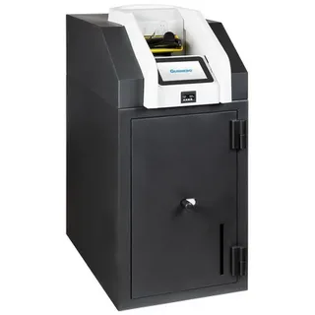
Why growing businesses need smart cash tools
Growth often means expanding to new locations. Each site creates another point of risk. Owners cannot be everywhere at once. Smart safes offer a way to maintain control without being on-site. Reports can be viewed from anywhere. That lets decision-makers see the full picture across all stores.

Slide 5
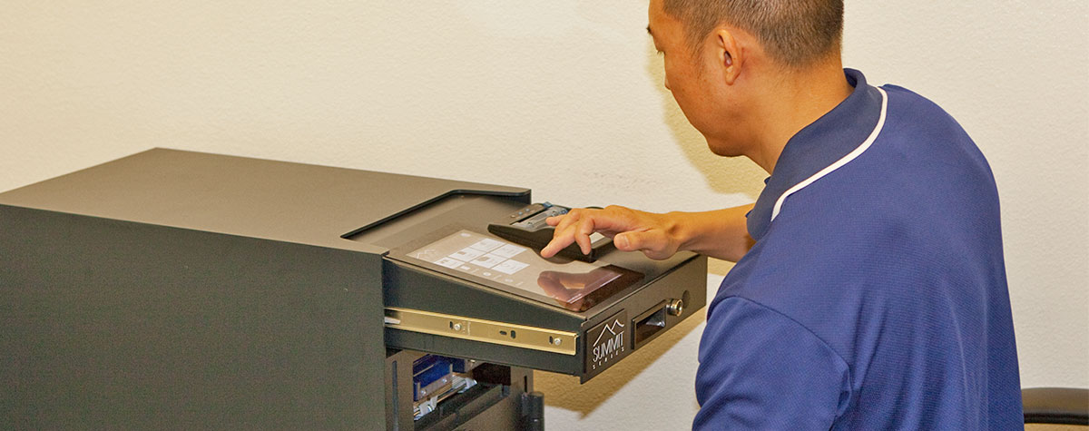
Linking smart safes with armored transport
Cash does not disappear after it enters a safe. It still has to reach the bank. That is where transport services come in. An armored car service in Southern California provides a secure way to move funds from store to bank. These vehicles are designed for safety. They reduce risk for staff and protect the value of the deposit.

Slide 6



CONTACT US
www.sectransecurity.com
P.O.Box 227267 Los Angeles, CA 90022
(562)-(948)-(1446)
info@sectransecurity.com

