Slide 1





OG Sunday Slice Club
Show your love for game with OG Sunday slice club cap, designed for golfers who enjoy every swing. Built for comfort & style, this cap brings fun & energy.

Slide 2
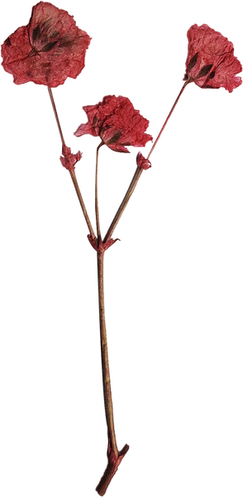



100% Cotton OG Cap
Enjoy breathable comfort with 100% cotton OG cap, made for daily sporting style. Soft, durable cotton ensures a relaxed fit from warm-ups to post-round hangs.

Slide 3
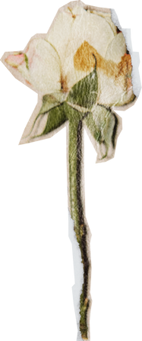

Velcro Closure OG Cap
Secure your fit with Velcro closure OG Cap, made for all-day comfort. Perfect for casual days or the course, offering a classic athletic look that stays put.

Slide 4

Contact Us
About: At TwentyFour Golf, we blend laid-back East Coast vibes with high-performance golf apparel. We embrace individuality, creativity, and fun, creating a community where golf is for everyone.
Country: Australia
Website: https://twentyfourgolf.com/

