Slide 1








AVOID THESE COMMON NJ STATE APOSTILLE ERRORS THAT COULD COST YOU TIME AND MONEY

Slide 2

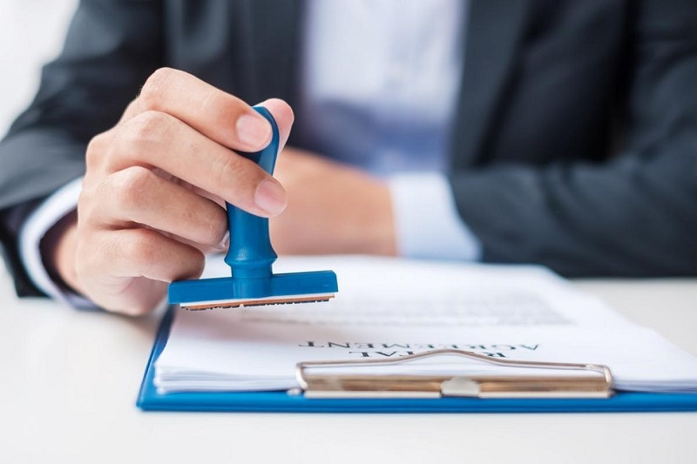

Submitting Ineligible or Improper Documents
A frequent mistake is sending in documents that are not eligible for apostille certification. For an apostille to be issued, the document must be an original or a certified copy issued by the appropriate authority. Submitting photocopies, expired forms, or improperly signed documents leads to immediate rejection. For example, a birth certificate must come from the correct issuing state office.

Slide 3
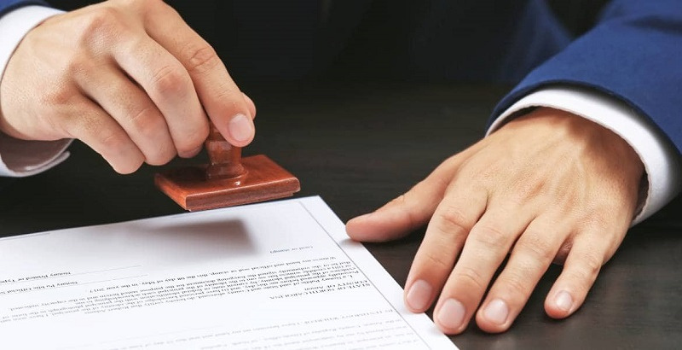
Incorrect or Incomplete Notarization
Certain documents must be notarized prior to being submitted for apostille. Many applicants either skip this step or rely on a notary unfamiliar with the state’s apostille requirements. In New Jersey, it is crucial to use a Notary Public State of New Jersey who understands the specific formatting, signature, and seal guidelines.

Slide 4
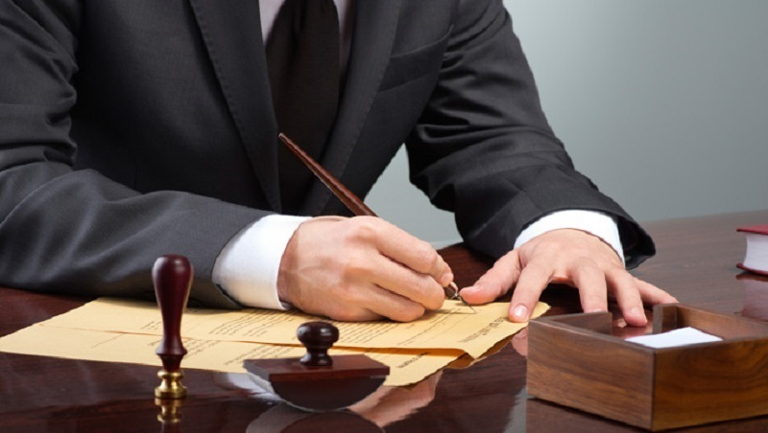
Sending to the Wrong Office or Department
Submitting your application to the incorrect office is another common but avoidable error. A designated department handles the NJ State Apostille process, and sending documents to other state offices can delay your application by weeks. Additionally, many assume all offices offer the same services, which is not the case.

Slide 5

Incorrect Payment or Fee Submission
Failure to follow payment instructions precisely is a key issue that leads to returned applications. Common mistakes include sending cash, writing incorrect amounts, or omitting payment entirely. Payments must follow the format outlined in the State of NJ Apostille instructions, typically in the form of a money order or check made out to the correct recipient.

Slide 6

The Final Note
An apostille application is a formal process that demands precision at every stage. Errors such as submitting the wrong documents, skipping proper notarization, or sending forms to the incorrect office can delay or derail your goals. Avoiding these mistakes ensures your State of NJ Apostille request is processed promptly and correctly.

Slide 7

THANK YOU
NEW JERSEY MOBILE NOTARY & APOSTILLE SERVICES
Address:
470 Schooleys Mountain Road Suite – 702, Hackettstown, NJ 07840, USA
Website:
https://njnotarygroup.com/
Email:
info@njnotarygroup.com

