Slide 1

Common Printer Problems, Maintenance & Repair Guide
Printers are essential for homes, offices and businesses. Common issues include paper jams, poor print quality, connectivity problems and error messages.
This guide covers common printer problems, basic troubleshooting and maintenance.
Printer Repair Dubai
+97145864033

Slide 2
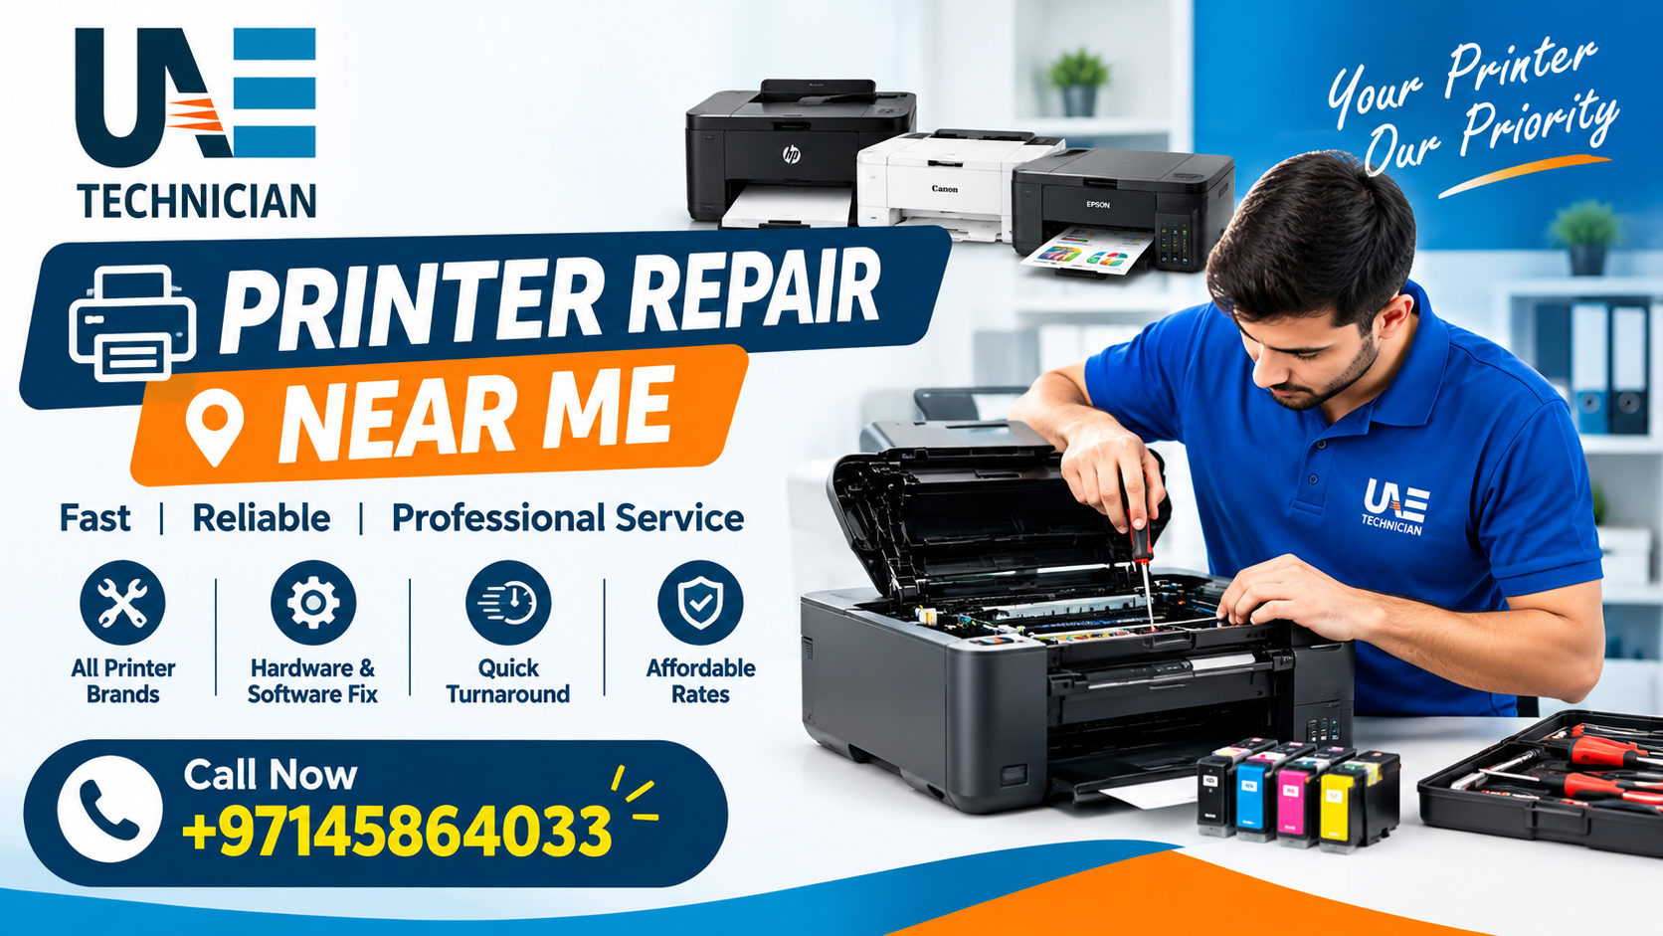
Most Common Issues
Paper jams
Blank pages
Faded or streaked prints
Printer showing offline
Slow printing
Wi-Fi or USB connection problems
Unusual noises
Ink or toner problems
Tip: Always identify the exact problem before replacing any printer part.

Slide 3
Common Printer Types
Inkjet Printers: Common issues include clogged printheads, dried ink and poor color quality.
Laser Printers: Typical problems include toner, drum, fuser and paper-feed issues.
Multifunction Printers: May require troubleshooting for printing, scanning, copying and network functions.
Dot-Matrix Printers: Common concerns include ribbon, printhead and paper-feed problems.

Slide 4
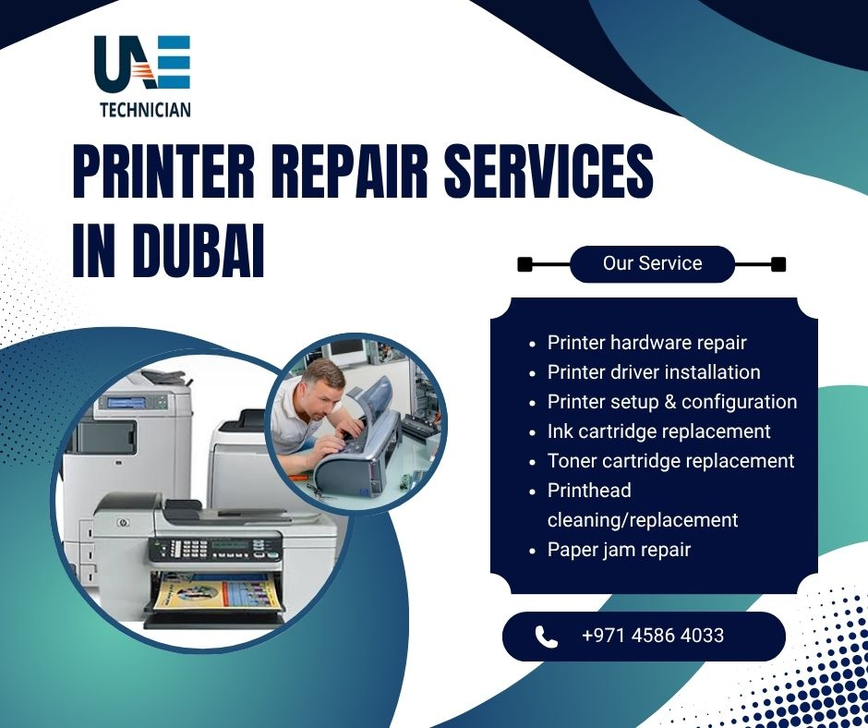
Paper Jams & Print Quality
Paper Jams
Check paper size and quality
Do not overload the tray
Check paper guides
Remove stuck paper carefully
Inspect rollers if jams repeat
Poor Print Quality
Check ink or toner
Clean the printhead if required
Check print settings
Inspect drum or imaging components
Try suitable printing paper

Slide 5
Printer Maintenance
Simple Maintenance Tips
Keep the printer clean
Store paper in a dry place
Check rollers and paper guides
Use genuine or compatible consumables
Keep drivers updated
Avoid unnecessary cleaning cycles
Print occasionally if the printer remains unused
Regular maintenance can help prevent avoidable printer problems.

Slide 6
When Repair Is Needed
Professional Repair May Be Needed For:
Repeated paper jams
Grinding or clicking sounds
Persistent error codes
Internal mechanical problems
Electrical issues
Continuous print-quality problems
Problems that remain after basic troubleshooting
Repair or Replace?
If repair costs become too high or the printer is very old, replacement may be more practical.

Slide 7
Choosing a Repair Service
What to Check
Proper diagnosis
Clear repair estimate
Experience with your printer model
Replacement-part transparency
Testing after repair
On-site or workshop support
For Dubai users, you can learn more about printer repair services here:
Anchor Text: Printer Repair Dubai
Contact: +97145864033

Slide 8
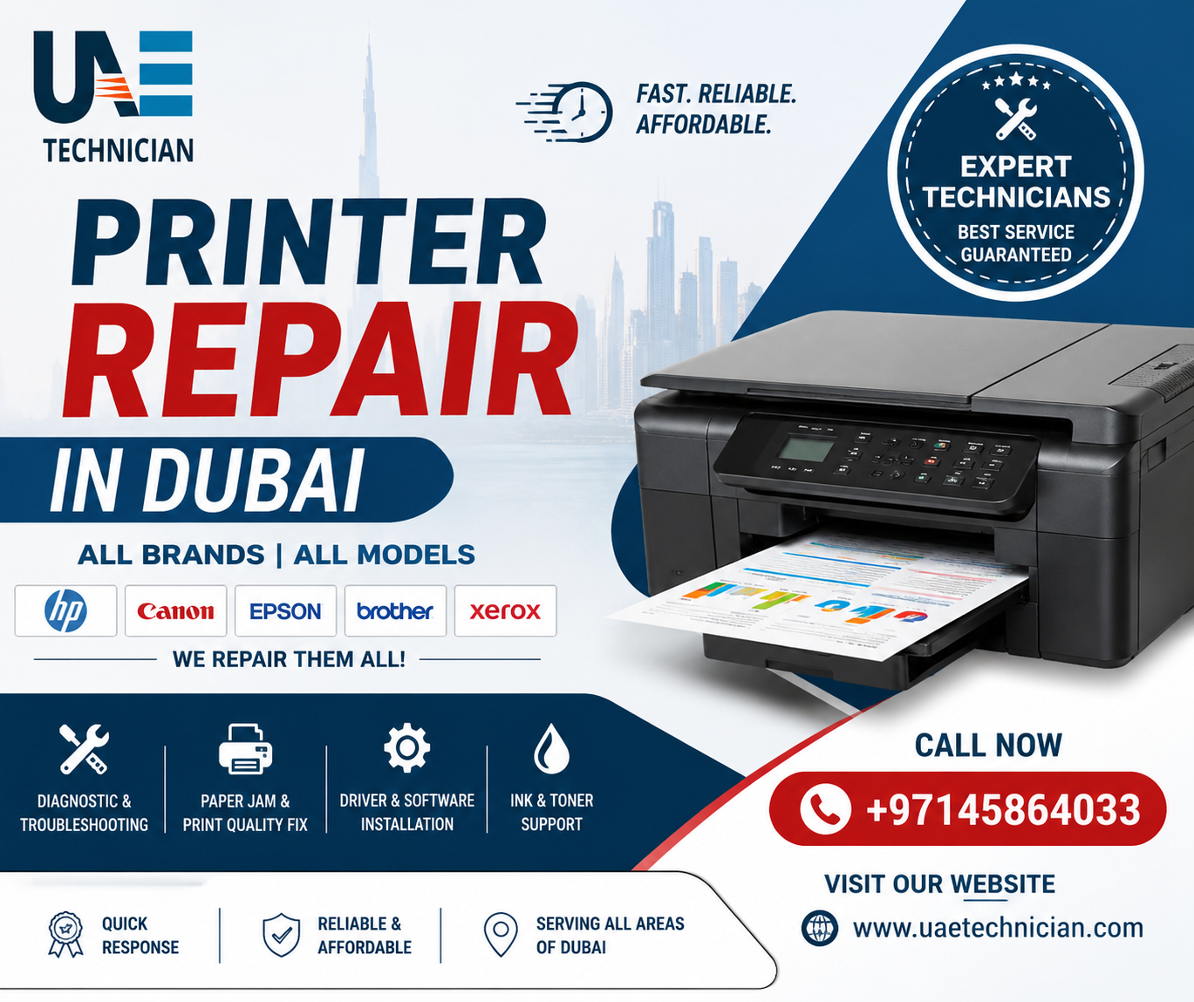
Final Takeaways
Printer Repair Quick Guide
Paper Jam: Check paper, guides and rollers.
Blank Page: Check ink/toner and print system.
Offline: Check Wi-Fi, USB, queue and drivers.
Faded Print: Check consumables and print settings.
Strange Noise: Stop using the printer and get it inspected.
Conclusion
Proper diagnosis, regular maintenance and timely repair can improve printer reliability and extend its useful life.
Printer Repair Dubai
+97145864033

