Slide 1


Slide 2

BEYOND GIFTS:
BUILDING
BUSINESS
RELATIONSHIPS
A thoughtful corporate gift is more than a gesture—it reflects appreciation, builds trust, strengthens partnerships, and leaves a lasting impression on clients, employees, and business associates.
Build meaningful connections, strengthen business partnerships, and create lasting impressions through thoughtful corporate gifting.
https://globalware.net/

Slide 3

https://globalware.net/

Slide 4
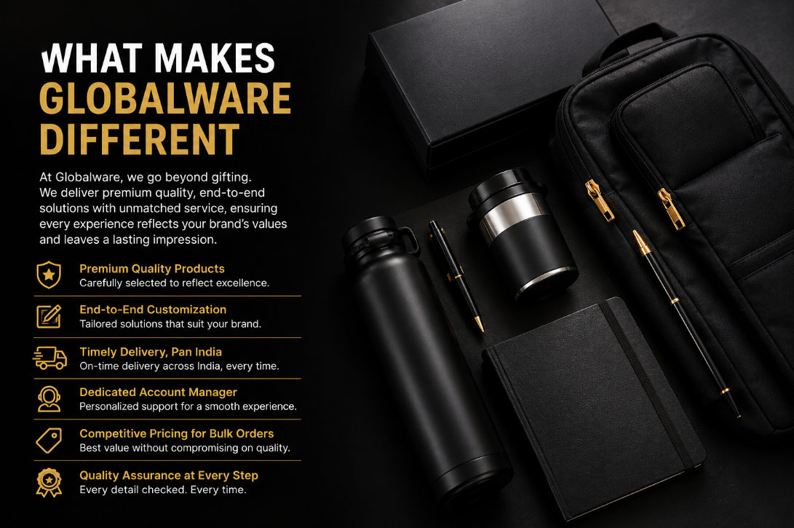
https://globalware.net/

Slide 5
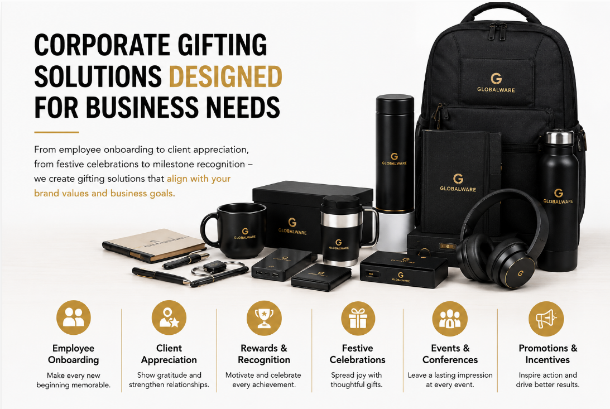

Slide 6

https://globalware.net/

Slide 7

https://globalware.net/

Slide 8
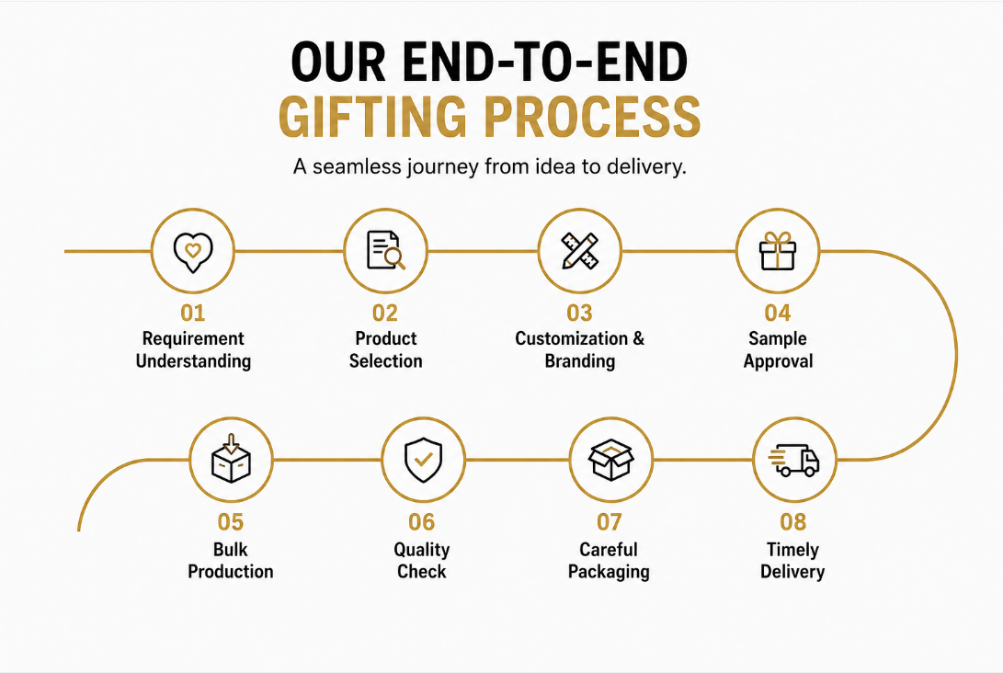
https://globalware.net/

Slide 9
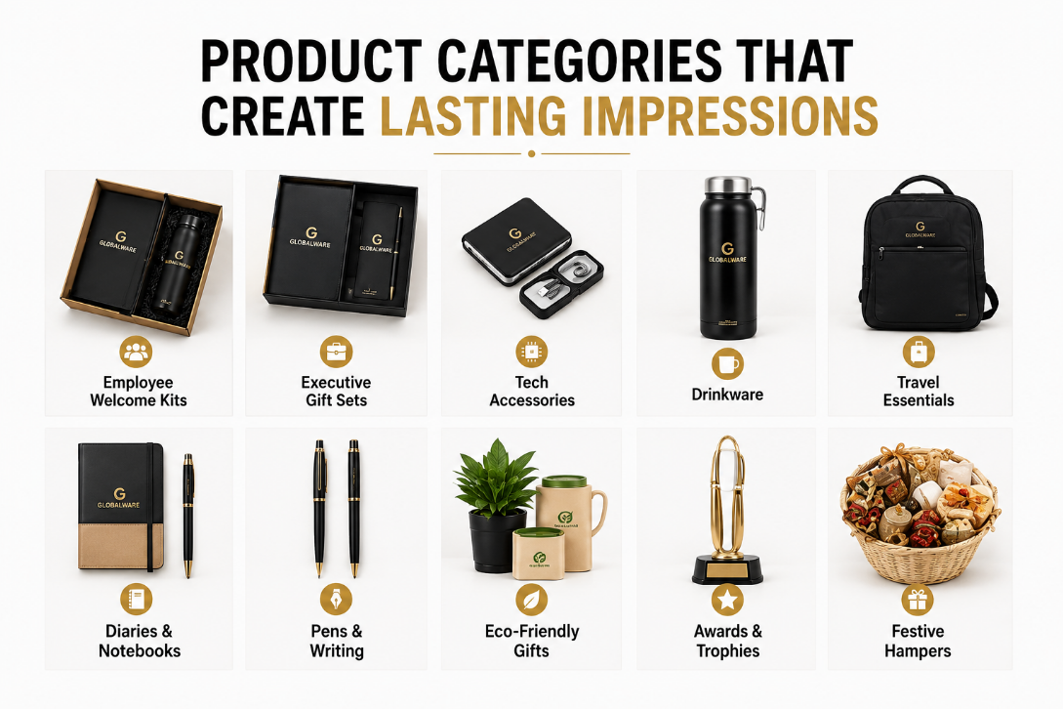
https://globalware.net/

Slide 10
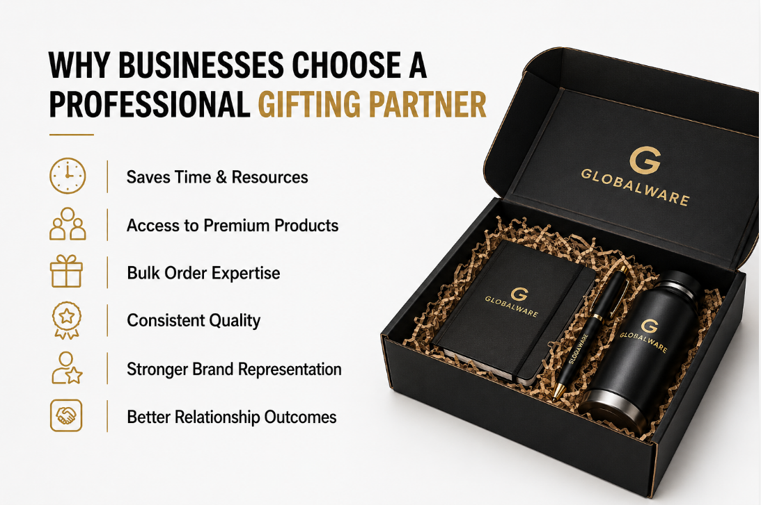
https://globalware.net/

Slide 11
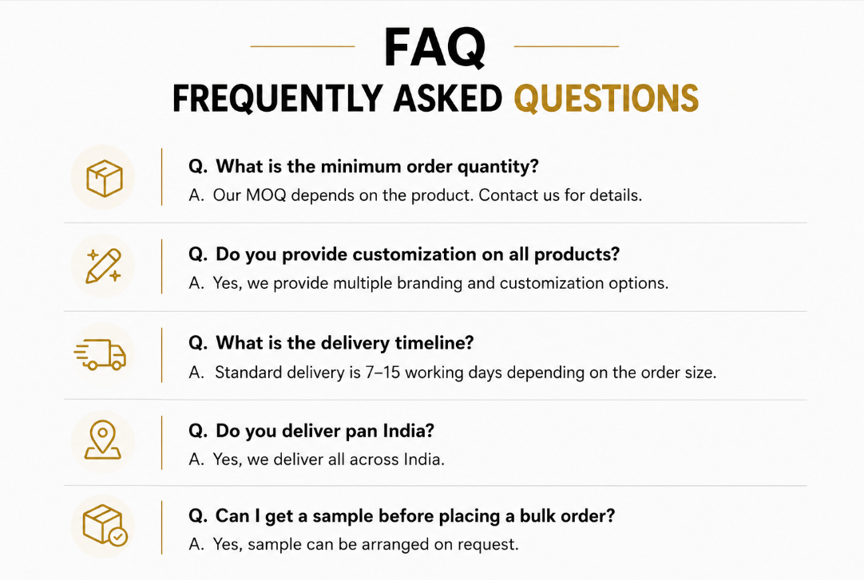

Slide 12

+91 9211791116
sales@globalware.net
https://globalware.net/

