Slide 1

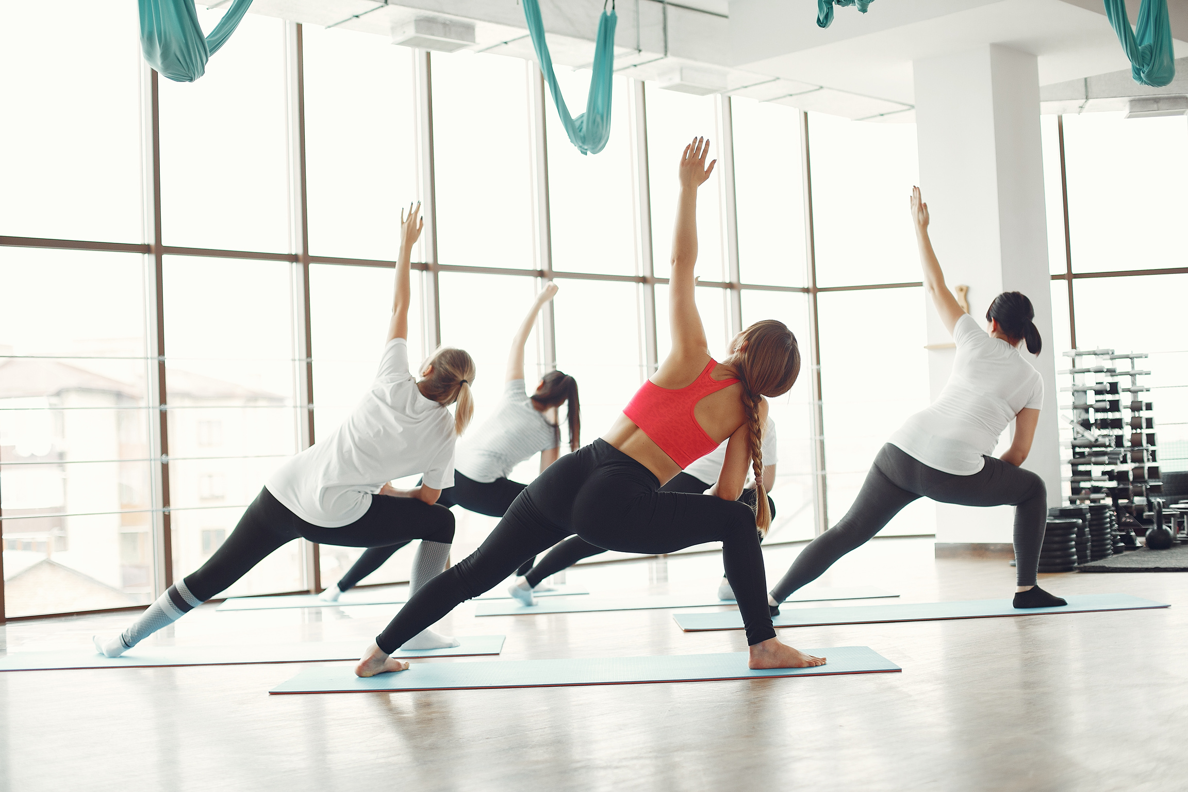
HOW POCKET CAPRI LEGGINGS CAN SIMPLIFY YOUR ACTIVE ROUTINE
In today’s fast-moving world, balancing health, mobility, and time is more important than ever. People are constantly looking for ways to make their lives easier, especially when it comes to their daily routines. This is where functional clothing comes into play.

Slide 2

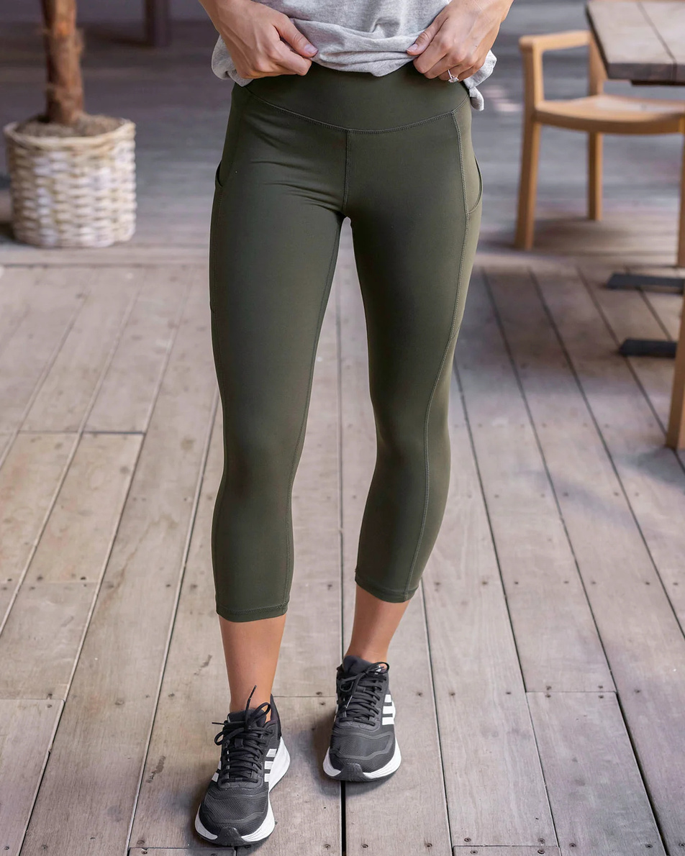
EXPLORE HOW THEY CAN SIMPLIFY YOUR ACTIVE LIFESTYLE IN POWERFUL WAYS.
  Simplifying Movement
Pocket Capri leggings provide hands-free mobility. With essentials securely stowed, you’re free to move naturally and confidently without interruption or discomfort. This small design feature makes a big impact on how smoothly your routine flows.
  Hands-Free Convenience
Pocket Capri leggings is their ability to minimize the need for extra items. No more arm bands, fanny packs, or juggling your belongings mid-exercise. Just slide your phone or locker key into the built-in pocket, and you're good to go.

Slide 3
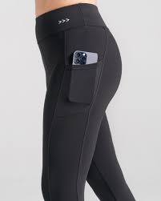


SMOOTH TRANSITIONS THROUGHOUT THE DAY
The versatility of pocket Capri leggings allows for seamless transitions between different parts of your day. Whether you're starting the morning with a walk, heading straight to the market, or taking a spontaneous detour to a coffee shop, there’s no need for an outfit change.
  Streamlined Gym Sessions
Fitness routines are more efficient when everything is in place. Having your phone, gym card, or even resistance bands tucked away in your leggings means fewer interruptions during workouts. You can change music, check timers, or scan into facilities quickly, all without stopping to dig through a gym bag.

Slide 4
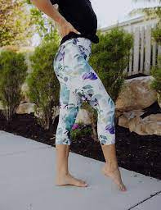

  Comfort with Functionality
One of the most appealing aspects of pocket Capri leggings is their comfort. Designed to hug the body without restricting movement, they often come with high or mid-rise waistbands that offer additional core support. The cropped length adds breathability, especially during warmer weather or high-intensity activities.
  Encouraging Daily Movement
Daily movement doesn't require intense workouts small, consistent actions like walking, stretching, or light exercise throughout the day can significantly improve well-being. Functional apparel, such as pocket Capri leggings, makes it easier to stay ready for activity at any moment.

Slide 5

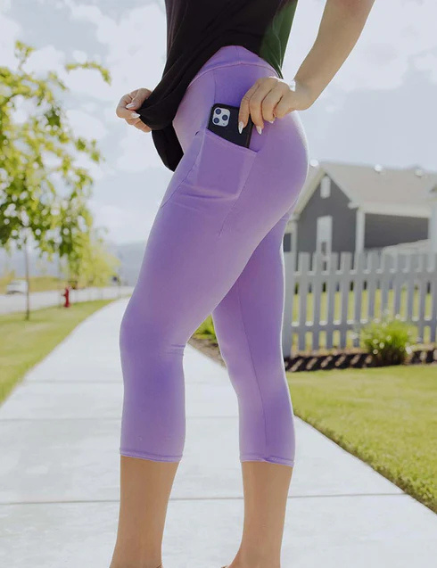

Contact Us
https://mutcci.com/collections/leggings

