Slide 1

PACKETTALK

Slide 2
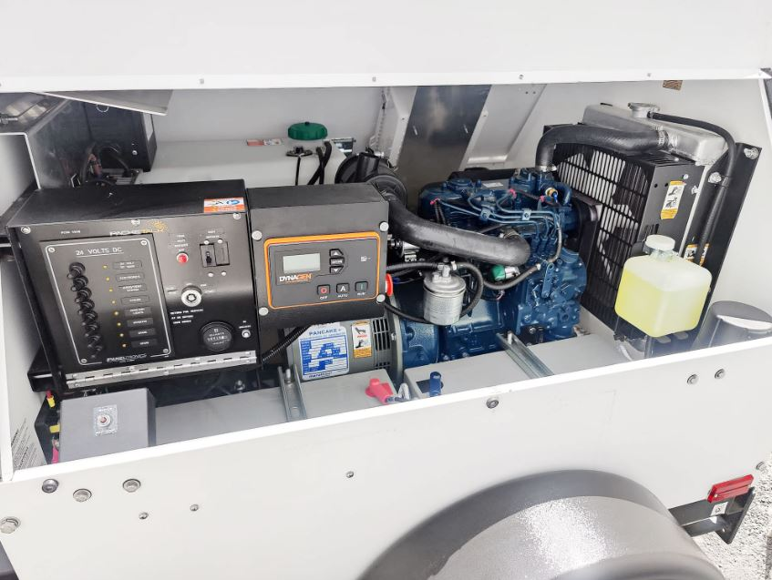
Security Cameras Company / Best Business Surveillance System
Packetalk stands out as a top-tier Company for Security Cameras that are equipped with unique and valuable features. Their cameras are engineered to produce high-quality images, performing exceptionally well even in ultra-low light conditions. Beyond just cameras, it also provides supplementary security solutions like trailers, software, and network systems designed to help detect and deter illegal activities. If you are seeking a reliable monitoring product for the security of your home or office, get in touch with the Packetalk team!
Government officials and business professionals consistently select Packetalk as their preferred monitoring solution because of its robust security features, reliable performance, and comprehensive coverage capabilities. It delivers enterprise-grade surveillance technology that meets the stringent requirements of federal agencies and corporate environments and provides real-time threat detection and advanced analytics that enable proactive security management. Whether you want to get the benefits of the Best Business Surveillance System or enhance the security of your secret location, contact us at 201 355 3323.

Slide 3
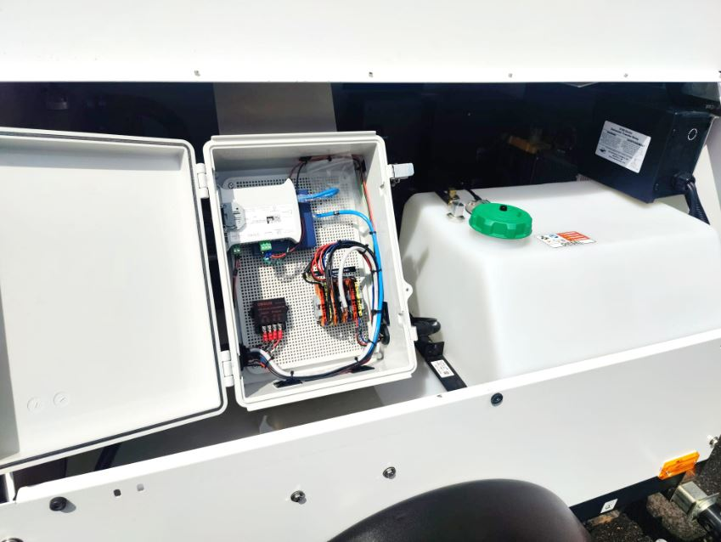
Outdoor Camera and Light / Outdoor Surveillance Camera System
Many customers choose Packetalk because it provides peace of mind and allows them to keep a watchful eye on their homes from anywhere through their best Outdoor Camera and Light user-friendly interface. This integrated system enhances safety by combining high-definition video surveillance with powerful motion-activated lighting, which effectively deters potential intruders. The dual functionality ensures that any activity is not only recorded with clarity, day or night, but also immediately illuminated, adding an extra layer of protection and visibility, and alert notification. If you want to learn more about their capabilities, please visit the website.
Packetalk's proven track record in high-stakes environments demonstrates its ability to protect sensitive data and critical assets, while its user-friendly interface ensures that security teams can efficiently monitor and respond to potential threats. Whether protecting government facilities or corporate headquarters, Packetalk's monitoring technology provides the reliability and precision that security professionals demand, and its advanced monitoring capability makes it the trusted choice for organizations that cannot compromise on their surveillance needs. To learn more about their Outdoor Surveillance Camera System for public safety, tap on the link!

Slide 4
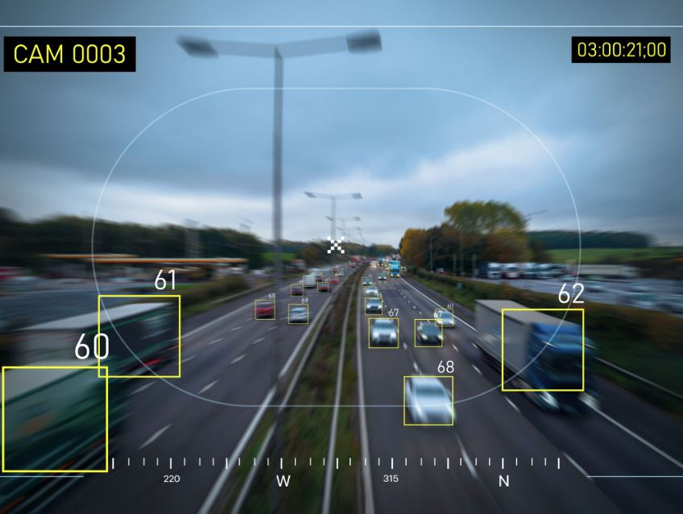
Good Outdoor Camera System
If you're searching for a Good Outdoor Camera System to enhance your security, the PTZ-4160-HD-36ALPR from Packetalk is the best which offering advanced features for comprehensive monitoring. It helps you focus on what truly matters by using advanced AI video analytics to specifically detect human and vehicle activity. With its powerful 36x optical zoom, you can capture clear, detailed images from a distance, while the high light compensation feature ensures image visibility is maintained even under strong lighting conditions. This camera system provides peace of mind with a substantial one-terabyte local storage capacity, ensuring reliable backup for both video footage and license plate data. For further information, click below!
!

Slide 5

Solar Camera Trailer / Surveillance Camera Trailer
Enhance security at your official or business location with Packetalk's advanced monitoring solutions. Designed to effectively detect and deter illegal activities, their products are highly sought after for their reliability. Packetalk also offers a range of trailers, including the popular Solar Camera Trailer, diesel-powered models, and rapid-deploy drone trailers, all available with advanced features as ALPR, video analytics, and thermal imagery. Among these, the PT-RD3000 trailer stands out as a premier monitoring tool. Its lightweight design allows for easy deployment anywhere, and it is built to operate reliably even in extreme environments. Want to learn more? Please visit Packetalk!
Are you struggling to find the best Surveillance Camera Trailer? No need to go anywhere, Packetalk offers several monitoring solutions that perform their task in all weather conditions. For the security of your secreted place, its PT- RD5000, a solar and engine-powered trailer, is one of the best solutions to navigate the complexities. Its on-board self-healing system allows the users to manage and monitor vitals for all assets in a centralized location from desktop, mobile phones, or tablets. To acquire more details about this product, follow the website!

Slide 6
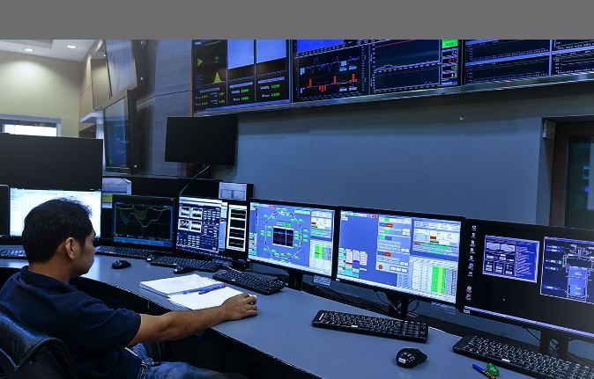
Trailer Surveillance Camera / Solar Powered Video Surveillance Camera
Keep your assets protected with a state-of-the-art Trailer Surveillance Camera available at Packetalk. This advanced monitoring solution is expertly designed to safeguard your official locations by effectively detecting and discouraging unauthorized actions. Featuring models like the popular Solar Camera Trailer and the premier Intelligent Diesel-Based Light Tower, this system offers unparalleled reliability and flexibility. Many people are investing in this surveillance trailer for a meaningful step toward securing their property with a system they can trust. For more details, tap on the link.
Packetalk offers the latest Solar-Powered Video Surveillance Camera to its customers at a budget-friendly cost. The officials from government authorities used this camera in public areas such as railway stations, airports, schools, and colleges to provide security for everyone. Except for that, for traffic control, their other monitoring products are installed to detect the movements of vehicles and their software identifies the vehicle colour, model, type, region, and then matches with against the list. If you want this real-time monitoring product, order it today from the website.

Slide 7
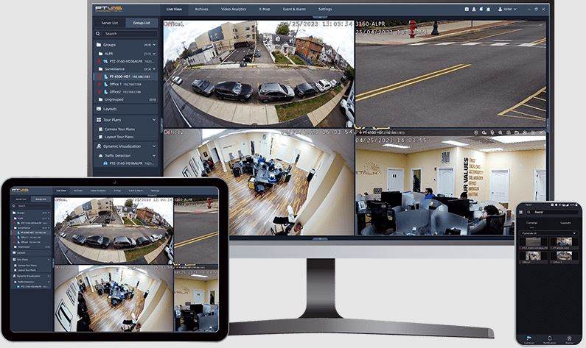
LPR Software / CCTV Analytics Software
The Comprehensive monitoring tools with LPR Software provide crucial oversight and operational assurance. User utilize Packetalk to proactively manage the performance of their entire security system, from individual cameras to network connectivity. Their proactive approach helps ensure consistent and reliable license plate capture, minimizes downtime by flagging potential issues before they become critical failures, and ultimately strengthens their security and data collection efforts. By having a clear, real-time view of their system's status, users can maintain optimal functionality and trust in the data their LPR software provides. For all surveillance needs, please get in touch with Packetalk’s team!
Through CCTV Analytics Software, Packetalk’s monitoring camera not only strengthens on-site security but also actively alerts users to unusual activities and potential mishaps in real-time. Its powerful PTVAS comes equipped with onboard smart analytics that deliver event-based notifications, ensuring quick and informed responses. Besides, with its adaptive learning algorithms and seamless integration into existing systems, it creates a highly efficient and responsive environment tailored to the needs of modern businesses and high-security zones alike. To discover more information about its capabilities, follow Packetalk’s official website today!

Slide 8
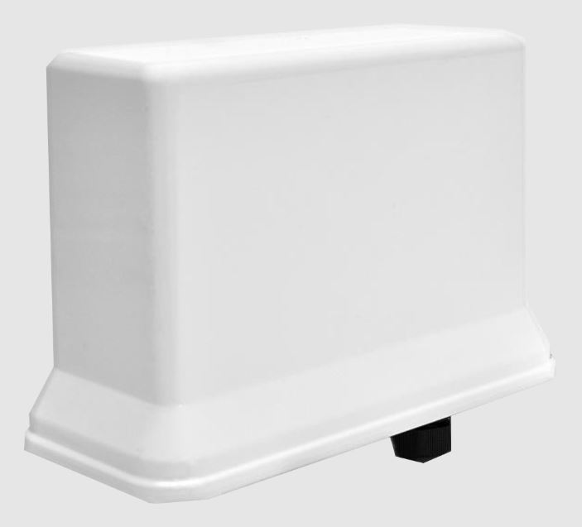
Video Monitoring System Software
Packetalk's Video Monitoring System Software is a robust and intelligent surveillance solution designed for modern security needs. Seamlessly integrating real-time video analytics with user-friendly controls, it empowers businesses to monitor, manage, and respond to incidents with precision. Known for its reliability and scalability, this product ensures crystal-clear footage, secure storage, and instant alerts that making it a trusted choice for shop owners who value both safety and smart technology. On the website, you can learn more about its benefits!

Slide 9

packetalk.net

