Slide 1

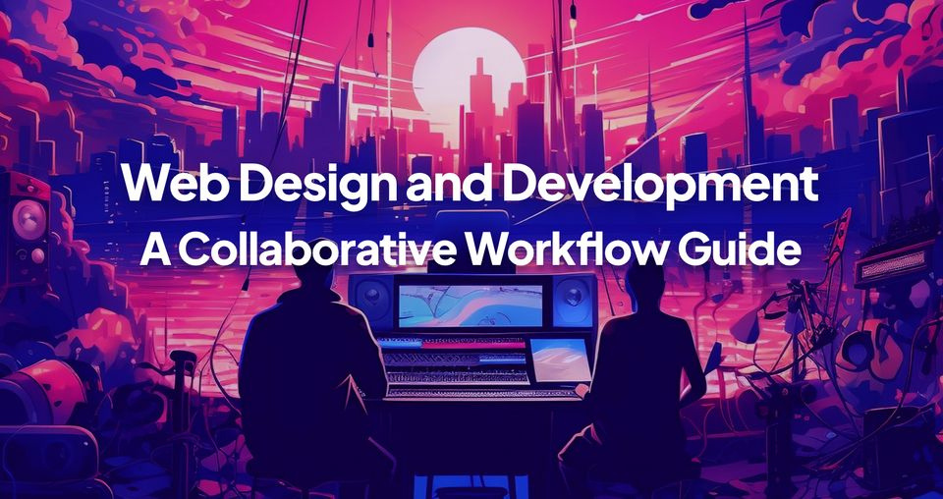
Quora Web Solution
Website Design and
Development
Company
Web Design & Web Development
Company in Bangalore, India
www.quorawebsolution.com
+91 9986 056 909
info@quorawebsolutions.com
24A, 1st Main Rd, Chandra Reddy
Layout, Koramangala 4th Block,
Koramangala, Bengaluru,
Karnataka 560034

Slide 2

The Complete Process of Website Design and Development: From Concept to Launch for Small and Medium Enterprises (SMEs)
Creating a website for a small or medium enterprise (SME) involves a clear process that helps businesses establish their online presence.
www.quorawebsolution.com

Slide 3

Here's a step-by-step guide that covers the essential stages of website design and development—from concept to launch.
1. Planning and Research
www.quorawebsolution.com

Slide 4

Before diving into design, planning is crucial. This phase includes:
Goal Setting: Identify the purpose of the website—whether it's to generate leads, sell products, or provide information.
www.quorawebsolution.com

Slide 5
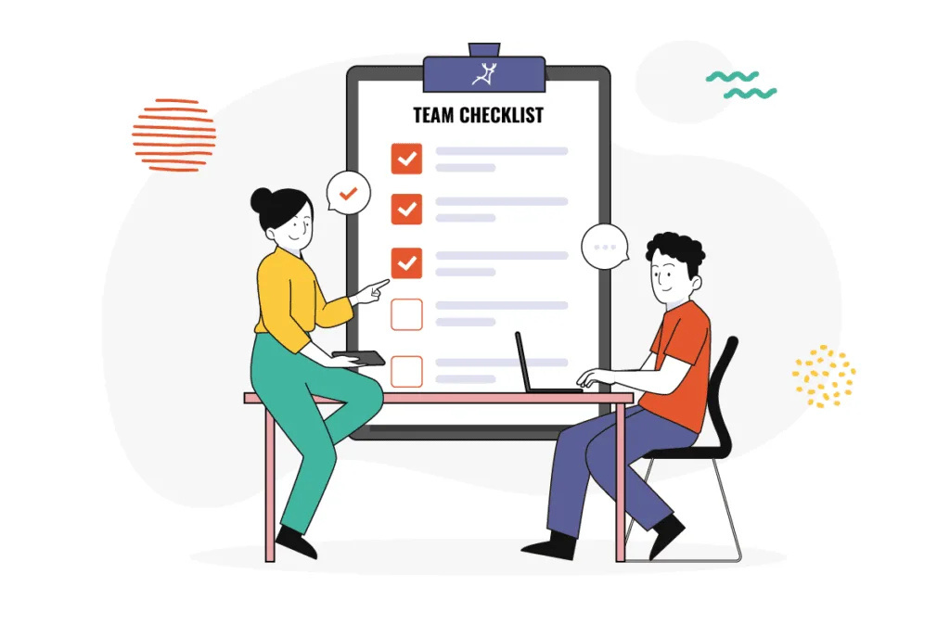
Target Audience: Understand the audience’s needs and preferences.
Competitor Analysis: Research competitors’ websites to gather insights on design trends and functionality.
Content Strategy: Plan the type of content the website will feature—product descriptions, blogs, case studies, etc.
Key Output: A detailed blueprint of the website with content and functionality outlined.
www.quorawebsolution.com

Slide 6
2. Wireframing and Design
In this phase, designers start bringing the vision to life:
Wireframes: These are basic sketches or blueprints of the website, showing layout, structure, and navigation.
UI/UX Design: Focus on user experience (UX) and interface design (UI) to make the site visually appealing and easy to navigate. Choose colors, fonts, and images that align with your brand.
Responsive Design: Ensure that the site works seamlessly on various devices, from desktops to smartphones.
Key Output: A visual representation of the website’s layout and user interface.
3. Development
Once the design is approved, the website moves to the development phase:
www.quorawebsolution.com

Slide 7
Front-End Development: This involves building the visible part of the website—what users see and interact with. Technologies such as HTML, CSS, and JavaScript are employed.
Back-End Development: The behind-the-scenes infrastructure like databases and server-side operations are set up. Common technologies include PHP, Ruby, or Node.js.
CMS Integration: A Content Management System (CMS) like WordPress, Joomla, or Drupal might be integrated, enabling easy content updates without coding.
Key Output: A functional website with both front-end and back-end development completed.
4. Testing
Testing ensures that everything works properly across devices and browsers:
Cross-Browser Testing: Check compatibility on all major browsers (Chrome, Firefox, Safari, etc.).
www.quorawebsolution.com

Slide 8
Device Testing: Test the site on different devices, including smartphones, tablets, and desktops.
Usability Testing: Ensure the site is easy to navigate and user-friendly.
Bug Fixing: Resolve any bugs or issues that arise during testing.
Key Output: A fully functional and error-free website.
5. Launch
The final phase is launching the website to the public:
Domain Name and Hosting: Set up hosting and link the website to your domain.
SEO Basics: Optimize the website for search engines with relevant keywords, meta tags, and a clean URL structure.
Go Live: Launch the site and ensure it’s accessible to users.
www.quorawebsolution.com

Slide 9
Monitor Performance: Keep an eye on site performance with tools like Google Analytics to track traffic and user engagement.
Key Output: The website is live and accessible to the target audience.
6. Post-Launch Maintenance and Updates
The work doesn’t end at launch. Regular updates and maintenance are key to keeping the website relevant and functioning smoothly:
Content Updates: Regularly add or modify content.
Security Checks: Ensure the website is secure from threats and attacks.
Performance Monitoring: Track website speed, load time, and user experience regularly.
www.quorawebsolution.com

Slide 10
Key Output: A well-maintained website that continues to meet business goals.
Conclusion
For SMEs, a well-designed and functional website can significantly boost online visibility and customer engagement. By following this structured process, businesses can ensure a smooth transition from concept to launch, creating a platform that serves both business goals and customer needs effectively.
From Concept to Launch: The Essential Stages of the Website Development Process Explained
www.quorawebsolution.com

Slide 11
Creating a website is an exciting process that requires careful planning, design, and development. Whether you are building a personal blog, an e-commerce platform, or a corporate website, understanding the stages of website development will help you achieve a successful launch. Here are the essential stages of the website development process explained:
1. Planning & Discovery
The first step in any successful website project is planning. This is where you define the purpose of the website, its target audience, and the goals you want to achieve. Key activities during this phase include:
Project Briefing: Clarifying the purpose, goals, and target audience.
Research: Competitor analysis and gathering inspiration.
www.quorawebsolution.com

Slide 12
Content Planning: Identifying the types of content you need for the site.
Planning sets the foundation for the entire project and ensures everyone is on the same page.
2. Design
Once the planning phase is complete, the design phase begins. This is where creativity comes into play, as the visual aspects of the website are created.
Wireframing: Creating basic layouts to define structure and user flow.
Mockups: High-fidelity designs that show the website's visual style.
UI/UX Design: Focus on user experience (UX) and user interface (UI) to ensure the site is easy to navigate and visually appealing.
www.quorawebsolution.com

Slide 13
This phase ensures that the website will be not only functional but also visually engaging.
3. Development
With the designs approved, it's time to bring the website to life through coding. This stage involves both front-end and back-end development.
Front-End Development: Coding the visual elements, ensuring the website looks and functions as intended on various devices.
Back-End Development: Setting up the server, databases, and other components that ensure the website operates smoothly.
This is where the bulk of the technical work happens, turning static designs into a fully functional website.
4. Testing & Quality Assurance
www.quorawebsolution.com

Slide 14
Before going live, the website needs to be thoroughly tested to ensure everything works correctly.
Browser Testing: Ensuring the website works across different web browsers.
Device Testing: Making sure the site is responsive and looks good on all screen sizes.
Performance Testing: Checking load times and fixing any performance issues.
Quality assurance ensures that the website is error-free, user-friendly, and ready for launch.
5. Launch
Once all testing is complete and you're satisfied with the website's functionality, it's time for the launch. This involves:
Finalizing Content: Ensuring all content is updated and optimized for SEO.
Deployment: Moving the website from the development server to the live environment.
www.quorawebsolution.com

Slide 15
Announcement: Publicizing the website to the intended audience through social media, email marketing, and other channels.
Launching your website is an exciting milestone, but the work doesn't end here.
6. Post-Launch & Maintenance
After the website goes live, continuous monitoring and maintenance are crucial to ensure it remains up-to-date and functional. This includes:
Fixing Bugs: Addressing any post-launch issues that arise.
Updates: Regularly updating content, plugins, and security features.
Analytics: Monitoring website performance through tools like Google Analytics to track traffic and user behavior.
www.quorawebsolution.com

Slide 16
Ongoing maintenance ensures that the website remains secure, fast, and relevant.
In conclusion, building a website is a structured process that involves several stages, from initial planning to post-launch maintenance. By following these steps and working closely with your design and development team, you can create a website that meets your business goals and provides a positive user experience.
www.quorawebsolution.com

Slide 17
Quora Web Solution: Quora Web Solution is a trusted website development company based in Bangalore, India, offering a wide array of services to not only domestic but global clientele. Be it Website Design and Development, SEO services, Digital Marketing, Branding, App Development, Ecommerce Solution, and Logo Creation . Quora Web Solution has the best website developers offering top quality services and that is the reason why we are well known as one of the best Website Development Companies in Bangalore, India.
Visit Us - www.quorawebsolution.com
Call Us - +91 9986 056 909
Mail Us - info@quorawebsolutions.com
www.quorawebsolution.com

Slide 18

WORDPRESS DEVELOPMENT
ECOMMERCE DEVELOPMENT
PHP DEVELOPMENT
CMS DEVELOPMENT
DRUPAL DEVELOPMENT
WEBSITE SERVICES
WEBPORTAL DEVELOPMENT
MAGENTO DEVELOPMENT
WEBSITE DEVELOPMENT
JOOMLA DEVELOPMENT
SMALL BUSINESS DEVELOPMENT
CHEAP WEBSITE DEVELOPMENT
STATIC WEBSITE DEVELOPMENT
DYNAMIC WEBSITE DEVELOPMENT
WEBSITE DESIGN COMPANY
TOUR AND TRAVEL WEBSITE DEVELOPMENT
Services

