Slide 1


Top Cleaning Agencies
in Dubai
Excellence in Cleanliness & Service
Notes:
1

Slide 2
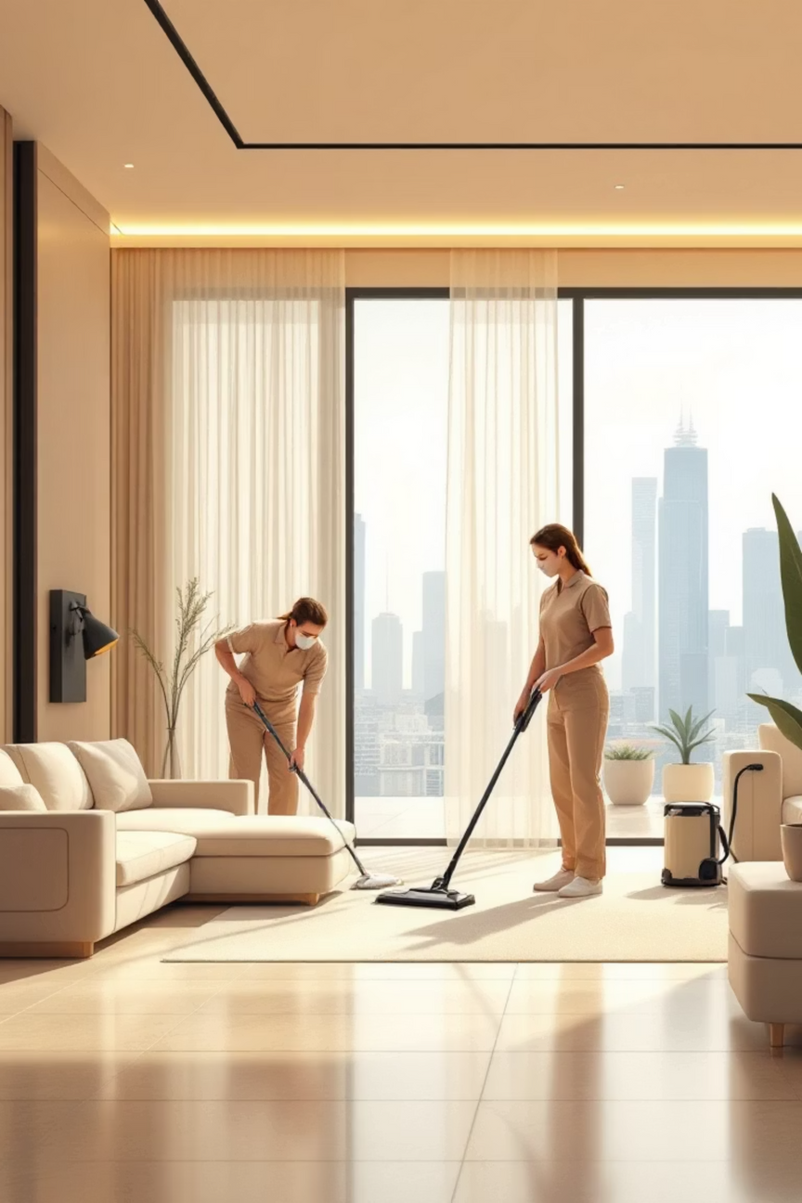



Why Choosing the Right Cleaning Agency Matters in Dubai
Fast-Paced Lifestyle
Health & Productivity
Dubai's dynamic environment demands reliable, efficient cleaning solutions that keep up with your busy schedule.
Clean environments directly boost health, enhance productivity, and provide essential peace of mind for residents and businesses.
Quality Assurance
With a crowded market, finding trusted, quality providers who deliver consistent excellence is absolutely key.
Notes:
2

Slide 3

SmileHandyy: Affordable & Trusted Cleaning Experts
Comprehensive Service Range
SmileHandyy offers home cleaning, deep cleaning, sofa care, pool maintenance, carpet cleaning, and flexible hourly maid services tailored to your specific needs.
Eco-Friendly Excellence
Utilizing advanced equipment and environmentally responsible materials, they deliver superior results while protecting your family and the environment.cleaning agency dubai ensures safe, effective, and eco-conscious cleaning solutions for both homes and workplaces.
Transparent & Honest
Based in Abu Dhabi and serving Dubai, they pride themselves on transparent pricing with no hidden fees and personalized customer service.
Notes:
3

Slide 4

Helpsters: Commercial & Residential Cleaning Specialists
Expert Training
Municipality Approved
Professional teams rigorously trained in disinfection protocols, deep cleaning techniques, and specialized carpet shampooing methods.
Dubai-based with official approval from Dubai Municipality, ensuring the highest standards of hygiene and customer satisfaction.
Full-Service Solutions
Comprehensive services include move-in/out cleaning, upholstery care, and specialized treatments for all property types.
Notes:
4

Slide 5
Enron Cleaning Company: Comprehensive Environmental Services
Specialized Industrial Cleaning
Licensed & Certified
Budget-Friendly Quality
Municipality licensed with unwavering commitment to safety, eco-responsibility, and regulatory compliance across all operations.
Offers pest control, duct cleaning, and industrial solutions known for exceptional quality at competitive rates throughout Dubai.
Expert services in grease trap, sewage systems, water tank cleaning, and hazardous waste management with cutting-edge technology.
Notes:
5

Slide 6
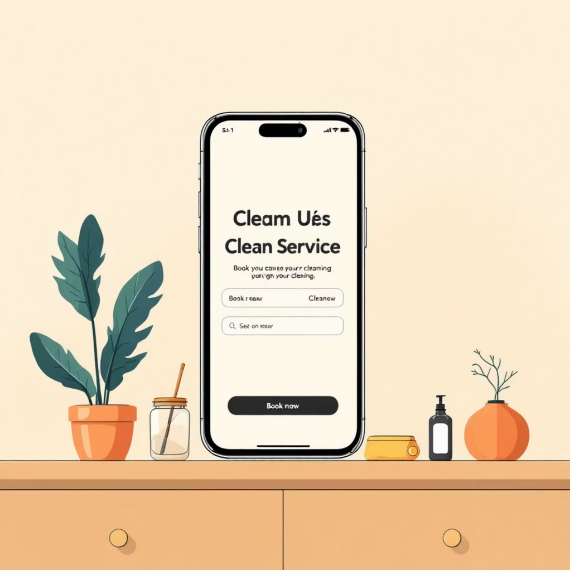
BusyBees Dubai: Customized & Tech-Enabled Cleaning Solutions
Established Excellence Since 2008
Operating with proven expertise in both residential and commercial cleaning, BusyBees has built a reputation for reliability and quality service delivery.
Technology-Driven Convenience
Mobile and web applications enable easy booking and fully tailored cleaning plans that adapt to your unique requirements and schedule.
Competitive Pricing & Special Offers
Starting at just 45 AED/hour for regular cleaning, with deep cleaning, move-in/out services, disinfection packages, and exclusive free sanitization deals.
Notes:
6

Slide 7

McKleenz: ISO-Certified Maintenance & Cleaning Leader
4.7+
40K+
100%
Star Rating
Annual Bookings
In-House Staff
Consistently high customer satisfaction scores
Trusted by thousands across Dubai
No third parties, full quality control
Canadian-managed with ISO certification, McKleenz offers comprehensive building cleaning, pest control, AC maintenance, and handyman services. Their advanced CRM system ensures seamless booking experiences and exceptional customer care throughout every interaction.
Notes:
7

Slide 8
What Sets These Agencies Apart?
Certified Professionals
Transparent Operations
All agencies employ trained, certified professionals using eco-friendly products that protect your health and the environment while delivering spotless results.
Clear, upfront pricing with no hidden fees, combined with flexible scheduling that adapts to your lifestyle and business requirements.
Comprehensive Services
Proven Track Record
Wide-ranging expertise from routine residential cleaning to specialized industrial tasks, ensuring all your cleaning needs are met under one roof.
Strong customer reviews, municipality approvals, and quality certifications demonstrate consistent excellence and reliability in service delivery.
Notes:
8

Slide 9

Pricing Snapshot: Competitive & Transparent Rates
Regular Cleaning
45-50 AED/hour
Perfect for routine maintenance and weekly cleaning schedules
Deep Cleaning
From 65 AED/hour
Includes free disinfection offers and comprehensive sanitization
Move-In/Out
550-3,500+ AED
Packages from studios to luxury villas, fully customizable
Custom Quotes
Based on needs
Tailored pricing for property size and service complexity
Notes:
9

Slide 10

Your Clean Space, Our Trusted Experts
01
Professional Excellence
Dubai's top cleaning agencies masterfully combine professionalism, cutting-edge technology, and eco-conscious practices.
02
Spotless Results
Whether home or office, these companies consistently deliver spotless, healthy environments that enhance your quality of life.
03
Perfect Match
Choose a partner that perfectly fits your specific needs, budget constraints, and scheduling preferences for complete peace of mind.
04
Take Action Today
Contact your preferred agency now and experience the absolute best cleaning services Dubai has to offer!
Notes:
10

