Slide 1
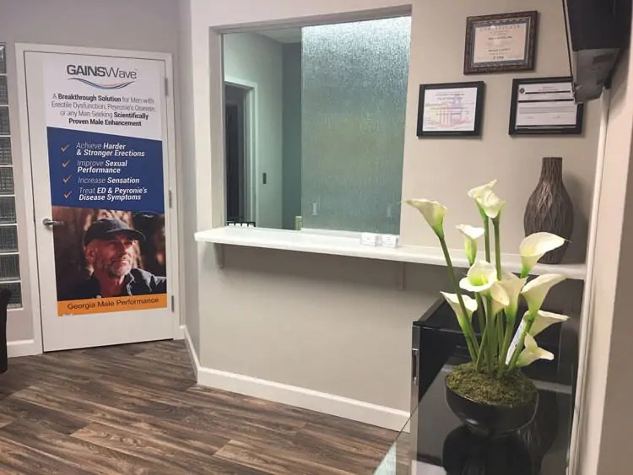
Shockwave Therapy for ED
Discover our advanced shockwave therapy for ED, a safe, non-invasive treatment designed to restore function, boost confidence, or improve men’s intimate health.

Slide 2


Non-Drug ED Treatment
Explore effective non-drug ED treatment using innovative methods that enhance circulation, improve performance, or deliver long-term natural wellness solutions.

Slide 3
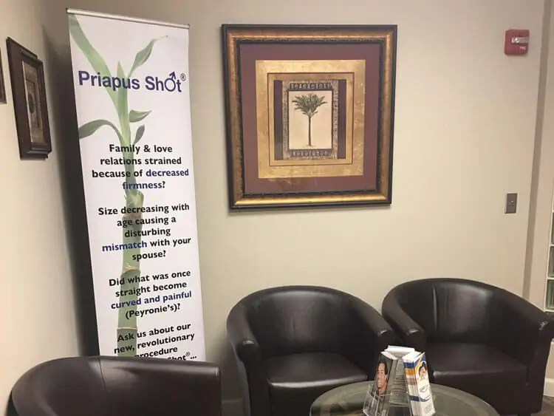
Gainswave
Therapy
Transform performance with gainswave therapy, a potent non-surgical solution that improves blood flow, restores vitality, or supports lasting intimate wellness.

Slide 4
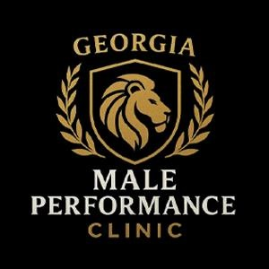
Contact Us
Bio: Georgia Male Performance Clinic provides advanced, non-surgical men’s health treatments in Duluth, specializing in ED solutions, hormone therapy, GAINSWave®, & personalized care to restore confidence.
Address:- 3635 Peachtree Industrial Blvd Suite 600 Duluth, GA 30096, Georgia, United States
Website: https://www.georgiamaleperformance.com/

