Slide 1
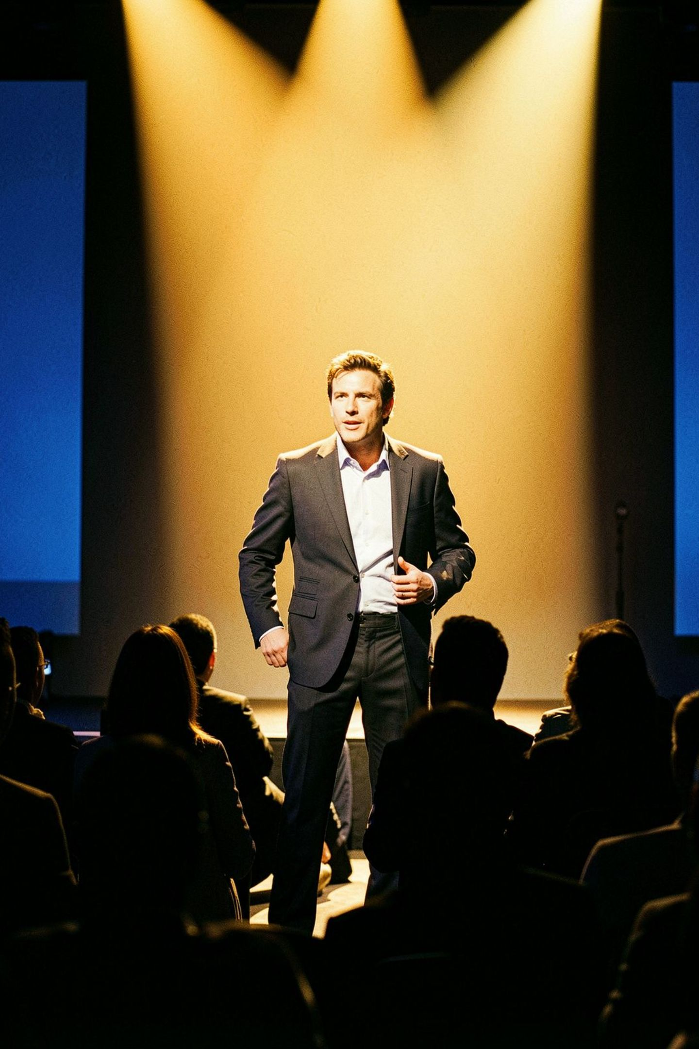
Expert Corporate Event Photographer Services Across San Francisco and the Bay Area
Slava Blazer Photography — Creating Photos That Stand Out

Slide 2
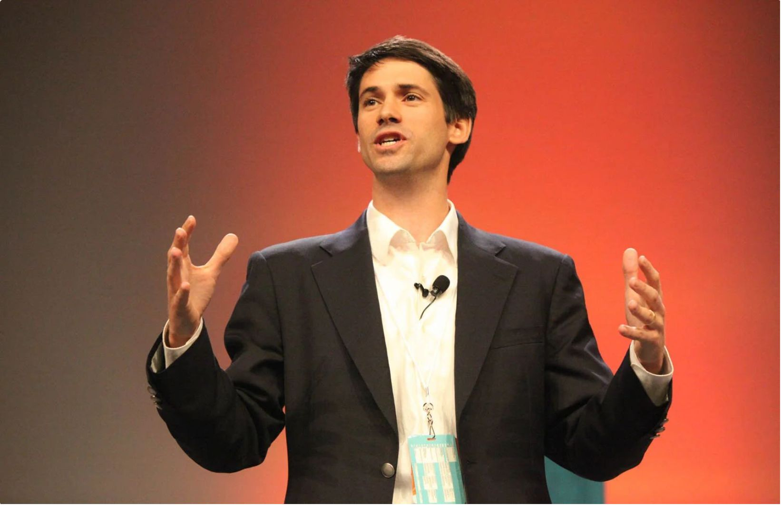
Why Choose Professional Event Photography?
Your corporate event deserves more than snapshots. Professional photography captures authentic moments, builds brand credibility, and creates lasting memories that tell your company's story.
Preserve key moments from conferences, galas, and corporate gatherings
Showcase your brand through high-quality visual content
Create marketing assets for future campaigns and social media
Document speaker presentations and panel discussions professionally

Slide 3
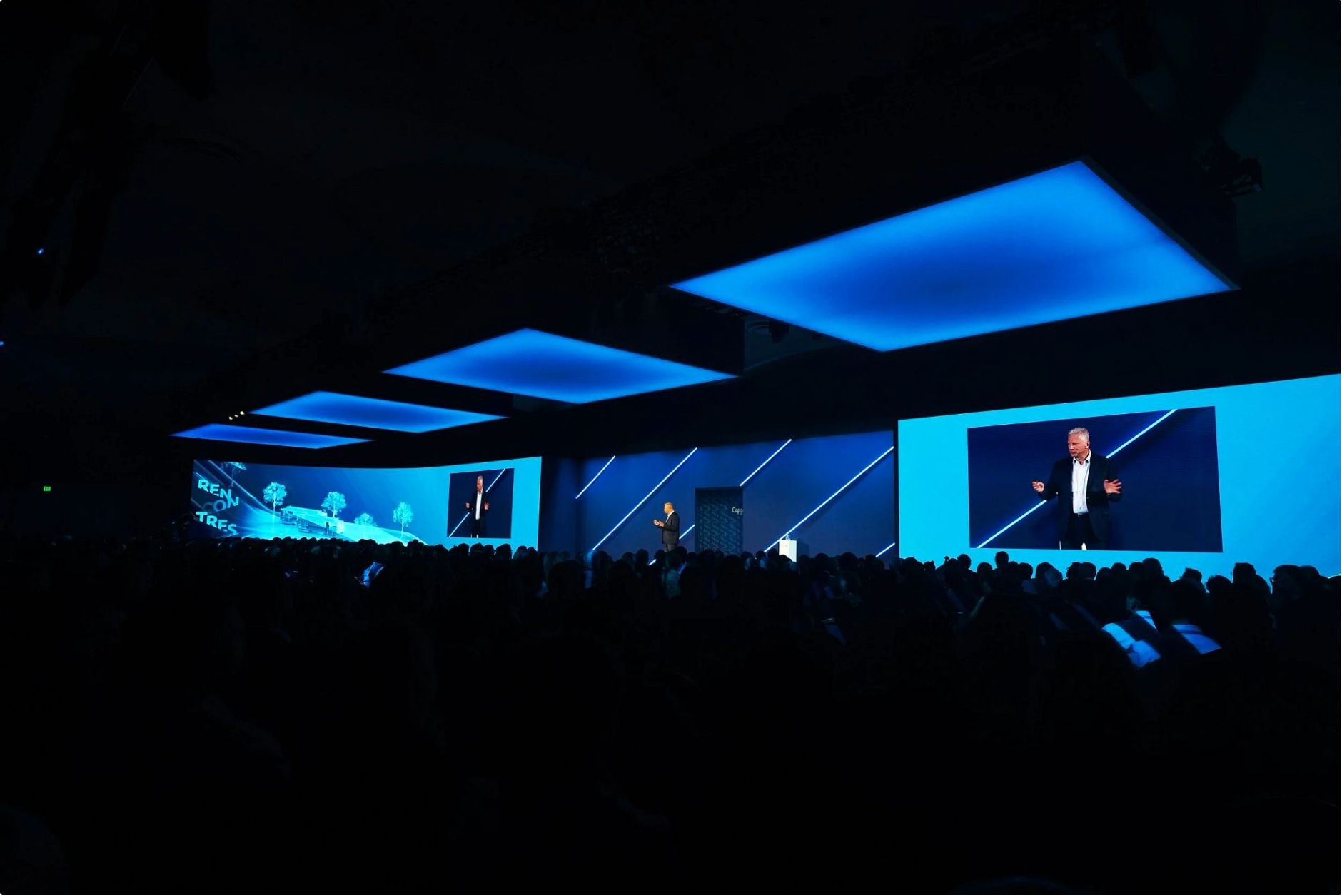
Our Event Photography Expertise
With over 190 five-star reviews, Slava Blazer Photography specializes in capturing corporate events that matter — from
intimate boardroom meetings to large-scale conferences.
Conferences & Summits
Panels & Speakers
Dynamic stage and audience coverage
Polished presentation documentation
Galas & Networking
Launches & Activations
Candid and formal event moments
Brand and product storytelling

Slide 4
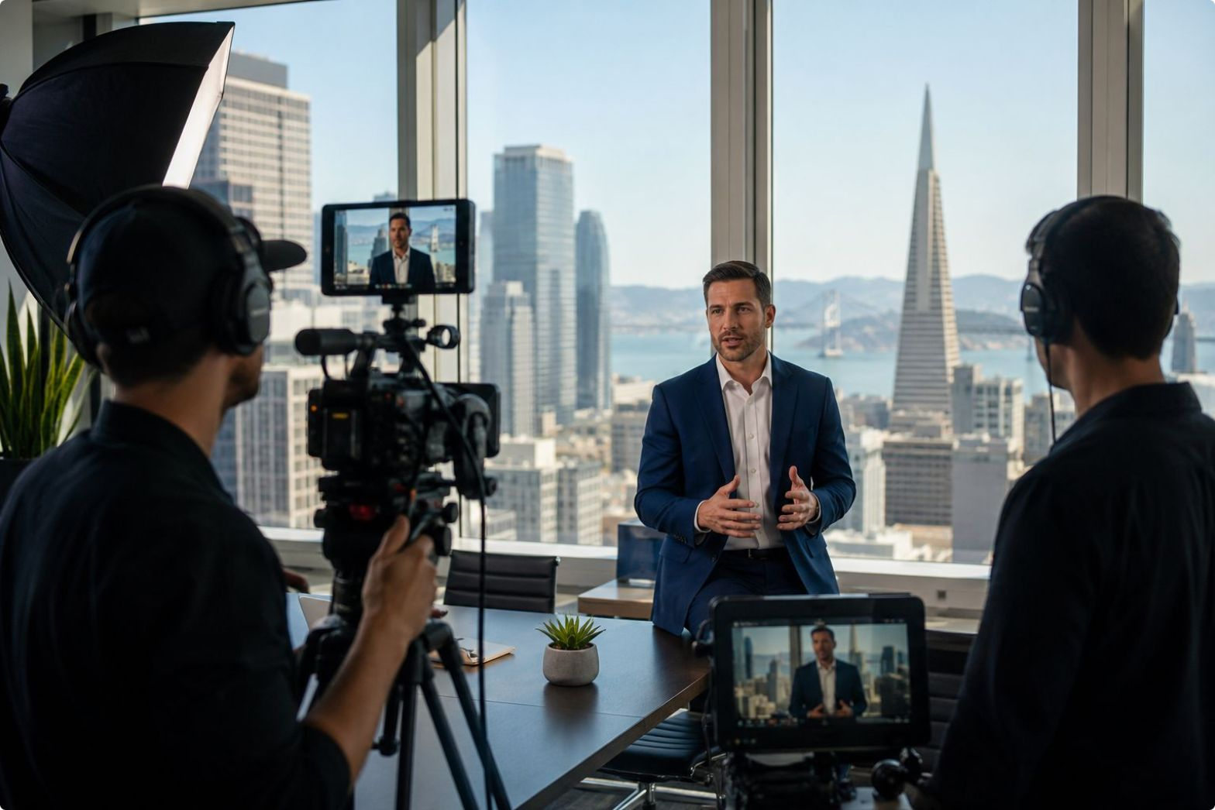
Trusted by Leading Bay Area Companies
Who We Serve
Fortune 500 companies and innovative startups trust Slava Blazer Photography to document their most important events. Our portfolio includes work with Google, LinkedIn, Adobe, Microsoft, Salesforce, and many more industry leaders.
Tech industry leaders and innovation conferences
Financial services and corporate headquarters
Healthcare and biotechnology organizations
Media and entertainment companies

Slide 5

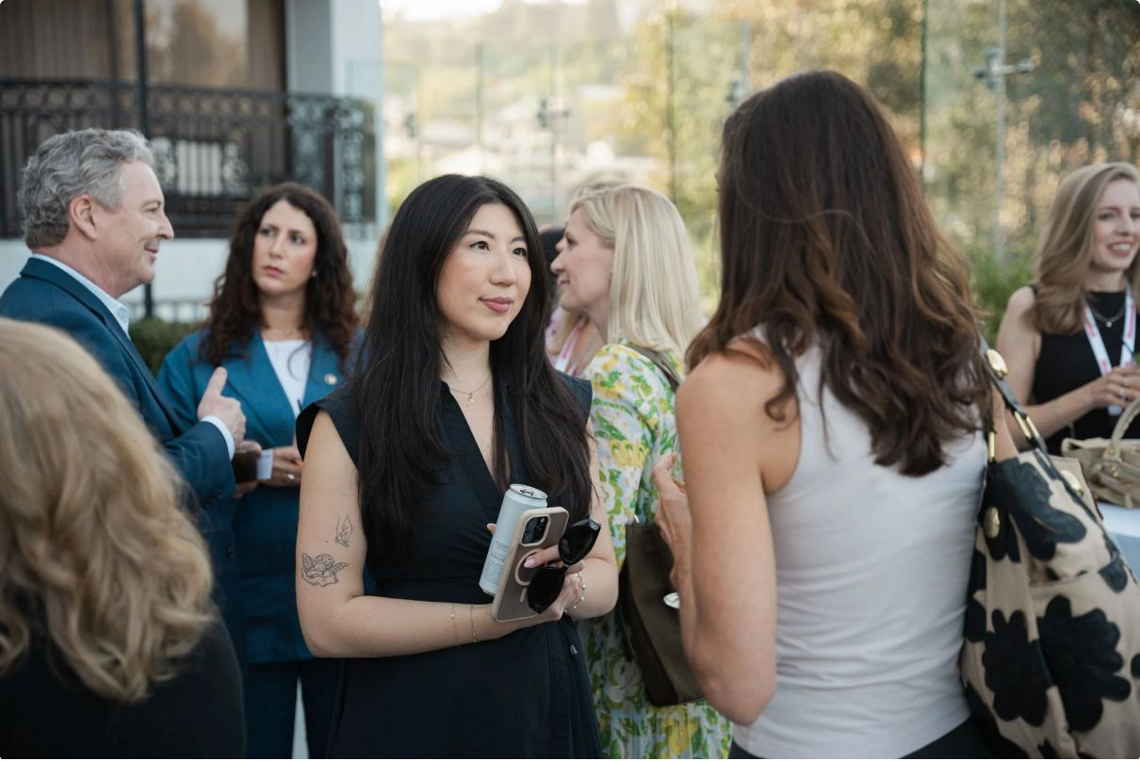

What Sets Us Apart
Professional event photography requires technical skill, creative vision, and the ability to anticipate moments before they happen. Slava Blazer brings all three to every assignment.
Expert Coverage
Fast Turnaround
Multiple photographers for comprehensive event documentation
Edited photos delivered within days of your event
Versatile Styles
Professional Editing
Candid moments, formal portraits, and dynamic action shots
Color correction and enhancement for polished final images
Digital Delivery
High-resolution files ready for print and digital use

Slide 6
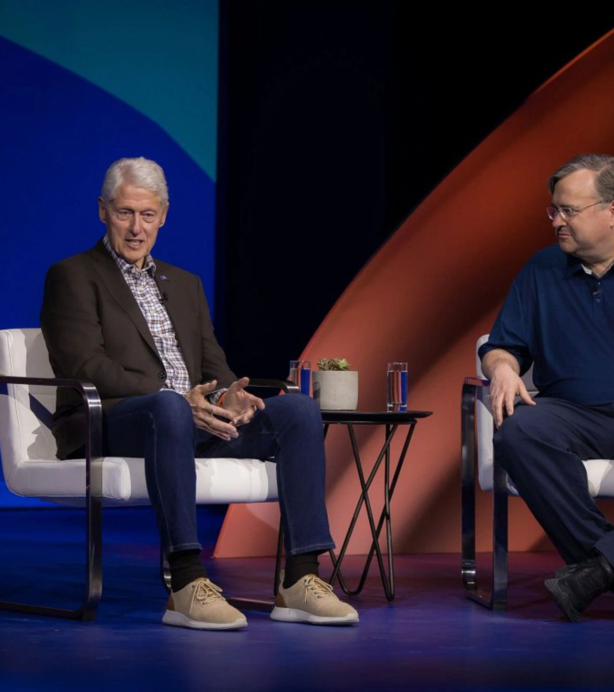
Ready to Capture Your Next Event?
Let Slava Blazer Photography document your corporate event with the professionalism and creativity it deserves. Contact us today for a custom quote.
Request a Quote
Visit our website to get started
View Our Portfolio
See examples of our event photography work
Flexible Packages
Customized solutions for events of any size
Bay Area Coverage
Serving all major venues and locations

Slide 7


Contact Slava Blazer Photography
Get In Touch
Slava Blazer Photography
810 Gonzalez Drive, Suite 4F, San Francisco, CA, 94132, USA
Email: info@slavablazer.com
Phone: 415-269-6347
Website: www.slavablazer.com
Event Photography: www.slavablazer.com/event-photography-san-francisco-bay-area
Over 190 Five-Star Reviews on Yelp & Google

