Slide 1


Front-End Developer Interview Questions & Answers (2025)
Welcome to this essential guide for aspiring front-end developers. We'll explore key concepts, practical tips, and common interview questions to help you succeed in your next interview.
📍 Address:
G-13, 2nd Floor, Sec-3, Noida, UP, 201301, India
📞 Phone:
+91-9599086977
📧 Email:
hr@tpointtech.com
📍
https://www.tpointtech.com/front-end-developer-interview-questions

Slide 2
What is Front-End Development?
User Interface (UI)
User Experience (UX)
Focuses on building the visual and interactive parts of websites and web applications that users directly interact with.
Aims to create intuitive, efficient, and enjoyable experiences for the end-user.
Core Technologies
Modern Tools
HTML (structure), CSS (styling), JavaScript (interactivity) form the foundation.
Leverages frameworks/libraries like React, Angular, and Vue.js to streamline development and enhance functionality.

Slide 3
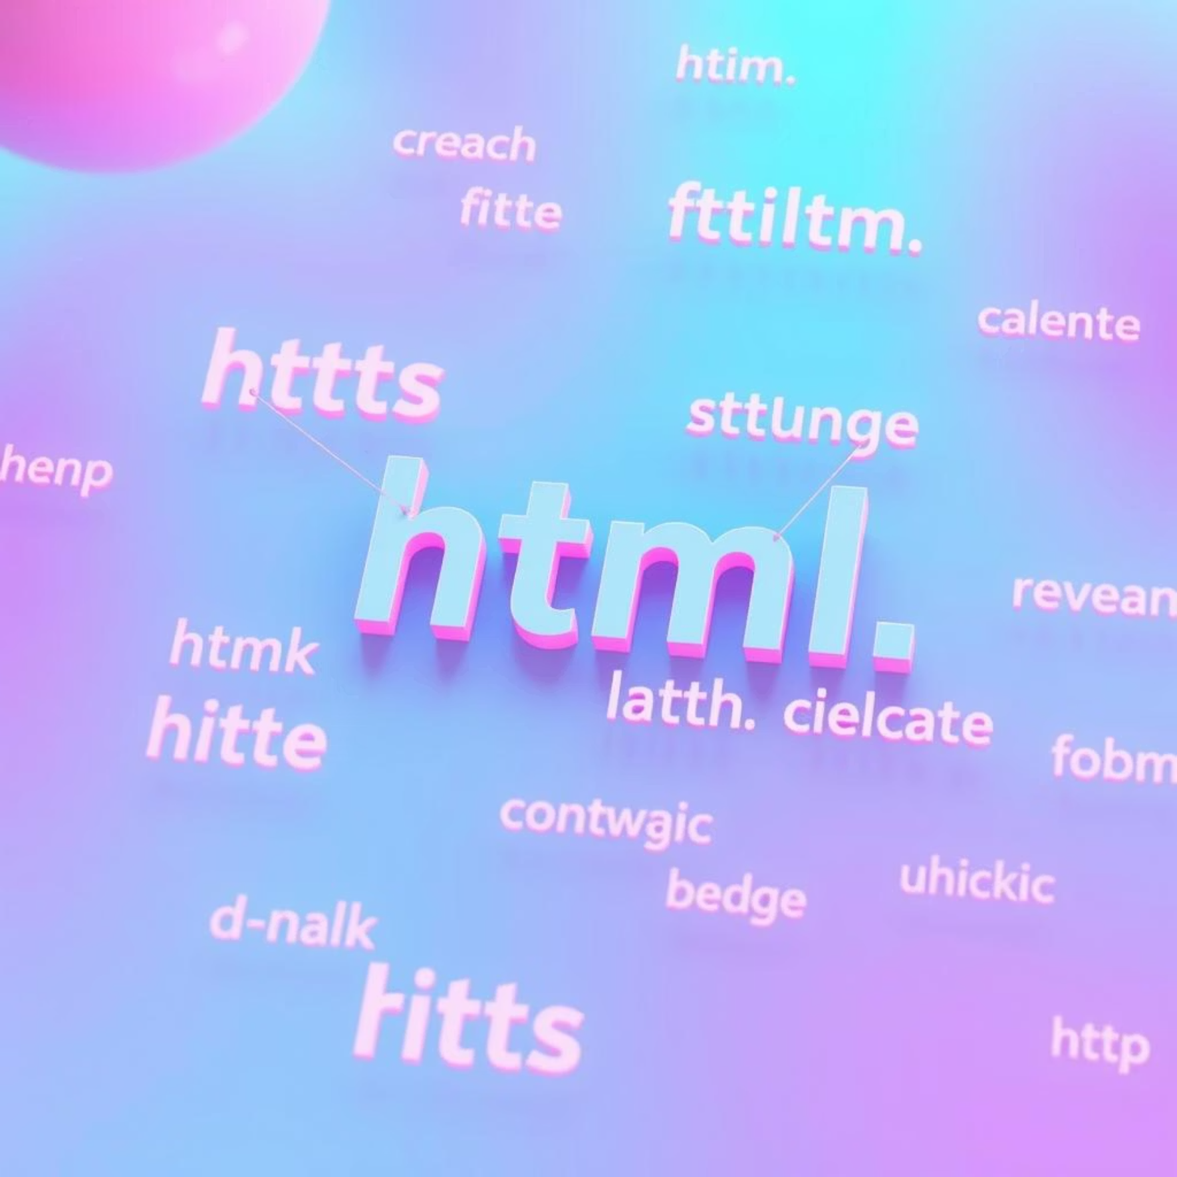
HTML Basics: Semantic Elements & Structure
Semantic Elements
Semantic HTML elements convey meaning to both the browser and the developer. They improve accessibility and SEO. Examples include:
<header>: Introductory content or navigational links.
<main>: Dominant content of the <body>.
<section>: Group of related content.
<article>: Independent, self-contained content.
<footer>: Concluding section, often containing copyright or contact info.
Block vs. Inline Elements
Block-level elements (<div>, <p>) start on a new line and take up the full available width.
Inline-level elements (<span>, <a>) flow within the text and only take up as much width as necessary.
HTML Lists
<ul>: Unordered list (bullets).
<ol>: Ordered list (numbers/letters).
<dl>: Definition list (term/description pairs).

Slide 4
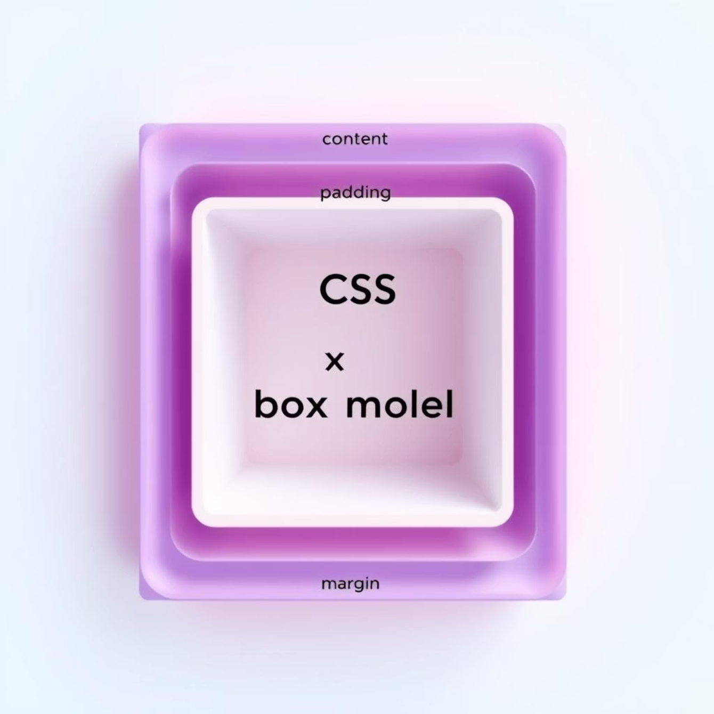
CSS Fundamentals: Box Model & Layout
1
The CSS Box Model
2
CSS Units: em vs. rem
Every HTML element is a box. Understanding its layers is crucial for layout:
em: Relative to the font-size of its direct parent element. Can lead to compounding issues.
Content: The actual content (text, image, etc.).
rem: Relative to the font-size of the root HTML element (<html>). Provides more consistent and predictable scaling across the page, making responsive design easier.
Padding: Space between the content and the border.
Border: The line that goes around the padding and content.
Margin: Space outside the border, separating elements from each other.
3
Modern Layout Techniques
Flexbox: One-dimensional layout system for distributing space among items in a single row or column. Ideal for alignment and distribution.
CSS Grid: Two-dimensional layout system for rows and columns simultaneously. Perfect for complex page layouts and responsive design patterns.

Slide 5
JavaScript Essentials: Scope, Coercion & Callbacks
Scope
Coercion
Callback Hell
Defines the accessibility of variables, functions, and objects in some part of your code.
JavaScript's process of converting a value from one type to another. Can be:
A common issue when dealing with asynchronous operations, leading to deeply nested and hard-to-read code. Solutions include:
Implicit: Performed automatically by JavaScript (e.g., '5' + 2 results in '52').
Function Scope: Variables declared with var are accessible within the function they are defined.
Explicit: Performed by the developer using functions like Number() or String() (e.g., Number('5') + 2 results in 7).
Promises: Provide a cleaner way to handle asynchronous operations.
Block Scope: Variables declared with let and const are accessible within the block (e.g., if statements, for loops) they are defined.
Async/Await: Syntactic sugar built on Promises, making asynchronous code look and behave more like synchronous code.

Slide 6



Modern Tools & Concepts
npm (Node Package Manager)
The world's largest software registry, it's used to manage JavaScript packages and dependencies in your projects. Essential for front-end development workflows.
Content Security Policy (CSP)
A security mechanism that helps protect against cross-site scripting (XSS) and other code injection attacks by allowing web developers to control the resources (scripts, stylesheets, etc.) that a user agent is allowed to load.
REST APIs
Representational State Transfer Application Programming Interfaces are a set of architectural principles for web services that use HTTP requests to access and use data. They are fundamental for modern web application communication.

Slide 7



Security Awareness: ClickJacking & XSS
ClickJacking
An attack where a malicious transparent or opaque layer is placed over a legitimate web page, tricking users into clicking on something different from what they perceive.
1
Cross-Site Scripting (XSS)
2
Involves injecting malicious client-side scripts into web pages viewed by other users. This can lead to session hijacking, data theft, or website defacement.
Mitigation Strategies
Content Security Policy (CSP): Controls allowed content sources.
3
Input Sanitization: Validate and clean user inputs to prevent script injection.
X-Frame-Options Header: Prevents pages from being framed by other sites (for ClickJacking).

Slide 8





Frameworks & Libraries
React.js
Angular
Vue.js
A JavaScript library for building user interfaces, particularly single-page applications. Known for its component-based architecture and virtual DOM.
A comprehensive framework for building dynamic web applications. Offers a structured approach with features like two-way data binding and dependency injection.
A progressive framework for building user interfaces. It's designed to be incrementally adoptable, making it easy to integrate into existing projects.
Key Concepts Across Frameworks
Testing Frameworks
Component Lifecycle: Understanding how components are created, updated, and destroyed.
Jest: A JavaScript testing framework focused on simplicity.
Cypress: An end-to-end testing framework for web applications.
State Management: How application data is handled and updated (e.g., Redux, Vuex).
React Testing Library: Encourages good testing practices for React components.
Hooks (React): Functions that let you "hook into" React state and lifecycle features from function components.

Slide 9


Interview Tips & Preparation
Master the Fundamentals
Solid understanding of HTML, CSS, and JavaScript is non-negotiable. Practice building small projects to reinforce your knowledge.
Practice Coding Challenges
Platforms like LeetCode, HackerRank, and FreeCodeCamp are excellent for honing your problem-solving skills and algorithmic thinking.
Understand UI/UX Principles
Familiarize yourself with accessibility (WCAG), responsive design, and general usability principles. This shows a holistic understanding of front-end development.
Research the Company
Understand their tech stack, products, and culture. Prepare thoughtful questions to ask the interviewer – it shows genuine interest and engagement.

Slide 10
Ready to Ace Your Front-End Interview!
Build Confidence
Stay Updated
Problem-Solving Mindset
Engage in real-world projects and contribute to open source. This provides valuable experience and portfolio pieces.
The front-end landscape evolves rapidly. Follow tech blogs, participate in communities, and experiment with new tools and frameworks.
Technical skills are crucial, but interviewers also look for your ability to think critically, communicate effectively, and approach problems systematically.
Good Luck! Your journey to becoming an exceptional front-end developer starts now.

