Slide 1

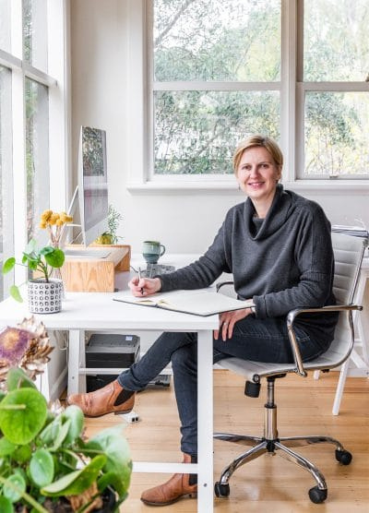

MELBOURNE BRANDING AGENCY
Jen Clark Design is a leading creative studio specialising in brand strategy, visual identity, and digital design. With a strong focus on helping businesses build meaningful and memorable brands.

Slide 2


Who is Jen Clark Design?
Jen Clark Design is an independent, female-led branding and web design studio based in Melbourne, Australia. With a strong emphasis on thoughtful design and strategic clarity, the agency specializes in working with startups, small businesses, social enterprises, and not-for-profits that are looking for branding with purpose.

Slide 3


WHAT SETS THIS MELBOURNE BRANDING AGENCY APART?
  Strategy-Driven Design
  Human-Centered Process
  Website Design & Development
  Ethical Approach
What truly sets this Melbourne branding agency apart is its unique blend of strategic thinking, design excellence, and values-driven collaboration.

Slide 4
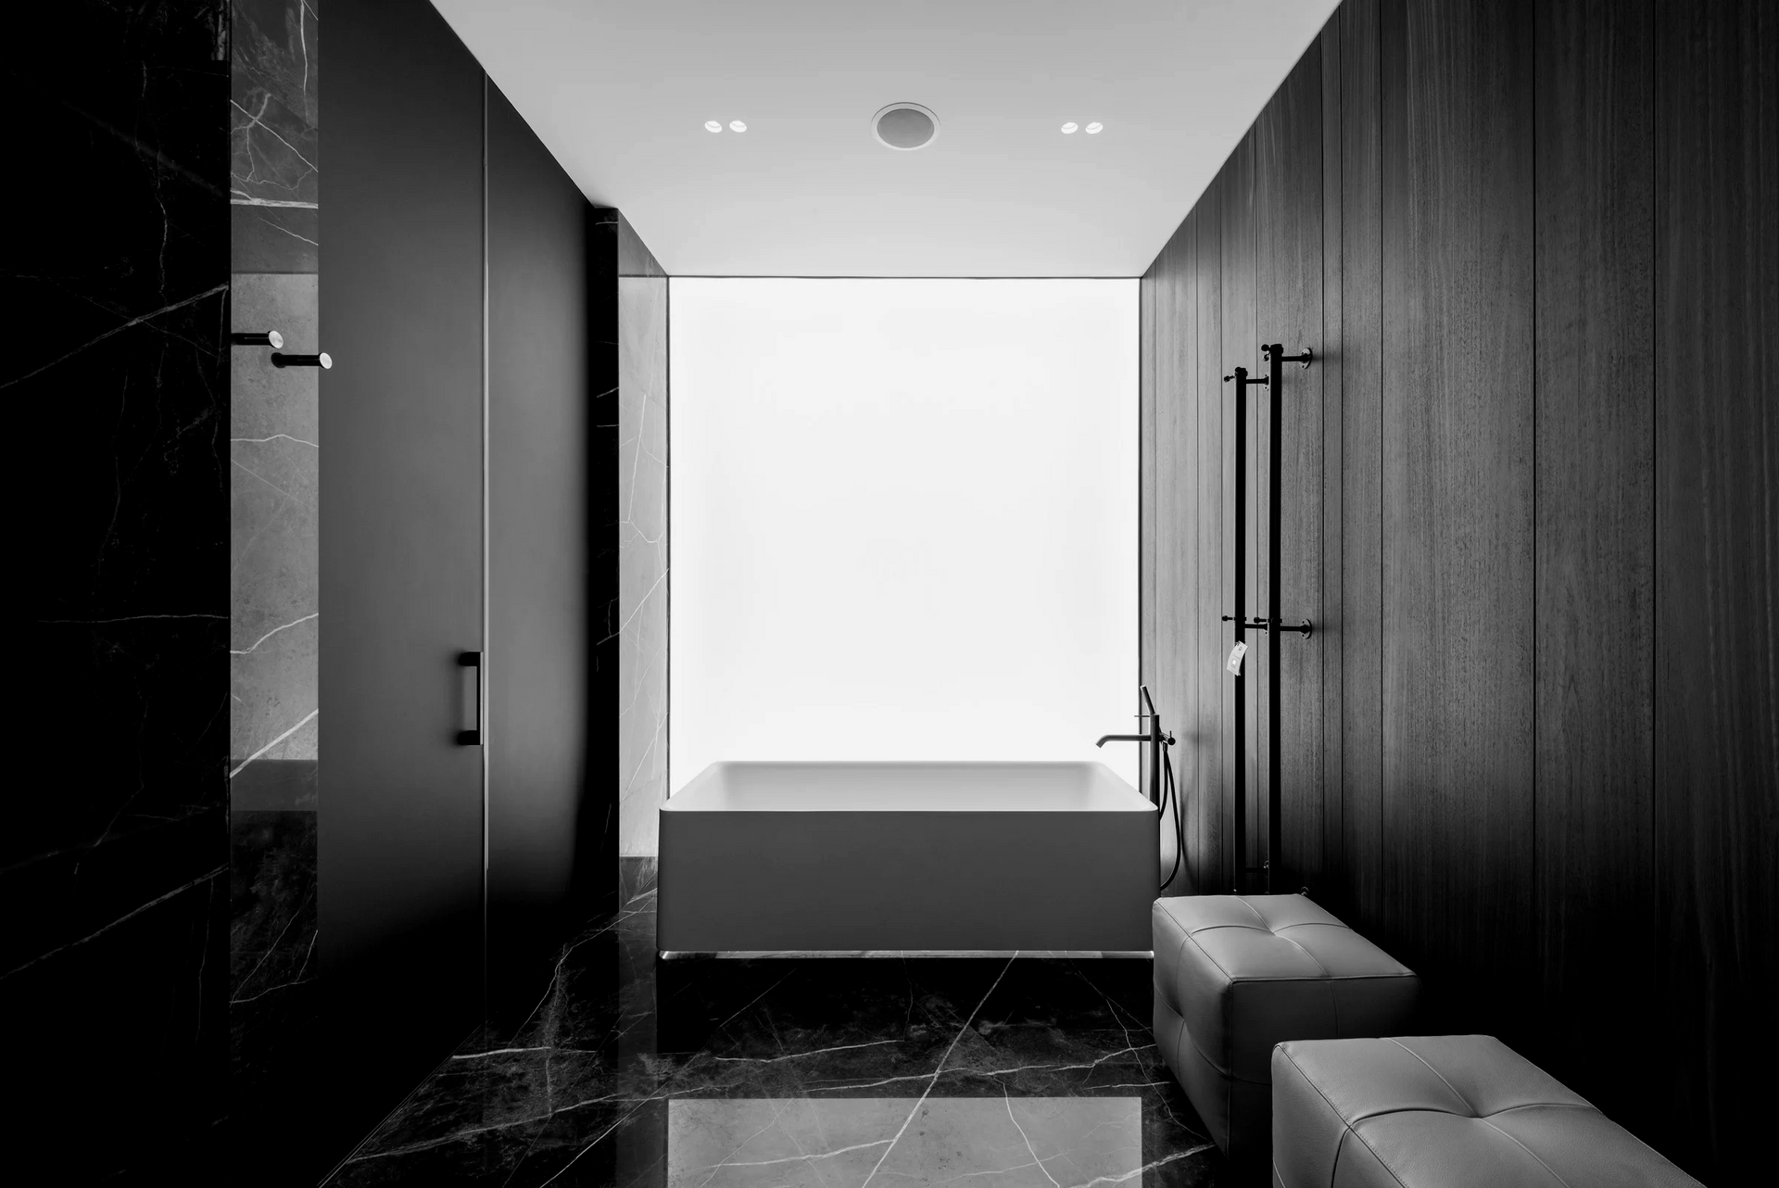



Contact
Details.
  Website - https://jenclarkdesign.com.au/
  Contact No. - 0409 971 124
  Country -Australia

Slide 5


