Slide 1


Quora Web Solution
Website Design and
Development
Company
Web Design & Web Development
Company in Bangalore, India
www.quorawebsolution.com
+91 9986 056 909
info@quorawebsolutions.com
24A, 1st Main Rd, Chandra Reddy
Layout, Koramangala 4th Block,
Koramangala, Bengaluru,
Karnataka 560034

Slide 2

Innovative Web Design and Development Solutions Tailored to Your Brand's Unique Needs for a Powerful Digital Experience
In today’s fast-paced digital world, your website is often the first point of contact between your brand and potential customers. A website is no longer just an online presence; it serves as a critical tool for brand identity, customer engagement, and business growth.
www.quorawebsolution.com

Slide 3

With the growing demand for highly functional and visually appealing websites, it’s essential to offer innovative web design and development solutions that are specifically tailored to meet your brand’s unique needs.
The Importance of Custom Web Design
www.quorawebsolution.com

Slide 4

Gone are the days when a generic website template could suffice. To stand out in a crowded market, your website must reflect the unique qualities of your brand. Custom web design allows businesses to create a site that not only showcases their products and services but also reinforces their values, mission, and personality.
www.quorawebsolution.com

Slide 5
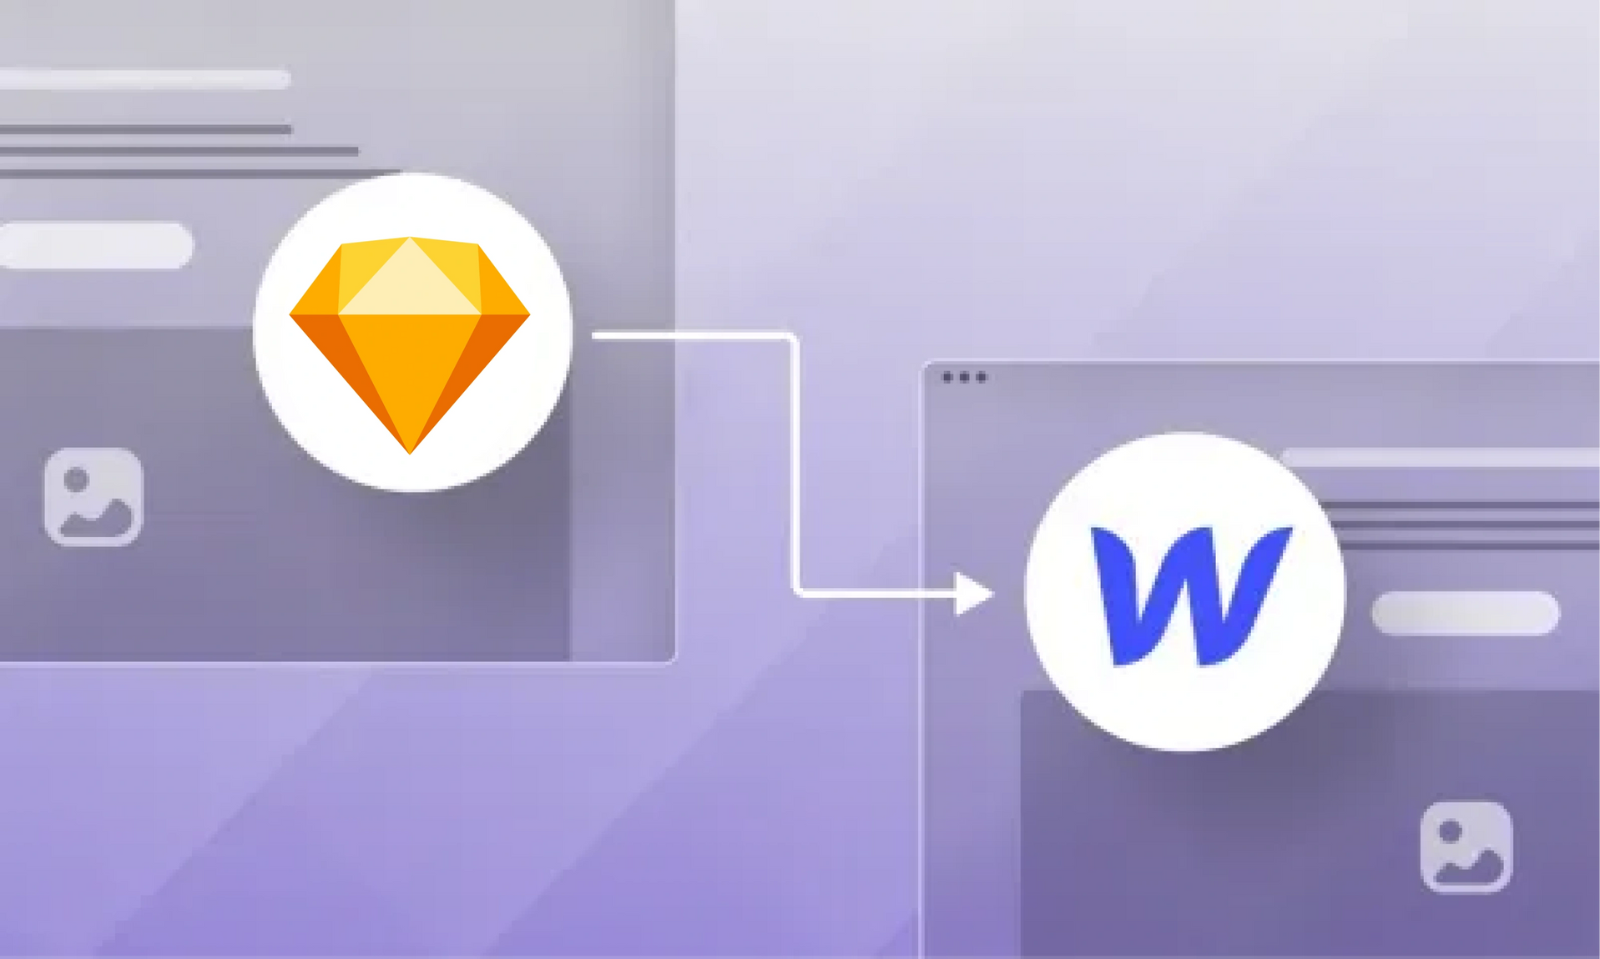
From color schemes to layout, custom web design ensures that every visual element aligns with your brand’s identity.
An innovative approach to web design combines both aesthetics and functionality.
www.quorawebsolution.com

Slide 6
A beautifully designed site that is difficult to navigate will only frustrate visitors, while a functional site with outdated design can lead to disengagement. The right balance ensures your website delivers a seamless user experience (UX) that keeps visitors engaged and encourages conversions.
Web Development that Powers Performance
Web development goes beyond design—it involves the technical aspects that make your website run smoothly. In today’s digital landscape, users expect fast load times, mobile responsiveness, and high performance. Slow websites are not only frustrating but can also negatively impact your search engine ranking.
To meet these demands, innovative web development solutions focus on optimizing the backend architecture, ensuring scalability, and integrating cutting-edge technologies.
www.quorawebsolution.com

Slide 7
Whether it’s adopting content management systems (CMS) like WordPress or custom development using frameworks like React or Angular, the goal is to build a platform that can adapt to future needs while ensuring a smooth experience for users.
Mobile-First and Responsive Design
With more people accessing websites through their mobile devices than ever before, mobile-first design has become essential. This approach prioritizes the mobile experience and ensures that your website is fully responsive across all devices, including smartphones, tablets, and desktops. A responsive website adapts its layout, content, and images according to the screen size, ensuring that users enjoy a consistent and seamless experience regardless of their device.
Google also places significant emphasis on mobile-friendly websites when determining search rankings.
www.quorawebsolution.com

Slide 8
Websites that perform well on mobile devices are more likely to rank higher in search results, which in turn can lead to increased visibility and higher traffic.
User-Centric Design and Development
The success of a website ultimately depends on the user experience. An innovative web design and development process must always keep the target audience in mind. A website that meets the needs and expectations of its visitors is more likely to convert visitors into customers.
User-centric design involves conducting research to understand your audience’s behavior, preferences, and pain points. By incorporating features like intuitive navigation, clear calls to action, fast load times, and engaging visuals, you create a website that is easy to use and provides a positive experience.
www.quorawebsolution.com

Slide 9
This can lead to longer visit durations, increased engagement, and higher conversion rates.
SEO and Digital Marketing Integration
A well-designed and developed website is only effective if people can find it. Integrating search engine optimization (SEO) best practices into the web design and development process is crucial for ensuring your site ranks well in search engines. SEO optimization involves optimizing elements like meta tags, headings, image alt text, and site speed—all of which contribute to higher visibility in search results.
Moreover, the integration of digital marketing strategies—such as content marketing, social media integration, and email marketing—can further enhance your website’s effectiveness in driving traffic and engagement. By aligning your website’s design and functionality with your marketing goals, you can create a powerful digital ecosystem that attracts, nurtures, and converts leads.
www.quorawebsolution.com

Slide 10
The Power of Innovation in Web Development
Innovation is at the heart of web development. As technology continues to evolve, new trends and tools emerge that can transform the way websites are designed and developed. From artificial intelligence (AI) and machine learning to voice search optimization and chatbots, staying ahead of the curve allows businesses to provide a futuristic, cutting-edge experience for their customers.
Conclusion
In a competitive digital landscape, investing in innovative web design and development solutions that are tailored to your brand’s unique needs is essential for standing out and succeeding. A custom, user-centric approach ensures that your website not only looks great but functions flawlessly, providing a seamless and engaging experience for visitors.
www.quorawebsolution.com

Slide 11
By embracing innovation, focusing on mobile responsiveness, optimizing for SEO, and integrating digital marketing strategies, you can create a website that elevates your brand and drives tangible results.
A powerful digital experience is no longer a luxury—it’s a necessity for businesses that want to thrive in today’s digital-first world.
Unlock the Full Potential of Your Brand with Professional Web Design and Development Services Crafted for Maximum Impact and User Engagement
www.quorawebsolution.com

Slide 12
In the digital age, your website is more than just a page on the internet—it’s a vital component of your brand’s identity. A well-designed and developed website not only reflects your business values but also acts as a powerful tool to attract, engage, and convert visitors. Professional web design and development services can help unlock your brand’s full potential by creating a digital presence that captivates and motivates action.
The Importance of Professional Web Design
A website is the first impression many potential customers will have of your business. Professional web design ensures that this first impression is striking, user-friendly, and memorable. From choosing the right color schemes and typography to structuring your website for intuitive navigation, expert design enhances your brand’s image and fosters trust with visitors.
Seamless User Experience
www.quorawebsolution.com

Slide 13
A key focus of professional web design and development is delivering a seamless user experience (UX). Users expect websites to be fast, responsive, and easy to navigate. By employing the latest technologies and UX principles, a professional web design service ensures that your website is not only visually appealing but also functional across all devices, from desktop to mobile.
Optimized for Performance and SEO
An attractive website is important, but it needs to perform well too. Professional web developers optimize site speed, ensure smooth functionality, and integrate search engine optimization (SEO) best practices. SEO-friendly web development helps improve your website’s visibility, making it easier for customers to find you online.
www.quorawebsolution.com

Slide 14
Fast load times and mobile responsiveness are key factors in enhancing both user experience and search engine rankings.
Tailored to Your Brand
Every brand is unique, and so should be your website. Professional web design and development services craft custom solutions that align with your brand’s identity and goals. Whether you need e-commerce functionality, a portfolio, or a simple informational site, your website will be tailored to meet your specific needs and speak directly to your audience.
www.quorawebsolution.com

Slide 15
Maximizing Engagement
A website that is both engaging and easy to navigate encourages visitors to stay longer and explore more. Interactive elements, clear calls to action, and an intuitive user journey are critical to keeping users engaged. The goal is to drive conversions, whether that’s signing up for a newsletter, purchasing a product, or getting in touch with your team.
Conclusion
Unlocking the full potential of your brand starts with a website that works for you. With professional web design and development services, you can create an online presence that not only looks great but also functions seamlessly, engages users, and drives results. By investing in the right website, you’re setting the stage for increased visibility, customer engagement, and long-term business success.
www.quorawebsolution.com

Slide 16
Quora Web Solution: Quora Web Solution is a trusted website development company based in Bangalore, India, offering a wide array of services to not only domestic but global clientele. Be it Website Design and Development, SEO services, Digital Marketing, Branding, App Development, Ecommerce Solution, and Logo Creation . Quora Web Solution has the best website developers offering top quality services and that is the reason why we are well known as one of the best Website Development Companies in Bangalore, India.
Visit Us - www.quorawebsolution.com
Call Us - +91 9986 056 909
Mail Us - info@quorawebsolutions.com
www.quorawebsolution.com

Slide 17

WORDPRESS DEVELOPMENT
ECOMMERCE DEVELOPMENT
PHP DEVELOPMENT
CMS DEVELOPMENT
DRUPAL DEVELOPMENT
WEBSITE SERVICES
WEBPORTAL DEVELOPMENT
MAGENTO DEVELOPMENT
WEBSITE DEVELOPMENT
JOOMLA DEVELOPMENT
SMALL BUSINESS DEVELOPMENT
CHEAP WEBSITE DEVELOPMENT
STATIC WEBSITE DEVELOPMENT
DYNAMIC WEBSITE DEVELOPMENT
WEBSITE DESIGN COMPANY
TOUR AND TRAVEL WEBSITE DEVELOPMENT
Services

