Slide 1


Quora Web Solution
Website Design and
Development
Company
Web Design & Web Development
Company in Bangalore, India
www.quorawebsolution.com
+91 9986 056 909
info@quorawebsolutions.com
24A, 1st Main Rd, Chandra Reddy
Layout, Koramangala 4th Block,
Koramangala, Bengaluru,
Karnataka 560034

Slide 2
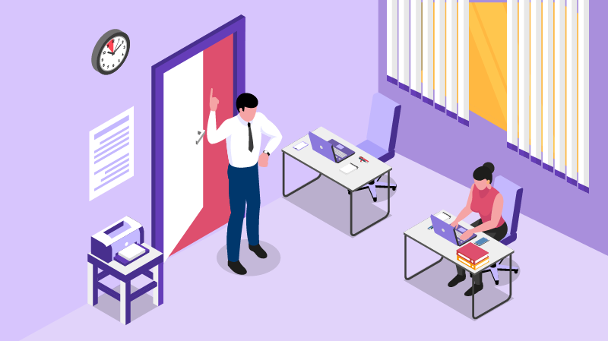
Everything You Need to Know About the Collaboration Process with a Website Design and Development Company
Building a successful website requires a well-organized collaboration with a professional website design and development company. Here’s a breakdown of the key stages involved:
1. Initial Consultation: Defining Goals and Needs
www.quorawebsolution.com

Slide 3

This is where you discuss your objectives, target audience, brand identity, and project scope. It’s crucial to set clear expectations regarding budget, timeline, and functionality.
2. Discovery & Research: Laying the Foundation
www.quorawebsolution.com

Slide 4
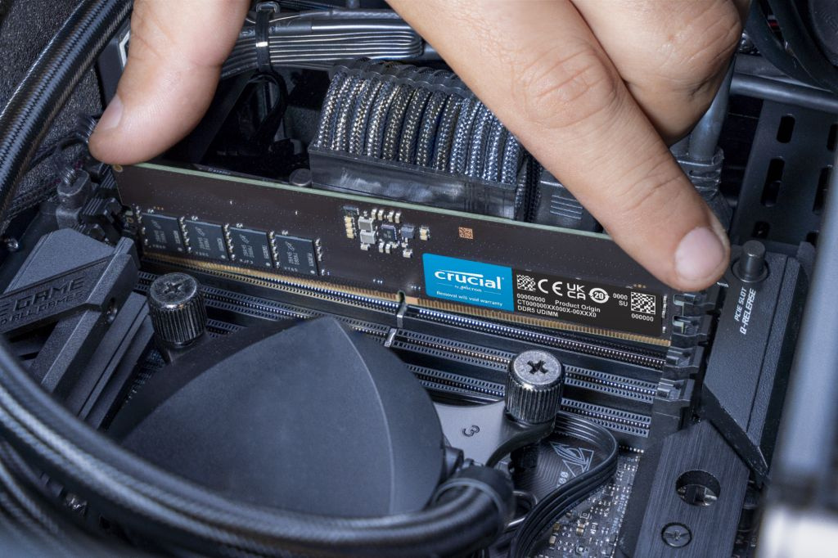
The company researches your industry, competitors, and audience to gather insights that will shape your website’s design and functionality. This ensures the final product meets user needs and stands out in the market.
3. Design Phase: Crafting Your Website’s Look
www.quorawebsolution.com

Slide 5

The design team creates wireframes and mockups, presenting you with the structure and aesthetic of your website. This is a collaborative phase where you provide feedback on layout, visuals, and branding.
4. Development Phase: Turning Design into Functionality
www.quorawebsolution.com

Slide 6
Once the design is approved, developers build the site, focusing on both the front-end (user interface) and back-end (functionality). This phase includes coding, integration, and ensuring the site is responsive across devices.
5. Testing & QA: Ensuring a Flawless Launch
Before going live, thorough testing checks for bugs, performance issues, and cross-browser compatibility. Usability testing ensures the site is intuitive and user-friendly.
6. Launch: Going Live
After final adjustments, your website is launched. It’s hosted, connected to your domain, and optimized for SEO to ensure it ranks well in search engines.
www.quorawebsolution.com

Slide 7
7. Post-Launch Support: Keeping the Site Running Smoothly
Once live, ongoing maintenance is crucial for updates, security, and performance monitoring. Your web development team should be available for any needed tweaks or improvements.
From Concept to Launch: Understanding the Website Design and Development Process with Experts
Creating a successful website involves several key stages, each of which requires expert attention.
www.quorawebsolution.com

Slide 8
Here’s a quick overview of the process:
1. Conceptualization: Defining Your Goals
The journey starts by defining the website’s purpose, target audience, and key features. Understanding these core elements guides the design and development process.
2. Research & Planning: Laying the Foundation
The team conducts market research, analyzes competitors, and creates a site map to plan the website’s structure and functionality. They also choose the most suitable technology stack for your project.
3. Design Phase: Turning Ideas into Visuals
Designers create wireframes, mockups, and prototypes to visualize your website.
www.quorawebsolution.com

Slide 9
This phase focuses on both the look (UI) and user experience (UX), ensuring a seamless, engaging design.
4. Development Phase: Building the Website
The development team turns the design into a working site. Front-end development handles the visual elements, while back-end development builds the functionality. The site is also made mobile-friendly.
5. Testing & Quality Assurance: Ensuring Quality
Before launch, the site undergoes testing for functionality, performance, cross-browser compatibility, and security. This ensures a bug-free, user-friendly website.
6. Launch: Going Live
www.quorawebsolution.com

Slide 10
The website is deployed to a live server, linked to your domain, and optimized for SEO. After launch, the team monitors performance to ensure everything runs smoothly.
7. Post-Launch Support: Ongoing Maintenance
After the site is live, ongoing support ensures updates, security patches, and content additions are handled. Performance is regularly monitored to ensure the site stays fresh and up-to-date.
Final Thoughts
www.quorawebsolution.com

Slide 11
From concept to launch, the website design and development process requires collaboration with experts at every step. By following a structured approach, you ensure your website is not only visually appealing but also functional and user-friendly.
www.quorawebsolution.com

Slide 12
Quora Web Solution: Quora Web Solution is a trusted website development company based in Bangalore, India, offering a wide array of services to not only domestic but global clientele. Be it Website Design and Development, SEO services, Digital Marketing, Branding, App Development, Ecommerce Solution, and Logo Creation . Quora Web Solution has the best website developers offering top quality services and that is the reason why we are well known as one of the best Website Development Companies in Bangalore, India.
Visit Us - www.quorawebsolution.com
Call Us - +91 9986 056 909
Mail Us - info@quorawebsolutions.com
www.quorawebsolution.com

Slide 13

WORDPRESS DEVELOPMENT
ECOMMERCE DEVELOPMENT
PHP DEVELOPMENT
CMS DEVELOPMENT
DRUPAL DEVELOPMENT
WEBSITE SERVICES
WEBPORTAL DEVELOPMENT
MAGENTO DEVELOPMENT
WEBSITE DEVELOPMENT
JOOMLA DEVELOPMENT
SMALL BUSINESS DEVELOPMENT
CHEAP WEBSITE DEVELOPMENT
STATIC WEBSITE DEVELOPMENT
DYNAMIC WEBSITE DEVELOPMENT
WEBSITE DESIGN COMPANY
TOUR AND TRAVEL WEBSITE DEVELOPMENT
Services

