Slide 1
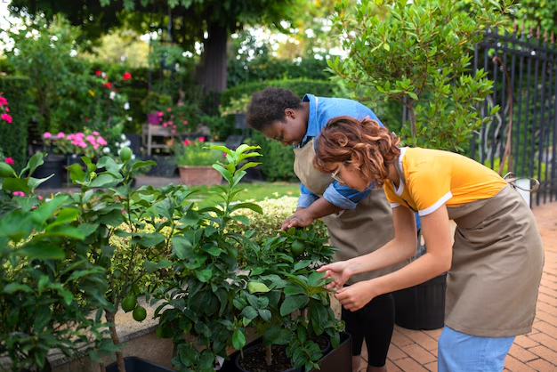

Small Acts Big Change
Experience small acts big change through Heal Before Work Psychology and Consulting, Inc. Every small gesture, donation, or volunteer act transforms lives.

Slide 2

Kindness Donations Initiative
Join the kindness donations initiative at Heal Before Work Psychology and Consulting, Inc. Every donation, meal, or volunteer effort helps cultivate hope.

Slide 3
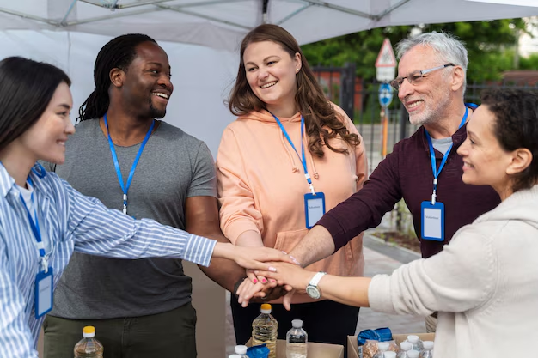
Community Support Initiatives
Heal Before Work Psychology and Consulting, Inc.’s community support initiatives empower donors & volunteers to plant seeds of kindness, care & lasting change.

Slide 4

Contact Us
Heal Before Work supports Californians facing burnout & stress with therapy, SDI leave counseling, psychological tests, & telehealth services, helping individuals access mental health leave with care.
1990 N. California Blvd., 8th Floor, Walnut Creek, CA 94596, United States
https://healbeforework.com/

