Slide 1

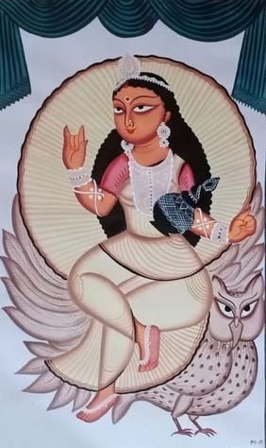
Folk Art Paintings on Mojarto
https://www.mojarto.com/

Slide 2

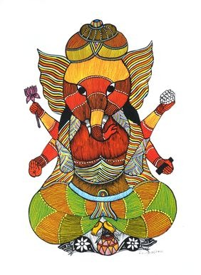
ABOUT US
About Mojarto
India’s leading online art platform since 2005
Offers original art, curated collections & artist stories
Dedicated section for folk art paintings featuring traditional and contemporary works
https://www.mojarto.com/

Slide 3

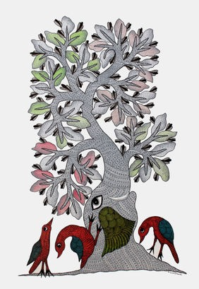
What Are Folk Art Paintings?
Expressions of India’s regional traditions & stories
Popular styles on Mojarto:
Gond – Nature & mythology with dots/patterns
Bhil – Mythical tales, tribal traditions
Kalighat – Bold, urban folk with humor
Madhubani & Warli – Ancient motifs & daily life depictions
https://www.mojarto.com/

Slide 4

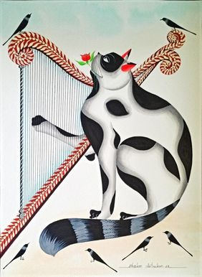
Featured Folk Artworks
Gond Painting by Vijay Ukey – Vibrant tribal storytelling
Bhil Painting by Bhuri Bai – Mythology in bright colors
Red Tiger! by Manoj Kumar Tekam – Gond patterns with modern flair
Kalighat Cat by Bhaskar Chitrakar – Whimsical Kalighat patachitra
https://www.mojarto.com/

Slide 5

Our Address
CONTACT US
No 123, Sterling Rd, Nungambakkam,
Chennai, Tamil Nadu 600034
Our mail id
contactus@mojarto.com
https://www.mojarto.com/

Slide 6
Thank You
https://www.mojarto.com/

