Slide 1

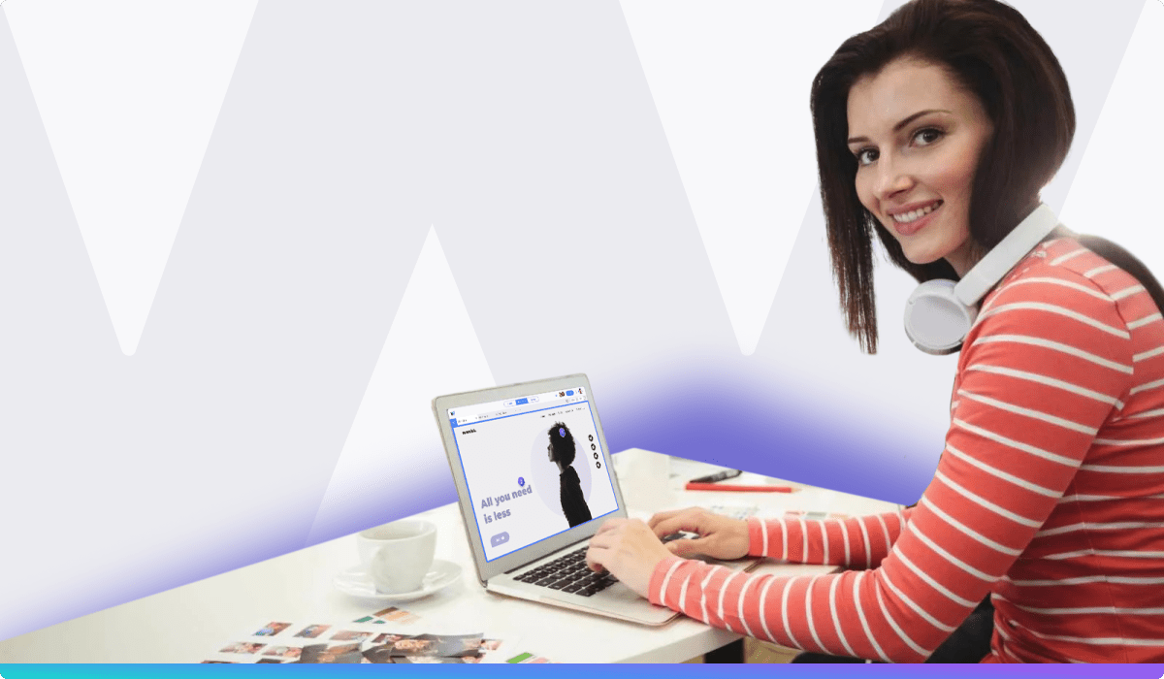
Quora Web Solution
Website Design and
Development
Company
Web Design & Web Development
Company in Bangalore, India
www.quorawebsolution.com
+91 9986 056 909
info@quorawebsolutions.com
24A, 1st Main Rd, Chandra Reddy
Layout, Koramangala 4th Block,
Koramangala, Bengaluru,
Karnataka 560034

Slide 2
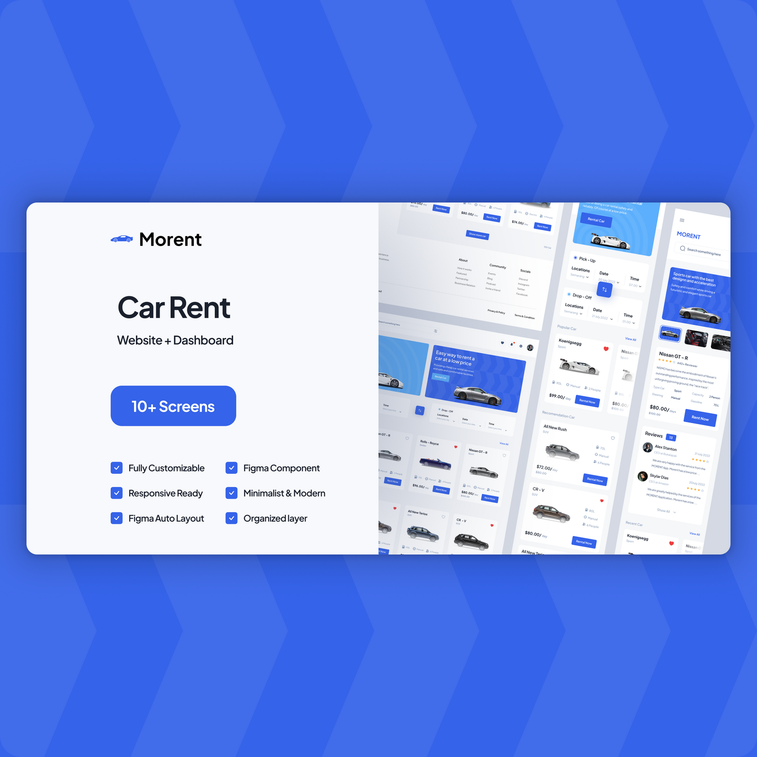
How to Collaborate with a Website Design and Development Company to Build a Mobile-Responsive Website
In today’s mobile-driven world, having a mobile-responsive website is crucial for providing a seamless experience to users on smartphones and tablets. Collaborating with a skilled website design and development company is key to ensuring your website performs well across all devices.
www.quorawebsolution.com

Slide 3
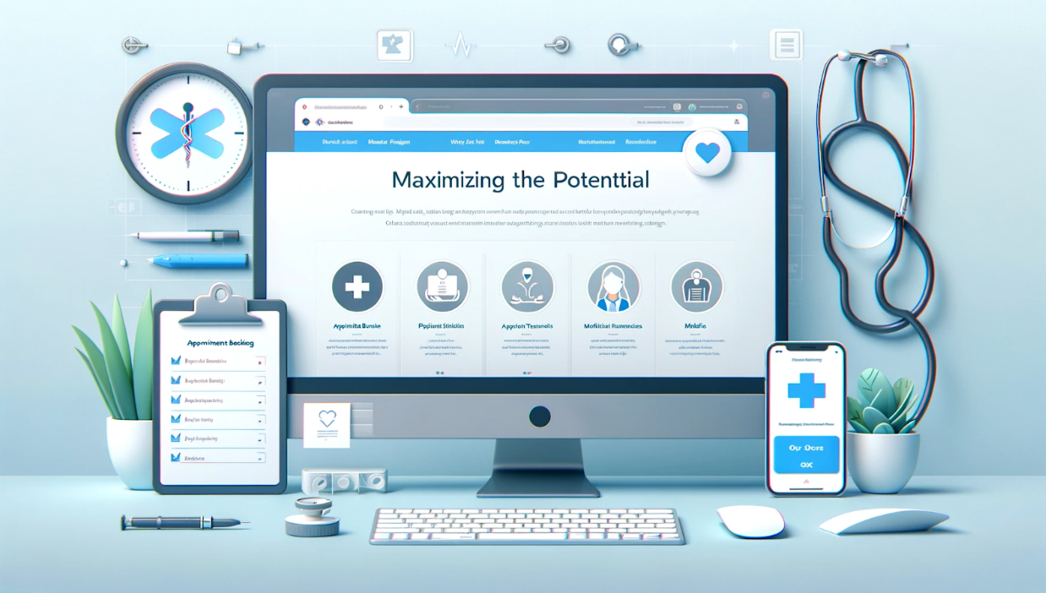
Here’s how you can effectively work together to achieve a responsive site.
1. Clarify Your Goals and Objectives
Start by defining your website’s goals. Do you want to improve user engagement, increase sales, or boost brand visibility? Discuss these objectives with your team so they can tailor the mobile-responsive design to meet your needs, focusing on speed, user-friendliness, and mobile-first design.
www.quorawebsolution.com

Slide 4

2. Choose the Right Design and Development Team
Look for a company with expertise in mobile-responsive web design. They should be experienced in creating websites that automatically adjust to any screen size, ensuring that your site performs well on both mobile and desktop devices.
www.quorawebsolution.com

Slide 5

3. Focus on User Experience (UX)
Mobile users interact differently than desktop users. Your design team should prioritize intuitive navigation, thumb-friendly buttons, and fast load times. Discuss the specific features you want to include, such as mobile-friendly forms, easy-to-navigate menus, and touch-friendly design elements.
4. Optimize Content for Mobile
www.quorawebsolution.com

Slide 6
Content needs to be mobile-friendly. Work with your design team to simplify text, optimize images, and ensure videos are scalable for small screens. This will help users easily consume content on mobile devices without long load times or unnecessary scrolling.
5. Ensure Performance Optimization
Mobile users expect fast-loading sites. Your development team should optimize images, minimize HTTP requests, and use lazy loading techniques to improve performance. Test the site’s speed and functionality regularly to address any issues early.
6. Test Across Devices
Once the website is designed, conduct thorough testing across different devices and browsers to ensure everything works as expected.
www.quorawebsolution.com

Slide 7
Check for any display issues, broken links, or usability problems on mobile devices.
7. Post-Launch Monitoring and Optimization
After the site is live, continue to monitor its performance. Use tools like Google Analytics to track user behavior and identify any areas for improvement. Regular updates and tweaks will ensure the site remains mobile-optimized as new devices and software updates are released.
Conclusion
Building a mobile-responsive website is a collaborative process that requires clear communication with your website design and development team.
www.quorawebsolution.com

Slide 8
By focusing on user experience, optimizing performance, and testing across devices, you’ll ensure that your website provides a smooth, engaging experience for all visitors, whether they’re on a desktop, smartphone, or tablet.
Behind the Scenes: How We Designed and Developed a Website That Doubled Our Client’s Revenue
In today’s fast-paced digital landscape, your website often serves as your brand’s primary touchpoint — and in many cases, the only opportunity to capture and retain a potential customer's attention.
www.quorawebsolution.com

Slide 9
At [Your Company Name], we believe that a website should do more than look good; it should drive real business results.
In this case study, we take you behind the scenes of one of our most successful projects — how we designed and developed a fully optimized website that doubled our client’s revenue within six months of launch.
The Client: A Mid-Sized E-Commerce Brand with Big Goals
Our client, a growing e-commerce business in the fashion industry, had a dated website that wasn’t keeping up with their increasing customer base. They were facing challenges including:
High bounce rates
Slow load speeds
www.quorawebsolution.com

Slide 10
Poor mobile experience
Outdated design that didn’t reflect their brand
Low conversion rates despite increasing traffic
They came to us with a simple request: "We need a website that converts."
Phase 1: Discovery and Strategy
We began with a deep-dive consultation to understand:
Their brand vision
Target audience behavior
Sales funnel weaknesses
SEO and content gaps
www.quorawebsolution.com

Slide 11
Competitor benchmarks
This phase also involved:
Analytics audits
Customer feedback analysis
Heatmap and session recording review
Key Insight: Most users dropped off before completing the checkout process due to confusing navigation and slow load times.
Phase 2: UX/UI Design with Conversion in Mind
Using the insights gathered, our design team created a modern, intuitive user interface that:
Highlighted bestsellers and new arrivals
Simplified the navigation with clear CTAs
www.quorawebsolution.com

Slide 12
Incorporated trust-building elements such as customer testimonials, star ratings, and satisfaction guarantees
Focused on mobile-first design principles
We ran A/B tests on key design components like hero banners, product page layouts, and checkout flows.
Result: The new design reduced bounce rates by 35% and improved average session duration by 42%.
Phase 3: Custom Development and Performance Optimization
Our developers built a custom site using [technology stack, e.g., React + Node.js or WordPress + WooCommerce], focusing on:
Clean, fast-loading code
SEO-friendly architecture
Scalable CMS for easy updates
Third-party integrations (CRM, inventory management, payment gateways)
www.quorawebsolution.com

Slide 13
We optimized:
Image sizes using next-gen formats
Lazy loading and caching
Code minification and CDN delivery
Site Speed Improvement: From 8.2 seconds to 2.1 seconds (Google PageSpeed Score: 94/100).
Phase 4: Launch and Post-Launch Optimization
The site went live after rigorous testing, including:
Mobile responsiveness checks
Browser compatibility testing
SEO migration planning
www.quorawebsolution.com

Slide 14
Implemented robust conversion tracking using tools like Google Analytics 4, Hotjar for behavior analysis, and the Meta Pixel for campaign performance monitoring
Post-launch, we:
Monitored performance daily
Implemented small tweaks based on live data
Ran email and ad campaigns to announce the relaunch
The Results: Revenue Growth and Beyond
Within 6 months of launch:
Revenue increased by 104%
www.quorawebsolution.com

Slide 15
Conversion rate improved by 67%
Cart abandonment dropped by 45%
Mobile sales grew by 89%
Most importantly, the client gained a future-ready digital platform that continues to scale with their business.
Conclusion: What This Means for Your Business
This success story isn’t unique — it’s a reflection of what’s possible when design, development, and strategy come together with a clear goal.
If you’re ready to stop leaving money on the table and build a website that works as hard as you do, let’s talk.
👉 [Schedule a free consultation with us today]
www.quorawebsolution.com

Slide 16
Quora Web Solution: Quora Web Solution is a trusted website development company based in Bangalore, India, offering a wide array of services to not only domestic but global clientele. Be it Website Design and Development, SEO services, Digital Marketing, Branding, App Development, Ecommerce Solution, and Logo Creation . Quora Web Solution has the best website developers offering top quality services and that is the reason why we are well known as one of the best Website Development Companies in Bangalore, India.
Visit Us - www.quorawebsolution.com
Call Us - +91 9986 056 909
Mail Us - info@quorawebsolutions.com
www.quorawebsolution.com

Slide 17

WORDPRESS DEVELOPMENT
ECOMMERCE DEVELOPMENT
PHP DEVELOPMENT
CMS DEVELOPMENT
DRUPAL DEVELOPMENT
WEBSITE SERVICES
WEBPORTAL DEVELOPMENT
MAGENTO DEVELOPMENT
WEBSITE DEVELOPMENT
JOOMLA DEVELOPMENT
SMALL BUSINESS DEVELOPMENT
CHEAP WEBSITE DEVELOPMENT
STATIC WEBSITE DEVELOPMENT
DYNAMIC WEBSITE DEVELOPMENT
WEBSITE DESIGN COMPANY
TOUR AND TRAVEL WEBSITE DEVELOPMENT
Services

