Slide 1
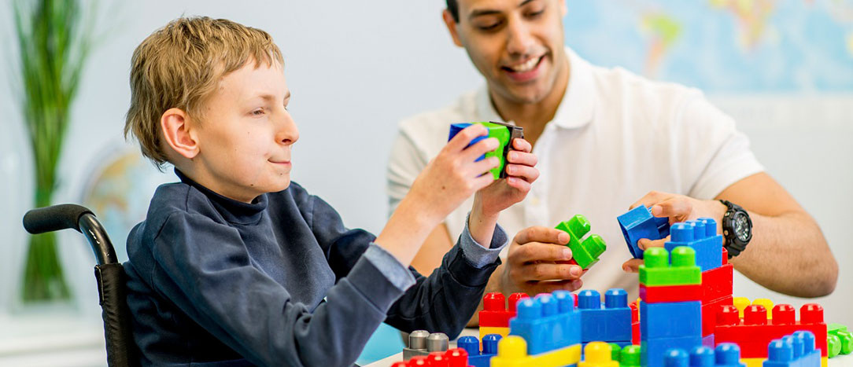


How the Pandemic is Affecting Kids with Special Needs?
Most children experienced a change in routines as their daily learning shifted from classroom experiences to remote learning.
www.cbstherapy.com

Slide 2
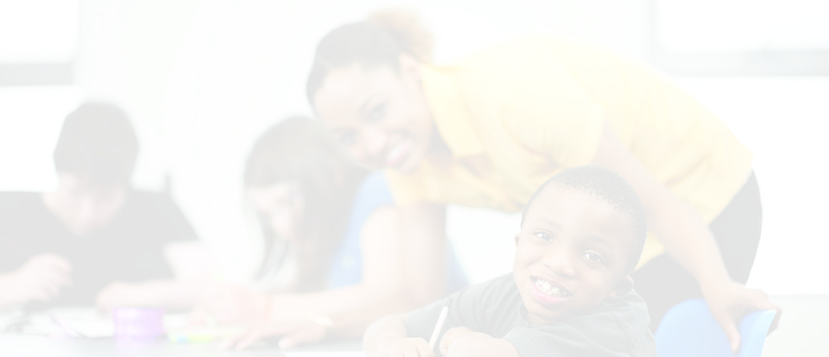
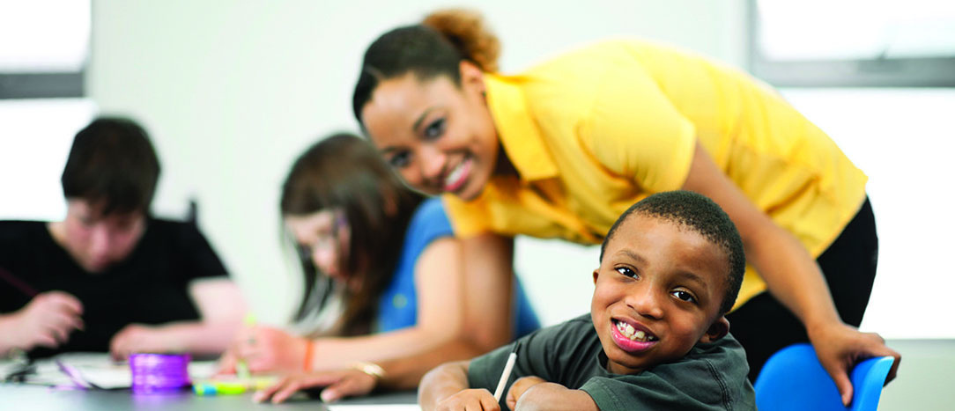
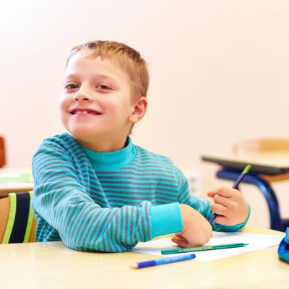

When schools shut down, and lockdowns became the “normal” around the world, it altered education opportunities for children of all ages. Most children experienced a change in routines as their daily learning shifted from classroom experiences to remote learning. While all students struggled through the changes, the most notable disruption is in the way special needs students were affected.

Slide 3
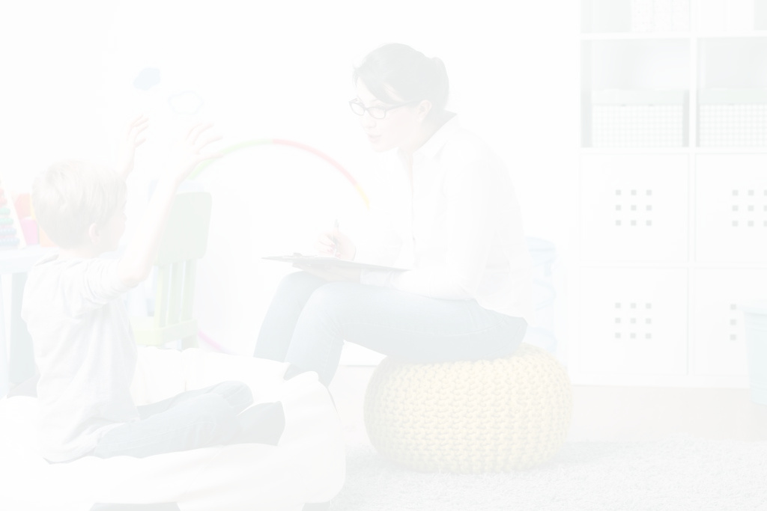

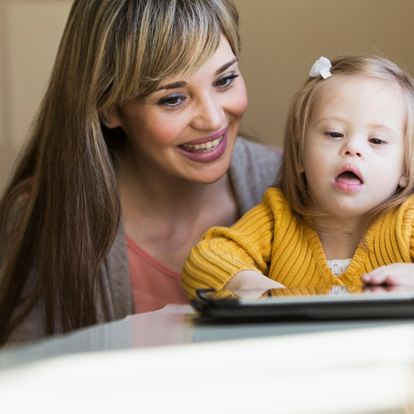
Amplifying the Inadequacies of the System
Pandemic life is stressful for all families, but the highest levels of stress are noted in families with special needs students. These children and their families depend on unique services and care to support daily needs. Not only are parents struggling with lost employment and lockdown-related challenges, but they also must supervise the child’s online school, therapies, and more.
When schools closed in the spring of 2020, the federal government required schools to maintain regulations, services, and timelines within the Individuals with Disabilities Education Act (IDEA). Even though there were no special education waivers, schools were unequipped to provide remote learning services for special needs students.

Slide 4



The challenges faced by the population as a whole were compounded for special needs students and their families. The longer education and medical services are limited, the more of an effect it has on the growth and well-being of the students.
Compounding Results for Special Needs Families
Students continue to miss essential medical appointments and services due to limited resources and support. Canceled therapy sessions are more than an inconvenience – the lack of support starts a domino effect that causes students to lose skills and fall behind even more than before.

Slide 5


Special Needs Students Thrive in Routine
Another notable impact the pandemic had on special needs students is how the lockdowns affected daily schedules. Previously, school attendance created the structure for daily routine. But the pandemic shifted more of the responsibility to parents, who found themselves struggling through the trial-and-error of finding what works at home.
In the past, parents could send their children to school and benefit from the ongoing supervision from teachers, school administrators, lunch and recess monitors, and more. COVID-19 moved these tasks back to the home, causing parents to wear more hats throughout the day. It goes without saying that working parents find it challenging to juggle employment, school, and the specialized physical/emotional care required for the child.

Slide 6
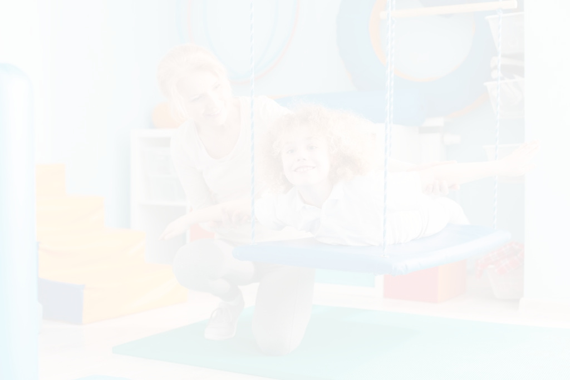

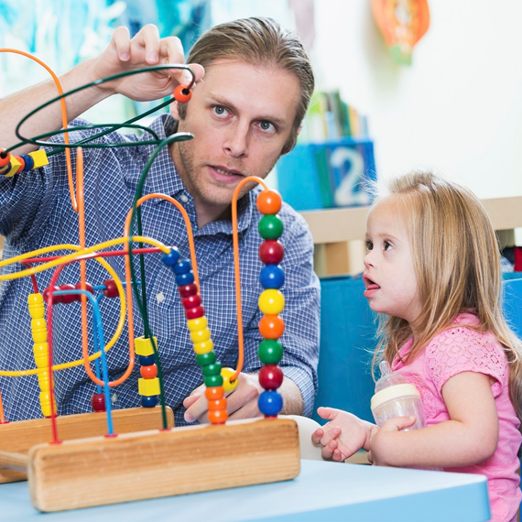
Backlog of Need in Special Education
By law, students with an IEP must have a newly written education plan each year. Additionally, each student is reevaluated every three years to determine eligibility in the special education program. But the COVID-19 quarantine resulted in little or no testing. This means that schools are now facing an unprecedented backlog in services and meetings. Schools are continuing to face the challenges of maintaining health and safety for students. Children with special needs are experiencing the consequences of not having access to free and appropriate public education.

Slide 7






Contact Us
401-270-9991
www.cbstherapy.com
peter@cbstherapy.com
845 North Main Street, Providence, Rhode Island, USA 02904

