Slide 1



Precision Property Surveys for Fence Installation
Ensuring your new fence is perfectly placed requires more than just measuring tape. A professional property survey identifies exact boundaries, prevents disputes, and ensures compliance, giving you peace of mind.

Slide 2




Why Property Line Surveys Matter
A property survey for a fence is an essential investment for any homeowner considering fence installation. It precisely defines your property's corners and lot lines, eliminating guesswork and preventing costly mistakes.
Define Boundaries
These surveys detect existing trespassing or encroachments early, allowing for resolution before construction begins. Crucially, they provide legal documentation that protects your ownership rights and serves as an official record for future reference or disputes.
Pinpoints exact property corners and lot lines.
Detect Issues
Identifies trespassing or encroachments.
Legal Protection
Provides essential legal documentation.

Slide 3

RealMapInfo LLC: Your Trusted Land Surveyors in MA
Decades of Expertise
Over 50 years of combined experience as a family-owned business.
Licensed Professionals
All projects overseen by Licensed Professional Land Surveyors (P.L.S.).
Extensive Coverage
Proudly serving Middlesex, Norfolk, Essex, Plymouth, and Worcester counties.

Slide 4




Our Precision Survey Process for Fence Projects
Advanced Technology
Permanent Markers
Utilizing state-of-the-art GPS and total station technology.
Placing durable markers at all property corners.
Precise Staking
Detailed Records
Stakes set along lot lines for accurate fence stringing.
Delivery of a comprehensive 'Record of Survey' plot plan.

Slide 5



Key Benefits of Professional Surveying
2 Weeks
24 Hours
Quick Turnaround
Free Estimates
Projects typically completed within two weeks from initial contact.
Receive a detailed, no-obligation estimate within one day.
Smooth Permitting
Protect Value
Streamlined Approvals
Asset Protection
Helps expedite permitting and zoning processes, avoiding delays.
Safeguards your property value and owner rights for years to come.

Slide 6
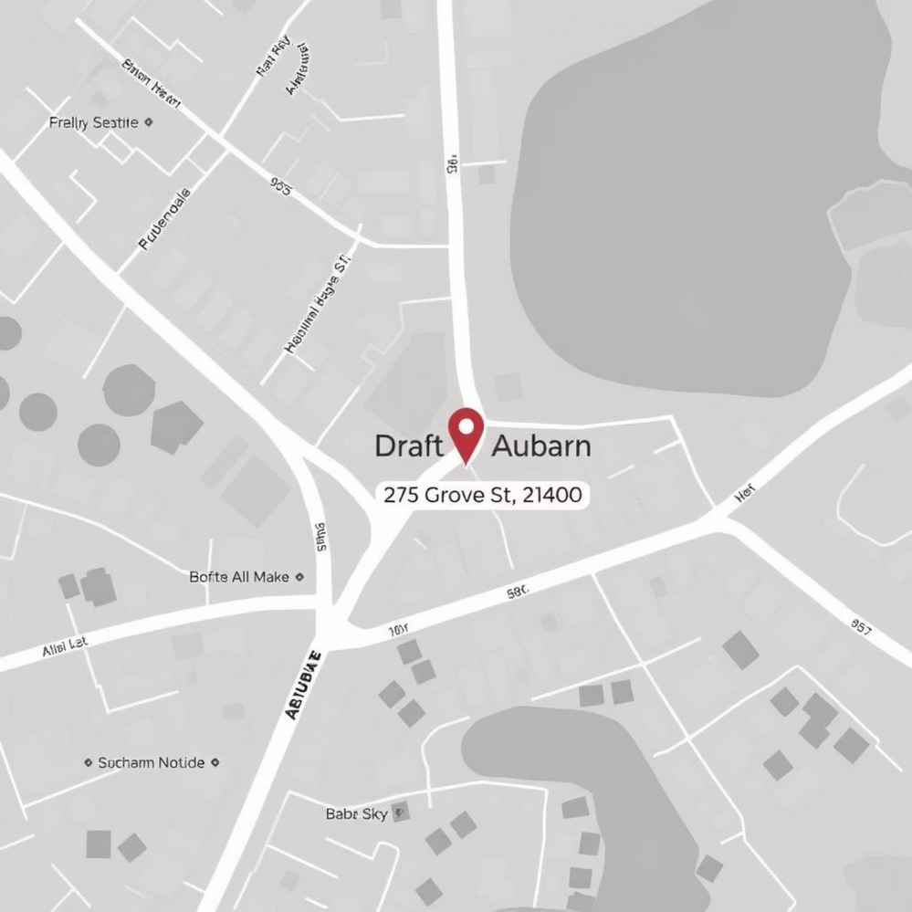
Contact RealMapInfo LLC Today
Ready to ensure your fence project is built on solid ground? Contact RealMapInfo LLC for reliable and precise property surveying services. We're here to help you protect your investment.
  Location: 275 Grove St #2400, Auburndale, MA 02466, United States
  Phone: (508) 318-1399
  Email: info@realmapinfo.com
  Website: realmapinfo.com
  Service Area: Greater Boston and surrounding areas

