Slide 1

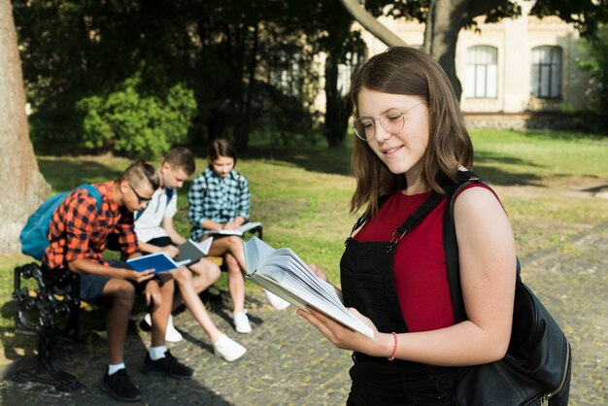
Appropriate Public Education Berks County
Jacobson & John LLP fights for your right to an appropriate public education in Berks County ensuring student success. Contact us for a free consultation now.

Slide 2

Student Discrimination
Jacobson & John, LLP defends your rights against unfair student discrimination in colleges and universities. Schedule a free consultation with our team now.

Slide 3
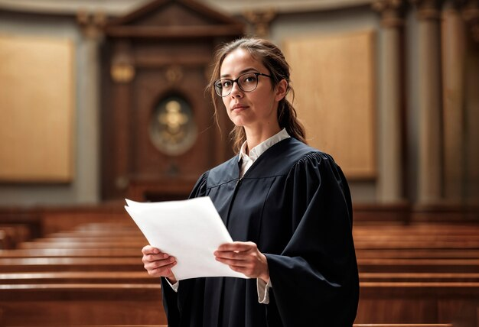
Student Rights Lawyer
Hire an experienced student rights lawyer from Jacobson & John LLP to defend against discrimination and misconduct allegations. Contact us for help now.

Slide 4
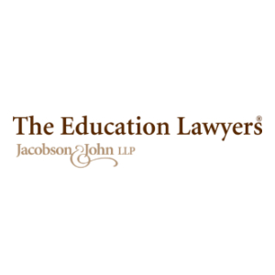


Contact Us
At Jacobson & John, we fight for students with disabilities across Pennsylvania. With decades of education law experience, we deliver trusted, compassionate, and effective legal advocacy.
https://theeducationlawyers.com/
99 Lantern Drive Suite 202 Doylestown, Pennsylvania 18901 United States

