Slide 1


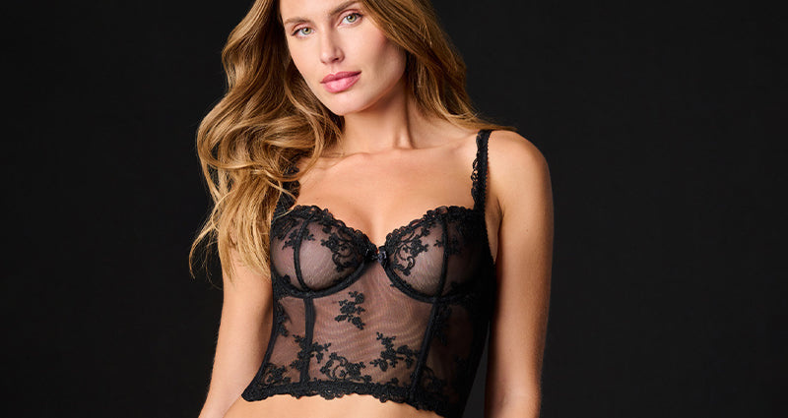
Strapless Corset Bra
Explore the perfect fit of our strapless corset bra that offers support without straps, creating a smooth, elegant look for any special event or daily wear.

Slide 2
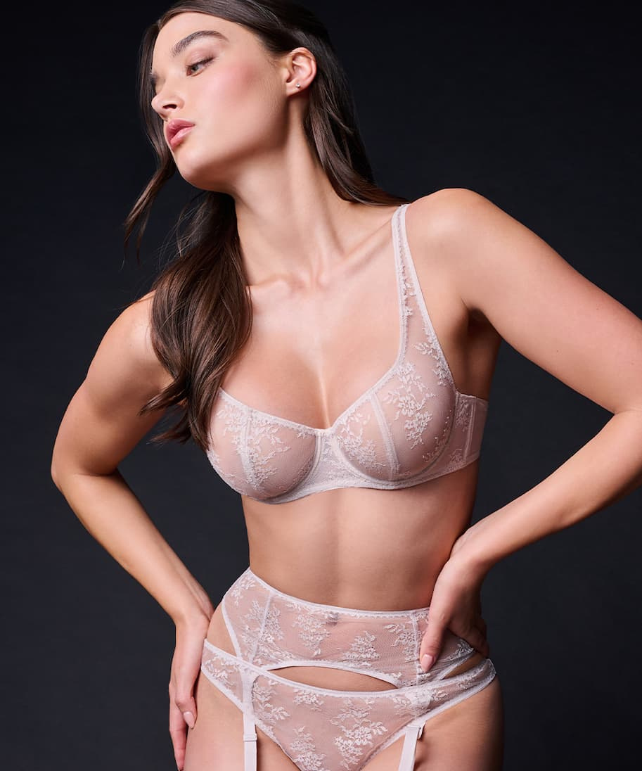
Sexy Garter Lingerie
Unlock confidence with our top-notch sexy garter lingerie made from delicate lace and satin to add a touch of glamour and make you feel stunning and empowered.

Slide 3

Balconette Style Bra
Bring out your beauty with balconette style bra designed to lift and shape, giving a flattering silhouette and complementing your favorite outfits with ease.

Slide 4
Contact Us
Journelle is your destination for luxurious lingerie that combines confidence, comfort, and elegance. Explore curated collections featuring top designer brands, perfect for every occasion.
Address :- United States
https://www.journelle.com/

Slide 5

THANK
YOU
https://www.journelle.com/

