Slide 1
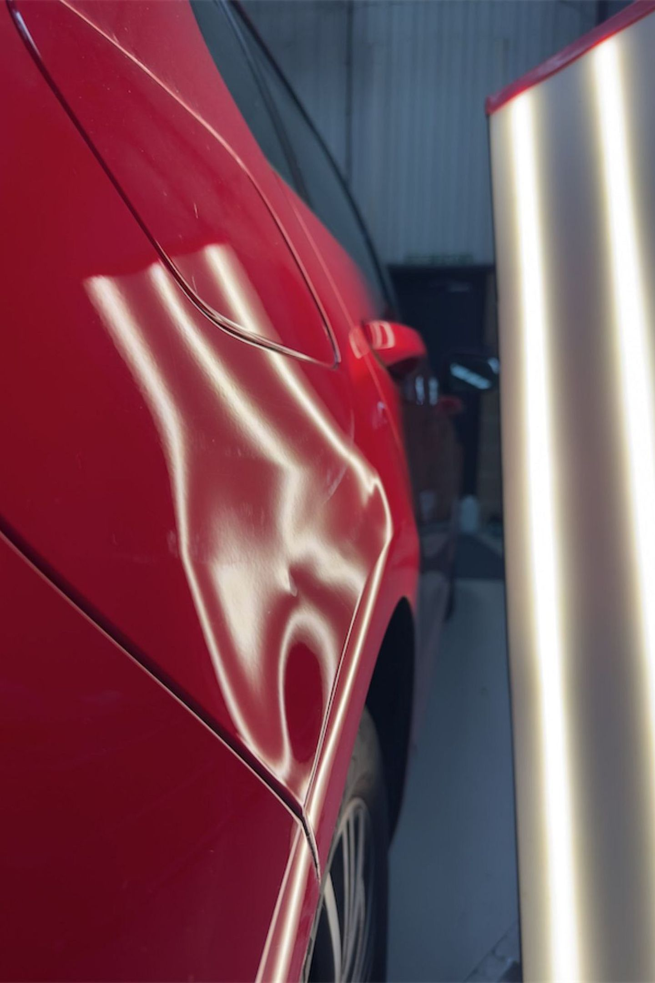

PDR Peterborough for Professional Paintless Dent Repair
A small dent can be surprisingly frustrating. Your car may be in great condition, yet one parking knock or careless door can leave a mark that catches your eye every time you walk past it. If you are looking for PDR Peterborough, Precision PDR provides specialist paintless dent repair for suitable vehicle damage, helping restore panels without unnecessary repainting.

Slide 2
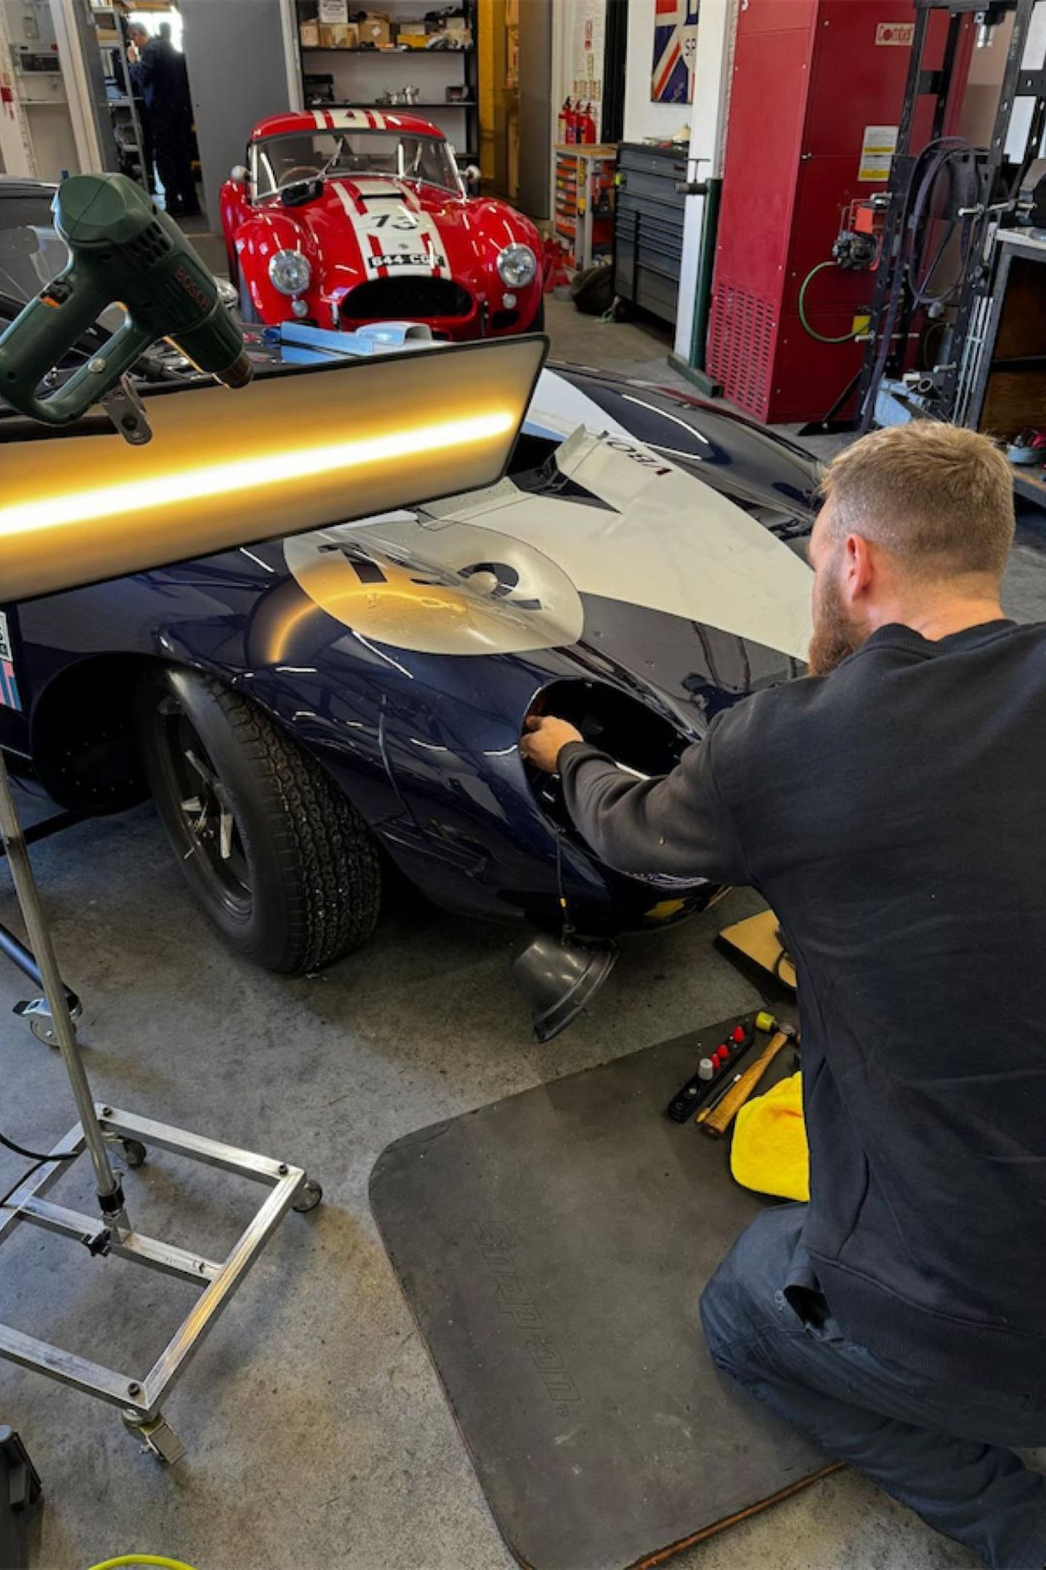
Restore Your Car Without Traditional Bodywork
Paintless dent repair is a practical option for many dents where the original paint is still intact. Rather than filling, sanding, and repainting the panel, a skilled technician carefully works the damaged metal back towards its original shape using specialist tools.
Here's the thing. Every dent is different. Its size, depth, position, and access to the damaged area all matter. A proper inspection helps determine whether PDR is the right approach for your vehicle.

Slide 3
Repairs for Everyday Dents
Common Dent Types
A Simpler Alternative
Parking dings, small dents, pin dents, creases, and styling line damage can all affect the appearance of your car. Precision PDR works with a wide range of suitable dent repairs and can also assess larger damage to see whether it can be restored using specialist techniques.
There's no need to assume that every dent requires a full body shop repair. In many cases, a professional PDR assessment can provide a simpler alternative.

Slide 4
Save Time and Reduce Disruption
Traditional body repairs can involve several stages, including preparation, filling, painting, and drying. For suitable dents, PDR can avoid many of these steps, making the repair process more efficient. Precision PDR also offers mobile dent repair, allowing suitable repairs to be carried out at your home or workplace.
That can be especially useful when you have a busy schedule and don't want to spend unnecessary time at a repair centre.
Efficient Process
Mobile Dent Repair
Less Disruption

Slide 5
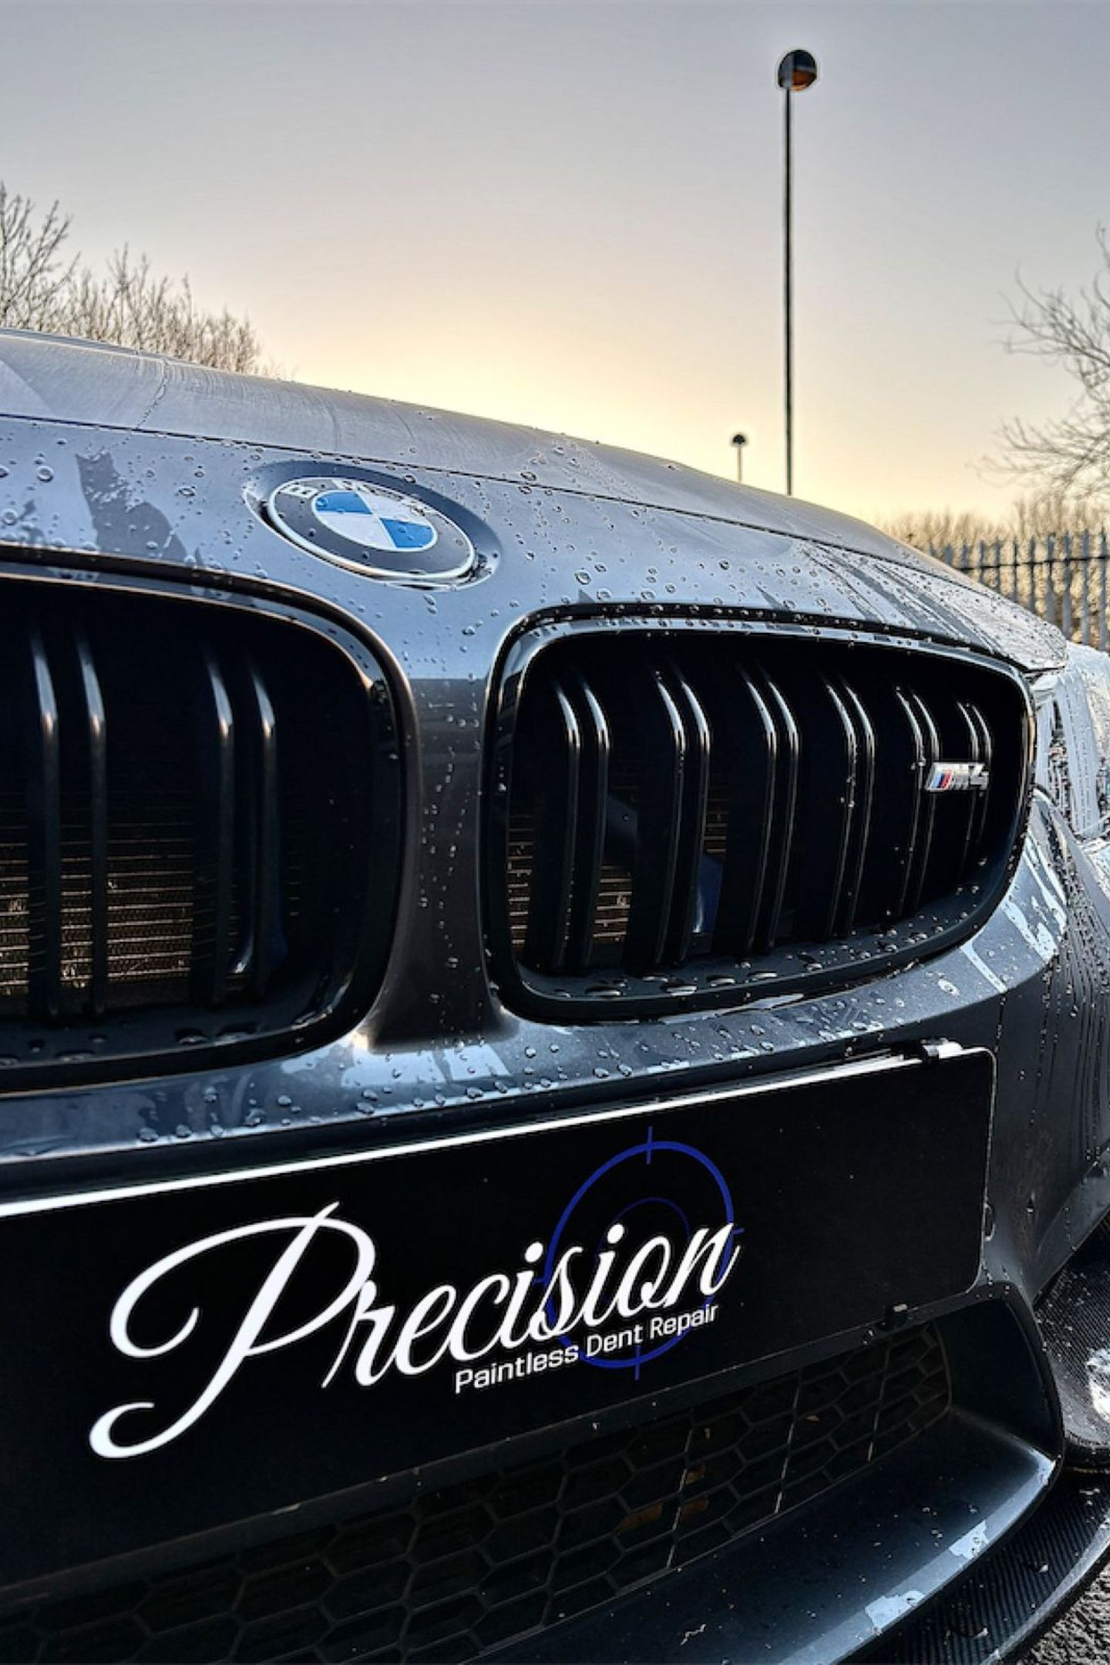
Experienced Technicians You Can Trust
Good PDR requires more than specialist tools. Experience, patience, and attention to detail are all essential. Precision PDR has more than 15 years of industry experience and provides professional dent repair with a focus on careful workmanship.
The team assesses each repair individually before work begins. This helps ensure the recommended method is appropriate for the damage and the vehicle.
15+
Years of Experience

Slide 6
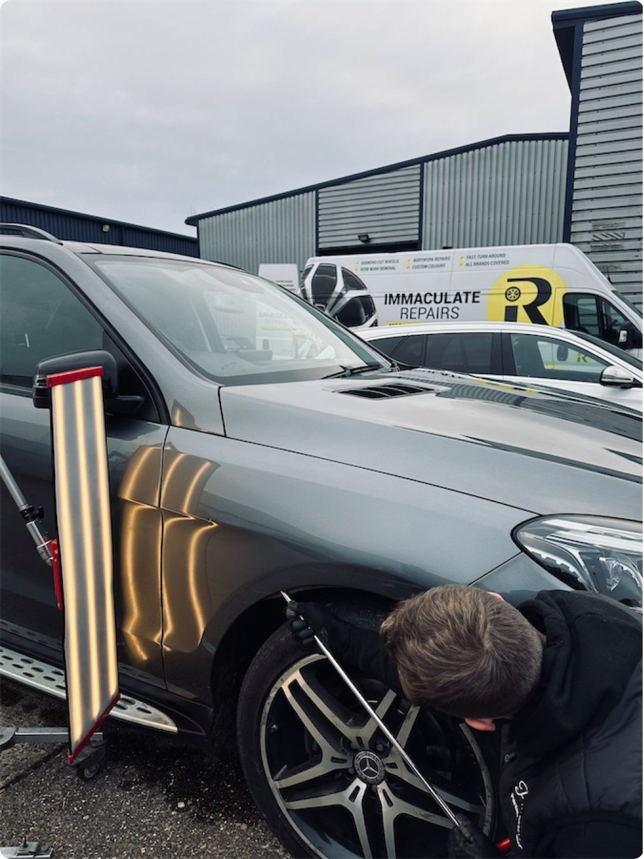
PDR for Different Types of Vehicles
Paintless dent repair can be suitable for many makes and models, from everyday family cars to higher value vehicles. Precision PDR also works with electric and hybrid vehicles and is IMI qualified and Tech Safe certified for EV and hybrid repairs.
Whether you have a single door ding or several minor dents, getting professional advice can help you understand what can realistically be repaired.

Slide 7

Choose Precision PDR in Peterborough
If an unwanted dent is spoiling the look of your car, PDR Peterborough could be the solution you have been looking for. Precision PDR combines specialist equipment, experienced technicians, and careful repair techniques to restore suitable dents while protecting the original finish.
Contact Precision PDR to discuss your vehicle damage and find out whether paintless dent repair is suitable for your car.
Phone
Email
Location
07514708118
info@precisionpdr.co.uk
Peterborough, Cambridgeshire, England, United Kingdom PE1 1AB 52.5703° N, 0.2408° W
Opening Hours
Wednesday | 8 am–5:30 pm
Thursday | 8 am–5:30 pm
Friday | 8 am–5:30 pm
Saturday | Closed
Sunday | Closed
Monday | 8 am–5:30 pm
Tuesday | 8 am–5:30 pm

