Slide 1


Quora Web Solution
Website Design and
Development
Company
Web Design & Web Development
Company in Bangalore, India
www.quorawebsolution.com
+91 9986 056 909
info@quorawebsolutions.com
24A, 1st Main Rd, Chandra Reddy
Layout, Koramangala 4th Block,
Koramangala, Bengaluru,
Karnataka 560034

Slide 2

From Concept to Launch: The Complete Workflow of a Professional Website Design and Development Company
In today’s hyper-connected world, a company’s website often serves as the first point of contact with its customers.
www.quorawebsolution.com

Slide 3
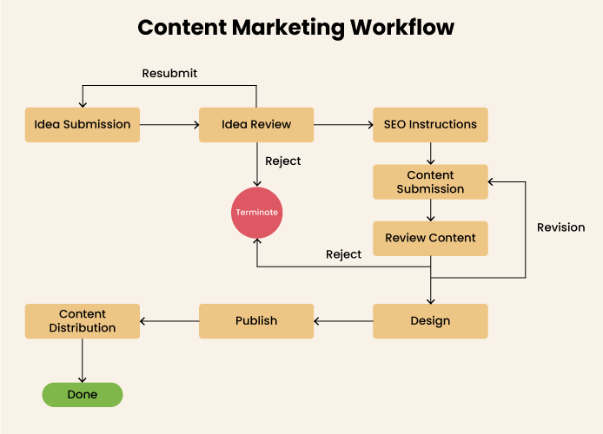
It’s more than just an online brochure—it’s your digital storefront, sales platform, and brand identity rolled into one. But creating a powerful, professional website doesn’t happen overnight. It requires a strategic, step-by-step approach handled by experienced website design and development companies.
www.quorawebsolution.com

Slide 4
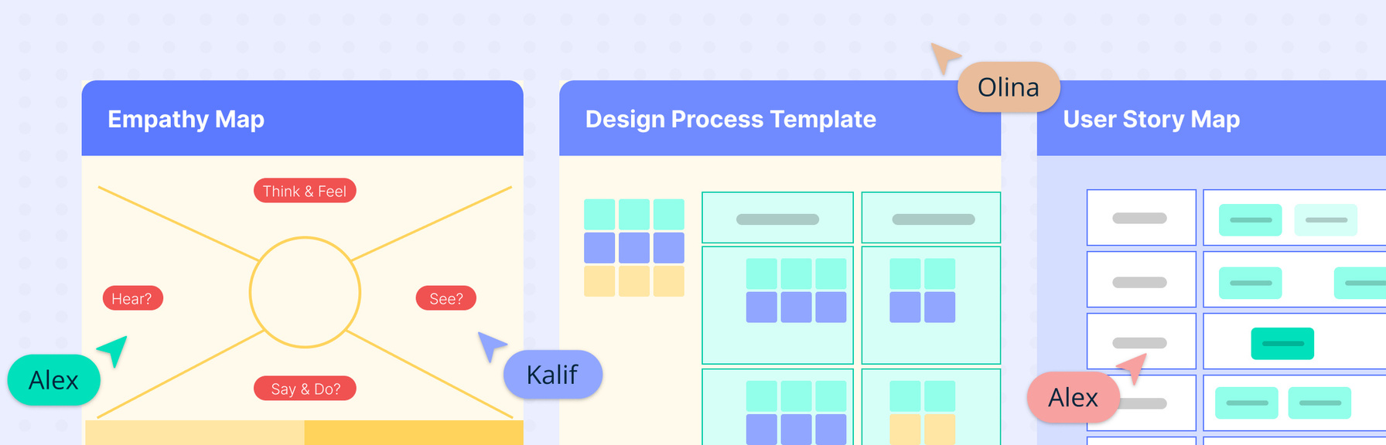
Let’s explore the complete workflow that transforms your vision into a fully functional, high-performance website.
1. Discovery Phase: Understanding the Vision
The process starts with discovery—diving deep into your business, goals, industry, and users.
What happens here:
www.quorawebsolution.com

Slide 5
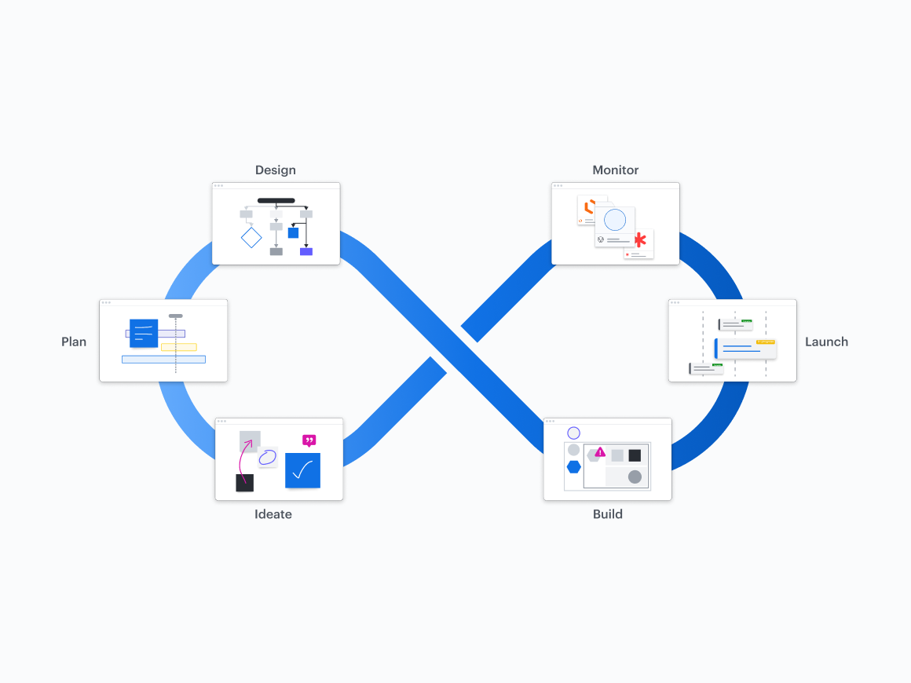
Stakeholder meetings and questionnaires
Market and competitor research
User persona creation
Defining site goals (sales, leads, brand awareness, etc.)
💡 Outcome: A solid foundation and shared vision between the client and the development team.
www.quorawebsolution.com

Slide 6
2. Strategy & Planning: Laying the Roadmap
With clarity on the goals, the team starts mapping out the path to execution.
Key deliverables:
Project timeline with milestones
Sitemap and page structure
Technology stack decision (e.g., WordPress, Webflow, Shopify)
Wireframes and user journey mapping
💡 Outcome: A blueprint that guides the design and development process with clear direction.
3. Design Phase: Crafting the Look & Feel
The design team takes the strategic vision and turns it into a beautiful, user-friendly interface.
www.quorawebsolution.com

Slide 7
Design tasks include:
Mood boards and style guides
High-fidelity mockups for homepage and important subpages
UX design with user flows and interactive elements
Mobile-first and responsive design considerations
💡 Outcome: A visually compelling and functional layout tailored to your audience.
4. Content Creation: Telling Your Story
Content breathes life into design. This phase ensures the right message is communicated clearly and persuasively.
Content needs:
www.quorawebsolution.com

Slide 8
SEO-optimized web copy
Product or service descriptions
Images, videos, and graphics
Calls-to-action (CTAs) and lead magnets
💡 Outcome: Engaging, high-quality content that supports user intent and business objectives.
5. Development Phase: Bringing It to Life
This is where your site moves from design to reality. Developers build both the front-end and back-end functionality.
Development includes:
Coding (HTML, CSS, JavaScript, and frameworks)
www.quorawebsolution.com

Slide 9
CMS setup and customization
Database and third-party integration
eCommerce setup (if applicable)
💡 Outcome: A fully functional website that mirrors the approved design and operates seamlessly.
6. Testing & Quality Assurance
Before launching, rigorous testing ensures everything works perfectly.
QA checks:
Browser and device compatibility
Site speed and performance
Link and form validation
Accessibility and SEO compliance
www.quorawebsolution.com

Slide 10
Bug identification and resolution
💡 Outcome: A polished website that performs well and delivers a smooth user experience.
7. Launch: Going Live
After testing and client approval, the site is ready to launch.
Launch activities:
Final content uploads
Hosting and domain setup
SSL certificate installation
Analytics and tracking integration
Post-launch checklist review
💡 Outcome: A successful, stress-free launch with your site live and functioning in the real world.
8. Post-Launch Support & Maintenance
www.quorawebsolution.com

Slide 11
Even after the launch, the journey continues. Ongoing support is vital to keep your website running smoothly and evolving with your business.
Ongoing services:
Regular updates and security patches
Uptime monitoring and performance optimization
Monthly analytics and SEO reporting
New feature development as your needs grow
💡 Outcome: A long-lasting, reliable website that grows with your brand.
Final Thoughts
Building a professional website is a strategic endeavor—not just a design task. A reputable website design and development company brings structure, creativity, and technical expertise to every phase of the project.
www.quorawebsolution.com

Slide 12
From discovery to deployment, this well-defined workflow ensures your website is more than just good-looking—it’s optimized for growth, performance, and long-term success.
Everything You Need to Know Before Hiring a Website Design and Development Company
In today’s digital-first world, your website isn’t just your online presence—it’s your brand’s first handshake with the world. Whether you're a startup building your first site or an established business revamping your digital strategy, hiring the right website design and development company is a crucial decision. This guide walks you through everything you need to know to make the best choice for your business.
1. Define Your Goals and Expectations
www.quorawebsolution.com

Slide 13
Start by clarifying what you need your website to do. Ask yourself:
Is the goal to generate leads, drive sales, or showcase a portfolio?
Do you need eCommerce capabilities, a blog, booking functions, or something custom?
What's your budget and desired launch timeline?
Having a clear roadmap will help you communicate effectively with potential partners and evaluate their fit for your project.
2. Know the Difference Between Design and Development
It’s important to understand the two primary facets of building a website:
Web Design focuses on aesthetics, layout, branding, and user experience (UX).
Web Development involves coding and functionality—both front-end (what users see) and back-end (servers, databases).
Look for a company that can handle both or collaborates effectively with specialists in each area.
www.quorawebsolution.com

Slide 14
3. Evaluate Portfolios and Past Work
A trustworthy agency will showcase a well-rounded portfolio of completed projects that highlight their design and development capabilities. When reviewing it:
Look for design versatility, mobile responsiveness, and user-friendly interfaces.
Check if they’ve worked in your industry or with businesses of your size.
Visit the live sites, not just screenshots, to assess performance and interactivity.
Portfolios tell you a lot about their design sensibility and technical skills.
4. Read Reviews and Get Referrals
Client testimonials and online reviews offer honest insight into how a company works. Explore reputable review platforms such as Google Reviews, Clutch.co, and professional networks like LinkedIn for unbiased feedback and client testimonials. Ask potential agencies for referrals and talk directly to their past clients to learn about:
Communication and transparency
www.quorawebsolution.com

Slide 15
Meeting deadlines and staying within budget
Post-launch support and flexibility
5. Understand Their Process
A professional web design company should have a well-defined workflow. Typically, this includes:
Discovery & Strategy – Understanding your business, audience, and goals.
Wireframes & Mockups – Outlining the structure and layout of key pages.
Visual Design – Translating your brand identity into an engaging and intuitive user interface that resonates with your audience.
Development – Building functionality and integrating systems.
Testing – Cross-browser, speed, SEO, and mobile compatibility checks.
Launch – Deployment and performance monitoring.
Maintenance – Ongoing updates, troubleshooting, and improvements.
Ask how they handle revisions and feedback at each stage.
www.quorawebsolution.com

Slide 16
6. Discuss Communication and Project Management
"Effective and transparent communication is essential to the success of any project. Find out:
Who will be your point of contact?
How often will you receive updates?
What project management tools (like Trello, Slack, or Asana) will they use?
This ensures your project stays on track and you're always in the loop.
7. Review Pricing and Contract Details
Understand exactly what you’re paying for. Clarify:
Is pricing fixed or hourly?
What deliverables are included (e.g., design, content, SEO)?
Are there extra charges for revisions, hosting, or support?
What are the payment terms and cancellation policies?
A detailed contract helps avoid unexpected costs and miscommunications later on.
www.quorawebsolution.com

Slide 17
8. Ensure Mobile Optimization and SEO Readiness
Your website must look and perform well on all devices—and it must be discoverable. Ensure the company:
Designs responsive layouts
Follows on-page SEO best practices (metadata, alt tags, schema)
Optimizes for fast load times
Implements tools like Google Analytics and Search Console
Mobile-friendly, search-optimized websites are a must in today’s digital ecosystem.
9. Clarify Ownership and Access
Before signing on the dotted line, ask:
Who owns the design, code, and content after launch?
Will you be granted complete administrative access to the content management system (CMS), such as WordPress or Shopify?
www.quorawebsolution.com

Slide 18
Who will handle hosting and domain registration?
Will they provide documentation or training to manage the site?
You should always retain full control over your digital assets.
10. Plan for Ongoing Maintenance
A successful website is never “finished.” You’ll need:
Regular updates to content, plugins, or themes
Security checks and backups
Bug fixes or performance improvements
Analytics reporting and conversion tracking
Find out if the company offers maintenance plans, how they handle support requests, and response times.
Final Thoughts: Think Long-Term
www.quorawebsolution.com

Slide 19
Hiring a website design and development company isn’t just about building a site—it’s about building a relationship. Look for a partner who listens, communicates clearly, understands your brand, and is genuinely invested in your success.
With the right team by your side, your website won’t just look great—it will deliver real business results.
www.quorawebsolution.com

Slide 20
Quora Web Solution: Quora Web Solution is a trusted website development company based in Bangalore, India, offering a wide array of services to not only domestic but global clientele. Be it Website Design and Development, SEO services, Digital Marketing, Branding, App Development, Ecommerce Solution, and Logo Creation . Quora Web Solution has the best website developers offering top quality services and that is the reason why we are well known as one of the best Website Development Companies in Bangalore, India.
Visit Us - www.quorawebsolution.com
Call Us - +91 9986 056 909
Mail Us - info@quorawebsolutions.com
www.quorawebsolution.com

Slide 21

WORDPRESS DEVELOPMENT
ECOMMERCE DEVELOPMENT
PHP DEVELOPMENT
CMS DEVELOPMENT
DRUPAL DEVELOPMENT
WEBSITE SERVICES
WEBPORTAL DEVELOPMENT
MAGENTO DEVELOPMENT
WEBSITE DEVELOPMENT
JOOMLA DEVELOPMENT
SMALL BUSINESS DEVELOPMENT
CHEAP WEBSITE DEVELOPMENT
STATIC WEBSITE DEVELOPMENT
DYNAMIC WEBSITE DEVELOPMENT
WEBSITE DESIGN COMPANY
TOUR AND TRAVEL WEBSITE DEVELOPMENT
Services

