Slide 1


Hair Growth Serums
Understand advanced care with our hair growth serums that strengthen roots, stimulate healthy growth, reduce thinning, & deliver visibly fuller or thicker hair.

Slide 2
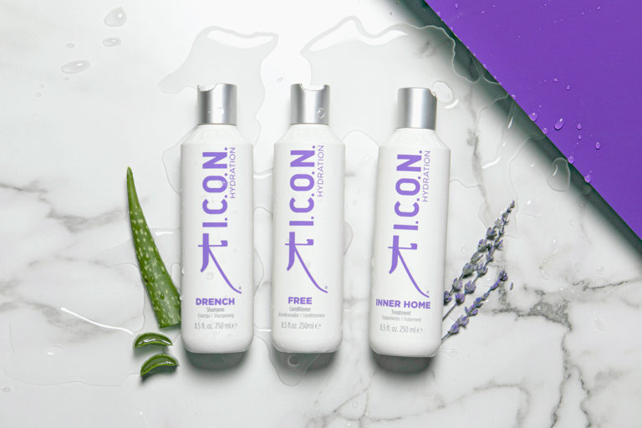
Anti Frizz Shampoo
Embrace smoother hair with anti frizz shampoo that tames unruly strands, locks in moisture, reduces static, & leaves every hair type silky, soft, or manageable.

Slide 3
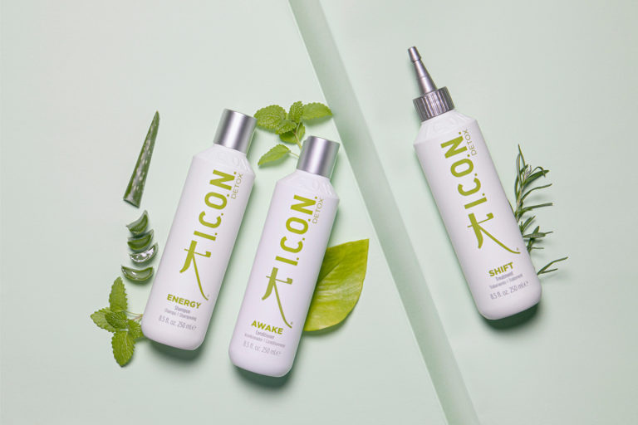
Natural Hair Care Products
Indulge in gentle beauty with natural hair care products enriched with botanicals that nourish deeply, protect health, enhance shine, & respect the environment.

Slide 4

Contact Us
I.C.O.N. Hair Care delivers vegan, eco-friendly, and innovative products for healthy, beautiful hair, using sustainable packaging and natural ingredients.
Address: 86 - 90 Paul Street Shoreditch London EC2A 4NE
Website: https://iconhaircare.com

