Slide 1

10 Affordable Protective Hard Case Models That Offer Premium Safety
Keeping valuables safe during travel and daily use remains important for many people. Items face drops, dust, and pressure in daily routines, so strong protection plays a clear role. A protective hard case shields items with firm shells and steady support.
Many buyers also seek trusted safety without high cost, and NEOTech Engineering focuses on designs that meet these needs. This blog explores ten affordable models that balance strength, comfort, and long life. Each option suits students, workers, and hobby users who value smart protection and simple design.
Why Hard Cases Matter
Hard cases shield items from harm and extend their life. For this reason, they block impact, stop dust, and resist moisture. Consequently, users feel calm during travel or storage.
Everyday Protection Needs
In daily life, items face risk. For instance, bags fall, and shelves shake. Meanwhile, surfaces scrape without warning. Hence, strong cases reduce these threats and keep content steady.
Long-Term Value
Over time, a solid case avoids repeat repairs. In turn, users save effort and time. Ultimately, one good choice brings lasting peace.
Model 1: Impact Shield Case
Core Strengths
To begin with, this model blocks shocks and guards edges.
Thick outer shell

Slide 2
Firm corner support
Secure locking points
As a result, the shell resists cracks, and items stay safe during rough handling.
Best Uses
In many situations, this protective hard case large school gear, gadgets, and hobby tools. Notably, it handles bumps without stress.
Model 2: Weather Guard Case
Built for Harsh Conditions
Next, this case fights water and dust with skill.
Tight seal ring
Raised lid edges
Strong snap locks
Consequently, while rain or dirt hits the case, the inside stays dry and clean.
Ideal Settings
Accordingly, outdoor trips, storage sheds, and work sites suit this model well.
Model 3: Travel Armour Case
Easy to Carry
Moving forward, this design suits trips and storage.
Light frame
Solid handle grip
Stack-ready shape
Thus, since the case feels light, users carry it with ease.

Slide 3
Travel-Friendly Design
Likewise, air travel, car trips, and daily commutes feel smoother with this case.
Model 4: Gear Vault Case
Organised Storage
At this point, this model holds tools and gadgets in order.
Deep inner space
Foam padding slots
Scratch-safe lining
Hence, because foam grips items, movement drops to zero.
Who Should Use It
As an example, DIY users, students, and hobby fans gain control and clarity.
Model 5: Field Ready Case
Outdoor Focus
Meanwhile, this case suits outdoor use and rough ground.
Hard base plate
Grip texture shell
Firm hinge build
Nevertheless, although the terrain feels rough, the case stands strong.
Practical Advantages
Therefore, campers, survey workers, and field staff trust this design.
Model 6: Compact Defender Case
Space-Saving Build

Slide 4
In contrast to larger options, this case fits a small gear.
Slim body
Easy latch press
Clean edge seal
Accordingly, when space feels tight, this case fits bags with ease.
Everyday Convenience
Similarly, it works well for cables, drives, and hand tools.
Model 7: Heavy Duty Guard Case
Built for Weight
Subsequently, this model handles weight and stress.
Thick wall built
Reinforced hinge rods
Load-ready base
Therefore, heavy items stay safe during moves.
Storage Confidence
In particular, workshops and garages benefit from this tough build.
Model 8: Multi-Use Storage Case
Flexible Interior
At the same time, this case fits many needs.
Removable foam layers
Wide inner space
Flat lid support

Slide 5
Consequently, because foam adapts, users shape the inside with ease.
Changing Needs
Over time, as gear changes, the case changes too.
Model 9: Shock Block Case
Impact Control
After that, this model absorbs impact with care.
Energy-cut shell
Soft inner walls
Tight lock grip
As a result, when drops occur, the case reduces the force on items.
Added Safety
Thus, sensitive items gain extra defence during travel.
Model 10: Large Capacity Safety Case
Room to Store More
Finally, this design suits bigger items and kits.
Broad inner frame
Strong side walls
Balanced carry handle
In short, a protective hard case large size helps store gear without stress.
Balanced Handling
Even so, despite its size, the case stays easy to lift and move.
How Storage Choices Affect Safety

Slide 6
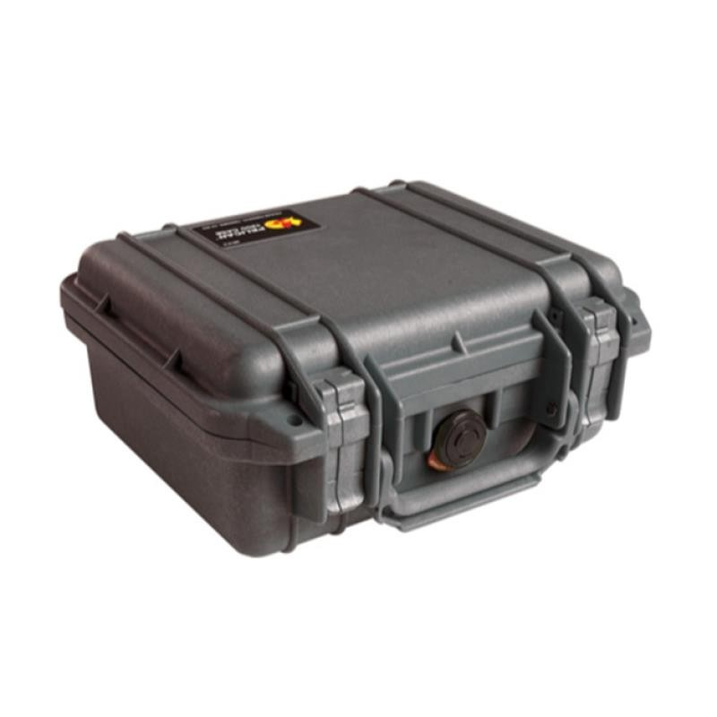
The place where you keep a case shapes how well it protects items. For this reason, smart storage habits reduce stress on the shell and help the case hold its form. In addition, good placement supports long-term use and easy access. As a result, careful storage builds trust and steady performance.
Tips for Safer Storage
Firstly, keep cases on flat, steady surfaces.
Secondly, avoid placing heavy items on top.

Slide 7
Moreover, choose cool, dry spots away from heat.
Finally, leave space for easy lifting and handling
Smart Design Features That Matter
A well-built case shows value through design details that improve safety and ease of use. In addition, small choices in shape and structure guide how well a case performs over time. For this reason, these features help users trust their gear in many situations. As a result, careful design supports steady use and long service.
Key Design Elements to Notice
Firstly, rounded corners that reduce impact force
Secondly, firm handles that support steady lifting
Moreover, a balanced shape that rests flat on surfaces
Finally, clean edges that resist wear
Materials That Shape Strength
The material of a case decides how it reacts to drops, pressure, and time. Therefore, strong materials guard contents and keep the case useful for years. Likewise, good material choice improves grip and comfort. In turn, users feel confident during handling.
Common Material Traits
To begin with, dense outer layers that block cracks
Next, the inner lining that softens contact
Additionally, a smooth finish that resists marks
Eventually, solid joints that hold shape
Comfort and Ease During Use
A case should feel easy to carry and open. Consequently, comfort matters when users move gears often. At the same time, simple handling reduces strain and improves daily use. Thus, smooth use builds trust.

Slide 8
User-Friendly Touchpoints
For example, easy-to-open latches
Meanwhile, handles are shaped for a firm grip.
Also, a light feeling during lifting.
Afterward, a stable base for setting down
Long-Lasting Care and Upkeep
Proper care helps a case perform well for a long time. In the meantime, simple habits keep parts strong and clean. Because of this, regular checks prevent early wear. Ultimately, good care extends life.
Simple Care Practices
At first, wipe surfaces after use.
Then, store in dry spaces.
Later, check hinges and locks often.
Over time, keep the inner padding clean.
Final Thoughts
Choosing the right case builds safety and peace of mind in many tasks. From storage travel, the right build guards items against damage and wear. A protective hard case from this guide shows that solid safety can stay affordable, which is a goal NEOTech Engineering continues to support. Strong shells, smart padding, and secure locks work together to protect valuable gear. With careful choice, users gain lasting value and confidence. A well-chosen case supports daily needs and keeps important items safe.
Frequently Asked Questions
Q 1: How do I choose the right size case?
Start by measuring the items you plan to carry. Leave a small gap for padding. A close fit stops movement and lowers the chance of damage during travel or storage.
Q 2: Are hard cases suitable for daily use?

Slide 9
Yes, many designs handle daily use with strong shells and easy grips. They guard items from bumps, dust, and pressure during school, work, or travel routines.
Q 3: How can I make a case last longer?
Clean the case often, keep it dry, and inspect locks and hinges. Simple care habits protect strength and support steady use over time.
Thankyou

