Slide 1
Where to Buy Cannabis Seeds: Your Essential Guide

Slide 2
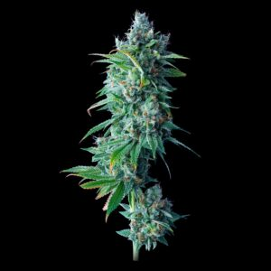
As cannabis legalization continues to expand across the United States and beyond, more people than ever are interested in growing their own marijuana plants. Whether you’re a seasoned grower or a first-time cultivator, knowing where to buy cannabis seeds is the first step in the journey. With a vast number of seed banks and online vendors available today, it can be overwhelming trying to choose the right source. This guide simplifies the process, offering tips and insights for finding cannabis seeds online from trustworthy sources.

Slide 3
Buying Cannabis Seeds Online: What to Know
Purchasing cannabis seeds online is one of the most convenient ways to access a wide variety of genetics. Online seed banks often offer hundreds of strains, including feminized, autoflowering, and regular seeds. These platforms provide detailed strain information, including effects, growing difficulty, yield estimates, and flowering times, allowing you to make an informed decision based on your personal preferences and growing environment.
However, not all online seed banks are created equal. The most reputable ones will offer:
Discreet shipping with tracking numbers
Germination guarantees
Secure payment options
Excellent customer service
Look for online reviews and forums like Reddit or GrowDiaries to read firsthand accounts of experiences with specific seed banks.

Slide 4
Local Dispensaries vs. Online Shopping
In legalized states, local dispensaries may also sell cannabis seeds, often from local breeders or state-approved partners. Buying seeds in person gives you the advantage of talking directly to a budtender, but it limits your selection to what’s available in store. Online seed banks provide far more options and are often the best place to find rare or specialty strains.

Slide 5
Legal Considerations
Before you place an order for cannabis seeds online, make sure to review the local laws in your state or country. While hemp seed sales are federally legal in the U.S., THC-rich cannabis seeds exist in a legal gray area depending on your state. Some states allow home cultivation, while others prohibit it altogether. Reputable seed banks will provide disclaimers and may refuse to ship to certain regions.

Slide 6
Final Thoughts
So, where should you buy cannabis seeds? If you’re looking for variety, discretion, and access to some of the best cannabis genetics in the world, purchasing cannabis seeds online is the way to go. Just make sure to do your research, check reviews, and choose a reputable supplier with transparent policies. Whether you’re planning to grow for personal use or future breeding, starting with quality seeds will make all the difference in your cultivation success.

Slide 7
Thank You
Contact Info.
info@thecloneconservatory.com
(424) 427-4777
Mon – Fri 8am -8pm
Saturday 9am – 6pm
Sunday CLOSED
Holidays TBD
Source URL- https://medium.com/@thecloneconservatory01/where-to-buy-cannabis-seeds-your-essential-guide-a00fb2d7b2da

