Slide 1


Quora Web Solution
Website Design and
Development
Company
Web Design & Web Development
Company in Bangalore, India
www.quorawebsolution.com
+91 9986 056 909
info@quorawebsolutions.com
24A, 1st Main Rd, Chandra Reddy
Layout, Koramangala 4th Block,
Koramangala, Bengaluru,
Karnataka 560034

Slide 2

E-commerce Website Development: Everything You Need to Know to Build a Successful Online Store
Introduction
In the modern digital era, establishing a robust online presence is crucial for business success.
www.quorawebsolution.com

Slide 3
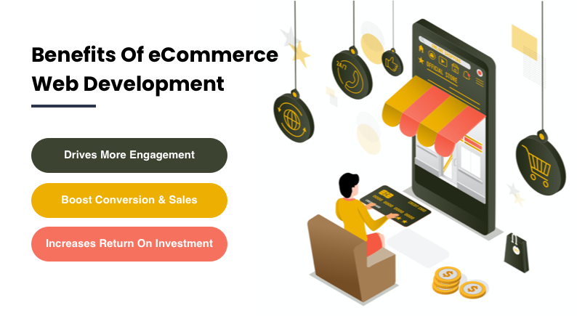
E-commerce has revolutionized the way people shop, making it critical for businesses to develop a well-designed and functional online store.
www.quorawebsolution.com

Slide 4

Whether you’re a small business owner or a large enterprise, understanding the key aspects of e-commerce website development will help you create a successful platform that attracts customers and drives sales.
1. Choosing the Right E-commerce Platform
www.quorawebsolution.com

Slide 5

The first step in developing an online store is selecting the right e-commerce platform. Some of the most popular platforms include:
Shopify – Ideal for beginners, offering a user-friendly interface and extensive app ecosystem.
www.quorawebsolution.com

Slide 6
WooCommerce – A WordPress-based solution that provides flexibility and customization options.
Magento – Best for large businesses with complex needs and advanced customization.
BigCommerce – Suitable for scaling businesses with built-in SEO and marketing tools.
Each platform has its strengths and limitations, so choosing the right one depends on your business requirements, budget, and technical expertise.
2. Essential Features of a Successful E-commerce Website
To build a high-performing online store, your website should include the following essential features:
a. User-Friendly Navigation
A clear and simple navigation structure helps users find products quickly, reducing bounce rates and increasing conversions.
www.quorawebsolution.com

Slide 7
b. Mobile Responsiveness
With mobile commerce on the rise, your website must be fully optimized for different screen sizes and devices.
c. Secure Payment Gateways
Integrating trusted payment options such as PayPal, Stripe, and credit/debit card payments ensures a smooth and secure transaction process.
d. Fast Loading Speed
A slow-loading website can drive potential customers away. Optimize images, use caching, and choose a reliable hosting provider to enhance speed.
e. SEO Optimization
www.quorawebsolution.com

Slide 8
Implement SEO best practices such as keyword-rich product descriptions, meta tags, and alt text for images to improve search engine visibility.
f. Customer Support & Live Chat
Providing real-time assistance through chatbots or live chat can enhance user experience and build trust.
g. Secure Checkout Process
A smooth and transparent checkout process with minimal steps reduces cart abandonment rates.
3. Steps to Develop an E-commerce Website
Step 1: Define Your Business Goals
www.quorawebsolution.com

Slide 9
Before developing your site, outline clear goals such as target audience, product offerings, and marketing strategies.
### Step 2: Selecting the Perfect Domain Name and Hosting Provider
Choose a domain name that is memorable, easy to spell, and aligns with your brand identity to enhance recognition and credibility. Reliable hosting providers like Bluehost, SiteGround, or AWS ensure website performance and uptime.
Step 3: Design and Develop Your Website
Use a professional theme or custom design for a visually appealing store.
Organize product categories and descriptions effectively.
www.quorawebsolution.com

Slide 10
Integrate necessary plugins and extensions for added functionalities.
Step 4: Integrate Payment Gateways
Enable multiple secure payment options to cater to diverse customer preferences.
Step 5: Implement Security Measures
Use SSL certificates, firewalls, and secure authentication to protect customer data and transactions.
Step 6: Test and Launch
Before going live, test website functionality, payment processes, and responsiveness on various devices.
Step 7: Monitor and Improve
www.quorawebsolution.com

Slide 11
Regularly track website performance using tools like Google Analytics, and optimize based on customer feedback.
4. Marketing Strategies for Your E-commerce Store
Once your e-commerce website is live, you need to drive traffic and increase sales. Here are some effective marketing strategies:
Search Engine Optimization (SEO): Optimize your site for organic search rankings.
Social Media Marketing: Promote products on platforms like Instagram, Facebook, and Pinterest.
Email Marketing: Engage with customers through personalized email campaigns.
Pay-Per-Click (PPC) Advertising: Use Google Ads and social media ads for targeted promotions.
Content Marketing: Create blogs, guides, and videos to provide value to customers and improve search rankings.
www.quorawebsolution.com

Slide 12
Conclusion
Developing a successful e-commerce website requires careful planning, the right platform, and continuous optimization. By implementing best practices in design, security, and marketing, you can create a profitable online store that meets customer expectations and drives growth. Investing time and effort into e-commerce website development will set your business apart in the competitive digital market.
The Ultimate Guide to Modern Website Design: Trends, Best Practices, and Future Innovations
Introduction
www.quorawebsolution.com

Slide 13
Website design is constantly evolving, driven by technological advancements, user expectations, and emerging trends. A well-designed website enhances user experience, improves engagement, and supports business growth. In this guide, we will explore modern website design trends, best practices, and future innovations to help you create a visually appealing, functional, and future-proof website.
1. Modern Website Design Trends
a. Minimalist Design
Simplicity is key in modern website design. Clean layouts, ample white space, and a focus on essential elements improve readability and usability.
b. Dark Mode
Dark mode has gained popularity as it reduces eye strain and enhances aesthetics. Many websites now offer a dark theme option for users.
www.quorawebsolution.com

Slide 14
c. Microinteractions
Subtle animations and interactive elements create a more engaging user experience. Microinteractions include hover effects, button animations, and scrolling effects.
d. Neumorphism
This design trend combines skeuomorphism and flat design, giving elements a soft, realistic appearance with subtle shadows and highlights.
e. Asymmetrical Layouts
Breaking away from traditional grid-based layouts, asymmetrical designs create dynamic and unique web experiences.
f. Bold Typography
www.quorawebsolution.com

Slide 15
Large, expressive fonts help capture attention and improve readability while reinforcing brand identity.
g. AI-Powered Personalization
Artificial intelligence enables websites to deliver personalized content, product recommendations, and chatbots for improved user interaction.
h. Voice User Interfaces (VUIs)
With the rise of voice assistants, websites are beginning to incorporate voice search and command functionalities for better accessibility.
2. Best Practices for Modern Website Design
a. Mobile-First Approach
www.quorawebsolution.com

Slide 16
With the majority of web traffic coming from mobile devices, designing with a mobile-first approach ensures a seamless user experience across all screen sizes.
b. Fast Loading Speed
Website performance is crucial for retaining visitors. Optimize images, use caching techniques, and choose a reliable hosting provider to enhance speed.
c. Accessible Design
Ensure your website is accessible to all users, including those with disabilities. Use proper color contrast, alt text for images, and keyboard navigation support.
d. Clear Call-to-Actions (CTAs)
www.quorawebsolution.com

Slide 17
Strategically placed CTAs help guide users toward conversions, whether it's making a purchase, signing up, or contacting your business.
e. Intuitive Navigation
A simple and well-structured navigation menu improves usability and helps users find information quickly.
f. Secure and Private
Implement HTTPS, strong authentication methods, and data protection policies to ensure user privacy and security.
g. Consistent Branding
www.quorawebsolution.com

Slide 18
Maintain a consistent visual style, color palette, and typography to reinforce brand identity and create a professional look.
3. Future Innovations in Website Design
a. Augmented Reality (AR) Integration
AR technology is making its way into web design, allowing users to interact with products in a more immersive way, especially in e-commerce and real estate.
b. AI-Generated Design
www.quorawebsolution.com

Slide 19
AI-powered tools can analyze user preferences and create custom designs in real-time, reducing design time and enhancing personalization.
c. 3D Elements and Immersive Experiences
Advancements in web graphics allow for more interactive and immersive 3D elements, creating engaging user experiences.
d. Blockchain for Enhanced Security
Blockchain technology is expected to improve data security and transparency, particularly for e-commerce and financial websites.
www.quorawebsolution.com

Slide 20
e. No-Code and Low-Code Development
Drag-and-drop website builders and AI-powered design tools are making web development more accessible to non-developers.
f. Progressive Web Apps (PWAs)
PWAs combine the best of websites and mobile apps, offering offline functionality, fast loading times, and an app-like experience.
Conclusion
www.quorawebsolution.com

Slide 21
Modern website design is about blending aesthetics, functionality, and emerging technologies to create an exceptional user experience. By staying updated with the latest trends, implementing best practices, and preparing for future innovations, businesses can build websites that stand out and drive success in the digital age.
www.quorawebsolution.com

Slide 22
Quora Web Solution: Quora Web Solution is a trusted website development company based in Bangalore, India, offering a wide array of services to not only domestic but global clientele. Be it Website Design and Development, SEO services, Digital Marketing, Branding, App Development, Ecommerce Solution, and Logo Creation . Quora Web Solution has the best website developers offering top quality services and that is the reason why we are well known as one of the best Website Development Companies in Bangalore, India.
Visit Us - www.quorawebsolution.com
Call Us - +91 9986 056 909
Mail Us - info@quorawebsolutions.com
www.quorawebsolution.com

Slide 23

WORDPRESS DEVELOPMENT
ECOMMERCE DEVELOPMENT
PHP DEVELOPMENT
CMS DEVELOPMENT
DRUPAL DEVELOPMENT
WEBSITE SERVICES
WEBPORTAL DEVELOPMENT
MAGENTO DEVELOPMENT
WEBSITE DEVELOPMENT
JOOMLA DEVELOPMENT
SMALL BUSINESS DEVELOPMENT
CHEAP WEBSITE DEVELOPMENT
STATIC WEBSITE DEVELOPMENT
DYNAMIC WEBSITE DEVELOPMENT
WEBSITE DESIGN COMPANY
TOUR AND TRAVEL WEBSITE DEVELOPMENT
Services

