Slide 1
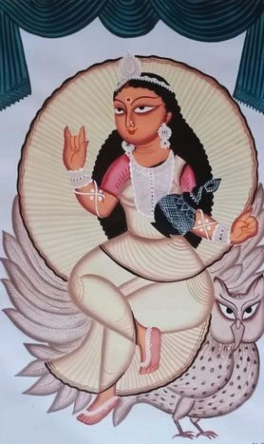

www.mojarto.com

Slide 2
Mojarto, founded in 2005, has been the largest and most innovative online art platform in the country. We are strong believers in the transformational power of technology and have long been the pioneering art entity in the country; bringing together artists, collectors, dealers, galleries and resellers onto a single powerful online platform. With a state of the art user experience, and a leading edge art portal backed by some
amazing analytics and data, we transform the art shopping experience, empower artists, and provide a huge convenience for those who wish to re-sell their art.Founded a decade ago, Mojarto was ahead of its time, bringing to the art world a number of 'firsts'. It was the first platform to democratize the art buying process, while also empowering the artist; the first platform with a completely transparent pricing and purchase process; the first platform to proactively help collectors re-sell their art. It was the first portal to bring on board galleries and dealers, art critics and writers alike – to bring art to every home. It is now also the first art portal in the country to be backed by
cutting-edge technology and data to drive its unique art selection and display process.
Mojarto was started by a small team of people who believed the art world experience would thrive online. We have grown to become a revolutionary international service that puts the best of Indian art at your fingertips to explore, engage with and bring home.
Our mission is to nurture and promote emerging artists side-by-side with masters of their field and create a unique, cutting-edge viewing experience with always-on international exhibitions, guest curations, gallery partnerships and daily updated videos and blogs that explore the ecology of the vibrant world of Indian art in a fun and engaging way.
www.mojarto.com

Slide 3
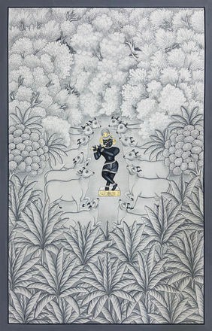
Madhubani Paintings — India’s Living Folk Art
Explore Authentic Madhubani with Mojarto
About Madhubani Paintings
Origin: Mithila region (Bihar, India & Nepal)
Traditional art practiced by women for rituals & festivals
Features geometric patterns, mythological themes, and nature motifs
Painted with natural dyes & pigments (turmeric, indigo, rice paste, lampblack, etc.) Tools: Fingers, twigs, matchsticks, nib pens
Cultural Significance & Styles
Linked to Ramayana – King Janaka’s commission for Sita’s wedding Symbolic art used for weddings, births, and festivals
Five key styles: Bharni, Katchni, Tantrik, Godna, Kohbar Recognized with Geographical Indication (GI) status
Madhubani Artists on Mojarto
Works available from both renowned & emerging artists Examples:
Sarita Devi – vibrant floral Madhubani works (Night Flower) Anjali Sharma – ritual wedding themes
Ajit Jha & Nabita Jha – traditional motifs with natural dyes Mojarto ensures authenticity, curated collection & global access
Why Buy Madhubani from Mojarto?
Authentic artworks with provenance
Diverse styles & artists from India’s folk traditions Accessible online platform with secure buying & shipping Support Indian artisans & preserve heritage
Call to Action: Discover & Collect Madhubani Paintings on Mojarto Today!
www.mojarto.com

Slide 4
+916385753122
support@mojarto.com www.mojarto.com

Slide 5
www.mojarto.com

