Slide 1

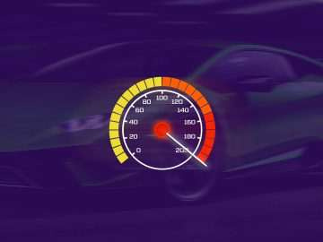
Quora Web Solution
Website Design and
Development
Company
Web Design & Web Development
Company in Bangalore, India
www.quorawebsolution.com
+91 9986 056 909
info@quorawebsolutions.com
24A, 1st Main Rd, Chandra Reddy
Layout, Koramangala 4th Block,
Koramangala, Bengaluru,
Karnataka 560034

Slide 2
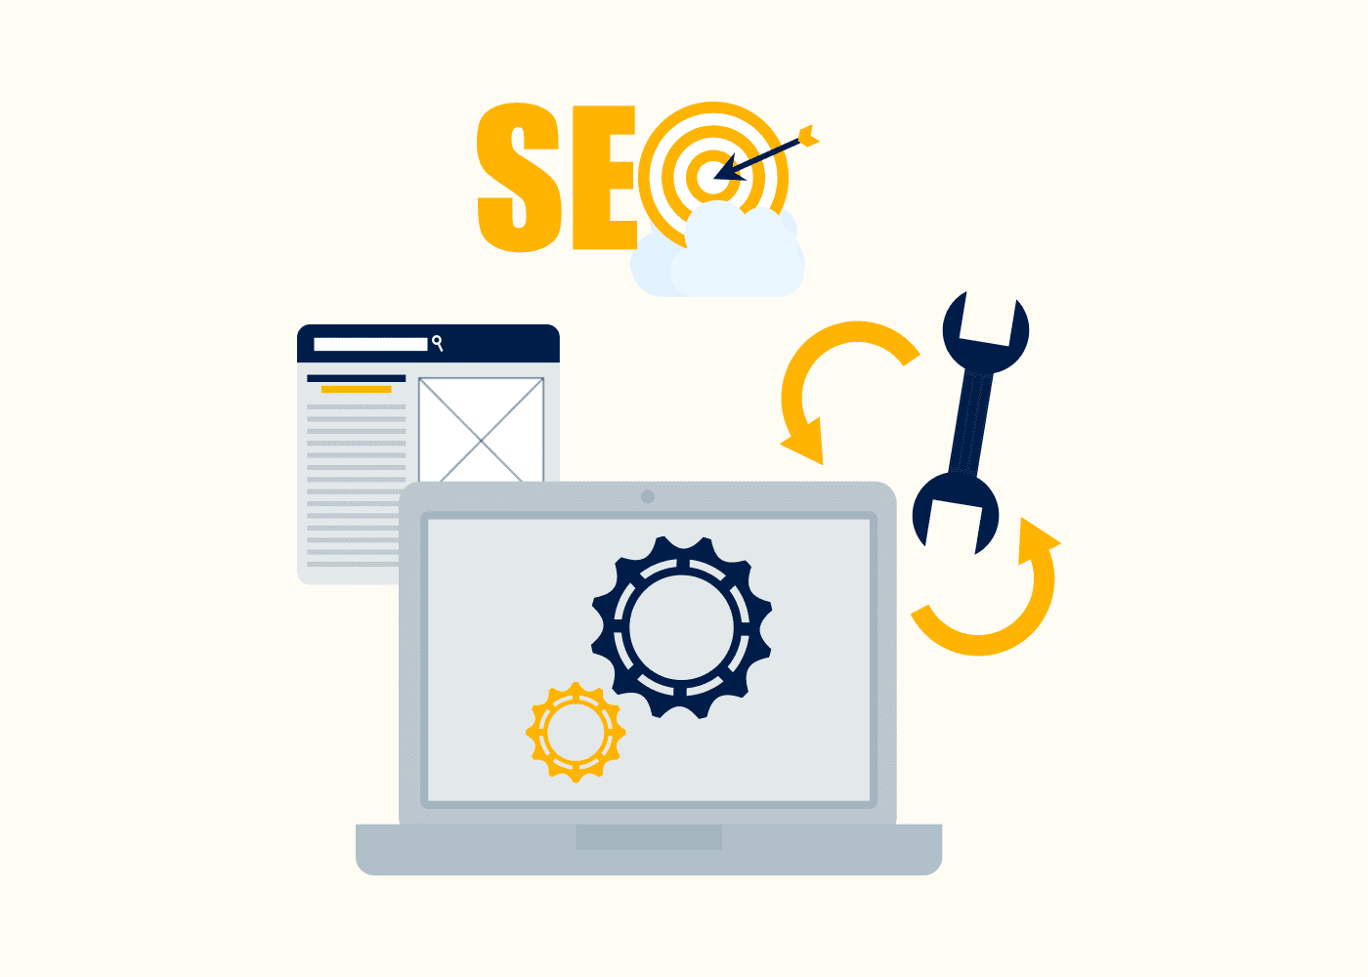
Website Speed Optimization: Why It Matters and How to Improve Your Site’s Performance for Better Results
Introduction
www.quorawebsolution.com

Slide 3

In today’s fast-paced digital world, website speed is a crucial factor that can make or break your online presence. A slow-loading website leads to poor user experience, higher bounce rates, and lost revenue opportunities.
www.quorawebsolution.com

Slide 4

On the other hand, a fast and optimized website enhances user engagement, improves SEO rankings, and boosts conversions. In this article, we will explore why website speed matters and how you can optimize your site’s performance for better results.
Why Website Speed Matters
www.quorawebsolution.com

Slide 5

Improves User Experience
Users demand fast-loading web pages for a seamless browsing experience. If your site takes more than a few seconds to load, users may abandon it and move to a competitor’s website. A fast-loading site ensures a seamless and satisfying experience for users.
www.quorawebsolution.com

Slide 6
Enhances SEO Rankings
Google and other search engines consider website speed a crucial ranking factor, impacting visibility and organic traffic. A slow website can negatively impact your search engine rankings, making it harder for potential customers to find you online.
Increases Conversion Rates
Websites with faster load times experience higher conversion rates, as users are more likely to engage and complete transactions. Research indicates that even a one-second delay in page load time can lead to a considerable drop in conversion rates, negatively impacting sales and user engagement. Optimizing your website speed can directly impact your sales and revenue.
Reduces Bounce Rate
A slow website increases the likelihood of visitors leaving your site without interacting with it.
www.quorawebsolution.com

Slide 7
High bounce rates signal to search engines that your website may not be providing value, which can hurt your rankings.
Enhances Mobile Experience
With the rise in mobile usage, speed optimization is even more critical. Mobile users expect fast-loading pages, and Google’s mobile-first indexing considers speed as a ranking factor for mobile search results.
How to Improve Your Website’s Performance
1. Optimize Images
Optimize image sizes using compression tools like TinyPNG or ImageOptim to reduce load time without sacrificing quality.
www.quorawebsolution.com

Slide 8
Use the appropriate file formats such as WebP for modern browsers.
Implement lazy loading to load images only when they appear on the user’s screen.
2. Enable Browser Caching
Store static files in the user’s browser to reduce load times for returning visitors.
Use tools like WP Rocket or W3 Total Cache for WordPress websites.
3. Minimize HTTP Requests
Minimize the number of scripts, images, and stylesheets on a page to decrease load time and enhance performance.
Merge CSS and JavaScript files where possible to minimize HTTP requests and enhance page load speed.
www.quorawebsolution.com

Slide 9
4. Use a Content Delivery Network (CDN)
Leverage a global network of servers to distribute your website’s content, ensuring faster load times and improved accessibility for users worldwide.
CDNs like Cloudflare, Akamai, or Amazon CloudFront can significantly improve load times for global users.
5. Optimize Code and Scripts
Compress and minify CSS, JavaScript, and HTML to eliminate redundant characters, spaces, and comments, thereby reducing file sizes and improving load times.
Defer JavaScript loading so that scripts don’t block the rendering of your page.
6. Upgrade Hosting Services
www.quorawebsolution.com

Slide 10
Choose a reliable hosting provider with high-speed servers.
Consider using a dedicated or VPS hosting solution instead of shared hosting for better performance.
7. Implement Gzip Compression
Compress your website’s files using Gzip to reduce file size and improve load speed.
Most web servers allow Gzip compression through simple configurations.
8. Reduce Redirects
Excessive redirects create additional HTTP requests and slow down your site.
Audit your website to remove unnecessary redirects and streamline navigation.
9. Use Asynchronous Loading for CSS and JavaScript
www.quorawebsolution.com

Slide 11
Load CSS and JavaScript asynchronously to prevent blocking page rendering.
Implement asynchronous loading techniques using tools like defer and async attributes.
10. Regularly Monitor Website Performance
Use tools like Google PageSpeed Insights, GTmetrix, and Lighthouse to analyze and improve speed.
Regularly check and optimize your website to maintain fast load times.
Conclusion
Website speed optimization is essential for delivering an outstanding user experience, improving search engine rankings, and increasing conversion rates.
www.quorawebsolution.com

Slide 12
By implementing the techniques mentioned above, you can ensure your website loads quickly, retains visitors, and performs optimally across all devices. Prioritizing speed optimization will not only enhance user satisfaction but also give you a competitive advantage in the digital space.
10 Essential Features Every Business Website Must Have for Success in the Digital Age
www.quorawebsolution.com

Slide 13
Introduction
In today’s digital landscape, a business website is more than just an online presence—it’s a crucial tool for attracting customers, generating leads, and establishing brand credibility. However, simply having a website isn’t enough. To stand out and succeed in the competitive online space, your website must include key features that enhance user experience, drive engagement, and support business growth. In this article, we’ll explore the 10 essential features every business website must have to thrive in the digital age.
1. Mobile-Friendly and Responsive Design
With the majority of web traffic coming from mobile devices, a responsive design is essential. Your website should adapt seamlessly to different screen sizes, ensuring an optimal user experience on smartphones, tablets, and desktops. A mobile-friendly site improves usability, increases time spent on your pages, and positively impacts search engine rankings.
www.quorawebsolution.com

Slide 14
2. Fast Loading Speed
Website speed is a critical factor in user experience and SEO. Visitors expect pages to load quickly—ideally within three seconds. A sluggish website frustrates users, leading to increased bounce rates and missed business opportunities. Optimize your site’s speed by compressing images, enabling browser caching, and using a reliable hosting provider.
3. Clear and Compelling Call-to-Action (CTA)
Every business website should guide visitors toward taking specific actions, such as making a purchase, signing up for a newsletter, or contacting your team. Strategically placed and well-designed CTAs encourage user engagement and conversions. Use action-oriented language and make your CTAs visually appealing.
4. User-Friendly Navigation
Easy navigation helps visitors find the information they need quickly.
www.quorawebsolution.com

Slide 15
A well-structured menu, clear categories, and intuitive design elements enhance usability. Implement a search bar, breadcrumb navigation, and an organized layout to improve user experience and reduce frustration.
5. SEO Optimization
To rank higher in search engine results, your website must be optimized for SEO. Key SEO elements include:
Keyword-rich, high-quality content
Proper heading structures (H1, H2, H3, etc.)
Meta tags and descriptions
Mobile optimization
www.quorawebsolution.com

Slide 16
Secure HTTPS protocol SEO best practices help increase organic traffic and improve visibility in search engines like Google.
6. High-Quality Content and Blog Section
Engaging, informative, and valuable content keeps visitors on your site longer and positions your business as an industry expert. A blog section can drive organic traffic, improve SEO, and establish credibility. Regularly updating your site with fresh content also encourages return visits and customer engagement.
7. Strong Security Features (SSL Certificate)
Security is a top priority for both businesses and website visitors. An SSL certificate encrypts data, ensuring secure connections and protecting sensitive user information.
www.quorawebsolution.com

Slide 17
Google also ranks HTTPS-enabled sites higher in search results. Other security features include firewall protection, regular software updates, and secure payment gateways for e-commerce sites.
8. Contact Information and Live Chat Support
Making it easy for customers to contact you builds trust and improves customer service. Your website should include:
A contact form
Phone number
Email address
www.quorawebsolution.com

Slide 18
Business address (if applicable) Additionally, live chat support enhances real-time communication, providing instant assistance and improving user satisfaction.
9. Customer Testimonials and Reviews
Social proof plays a significant role in influencing purchasing decisions. Featuring customer testimonials, case studies, and reviews builds credibility and trust. Authentic feedback from satisfied customers reassures potential clients about the quality of your products or services.
10. Integration with Social Media
A strong online presence extends beyond your website. Integrate social media buttons to encourage visitors to connect with your brand on platforms like Facebook, Instagram, LinkedIn, and Twitter. Embedding social media feeds or sharing options increases engagement and helps drive traffic to your website.
www.quorawebsolution.com

Slide 19
Conclusion
A successful business website requires more than just an attractive design—it must be functional, user-friendly, and optimized for performance. By incorporating these 10 essential features, you can enhance user experience, improve search rankings, and increase conversions. Whether you're building a new website or optimizing an existing one, prioritizing these elements will set your business up for digital success.
www.quorawebsolution.com

Slide 20
Quora Web Solution: Quora Web Solution is a trusted website development company based in Bangalore, India, offering a wide array of services to not only domestic but global clientele. Be it Website Design and Development, SEO services, Digital Marketing, Branding, App Development, Ecommerce Solution, and Logo Creation . Quora Web Solution has the best website developers offering top quality services and that is the reason why we are well known as one of the best Website Development Companies in Bangalore, India.
Visit Us - www.quorawebsolution.com
Call Us - +91 9986 056 909
Mail Us - info@quorawebsolutions.com
www.quorawebsolution.com

Slide 21

WORDPRESS DEVELOPMENT
ECOMMERCE DEVELOPMENT
PHP DEVELOPMENT
CMS DEVELOPMENT
DRUPAL DEVELOPMENT
WEBSITE SERVICES
WEBPORTAL DEVELOPMENT
MAGENTO DEVELOPMENT
WEBSITE DEVELOPMENT
JOOMLA DEVELOPMENT
SMALL BUSINESS DEVELOPMENT
CHEAP WEBSITE DEVELOPMENT
STATIC WEBSITE DEVELOPMENT
DYNAMIC WEBSITE DEVELOPMENT
WEBSITE DESIGN COMPANY
TOUR AND TRAVEL WEBSITE DEVELOPMENT
Services

