Slide 1
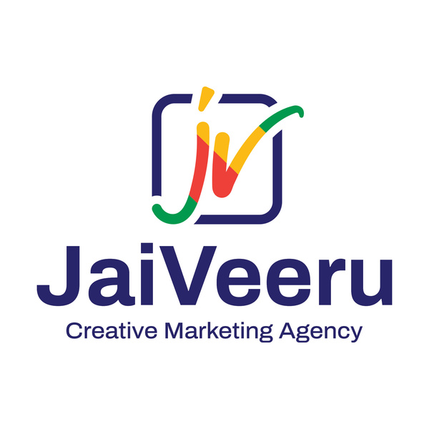


Best Advertising Services in Delhi
Unlocking Creative Growth for Delhi Businesses
www.jaiveeru.co.in

Slide 2
Why Advertising Services Matter in Delhi
Delhi is one of India’s most competitive business hubs. With thousands of brands vying for consumer attention, effective advertising isn’t optional — it’s essential. From digital platforms to outdoor billboards, businesses need targeted, creative strategies to stand out and grow.

Slide 3
Key Elements of Top Advertising Services
The best advertising agencies in Delhi combine creativity, data, and market insight. Key services include:
  Brand Strategy
  Digital Marketing (SEO, Social Media, Google Ads)
  Graphic Design & Content Creation
  Video & Photography
  Outdoor & Print Media

Slide 4
Jai Veeru Creatives – Your Local Growth Partner
Located in Okhla, Jai Veeru Creatives delivers high-impact advertising tailored for Delhi’s vibrant market. We specialize in:
  Creative campaign development
  Social media marketing
  Website design & branding
  Print & outdoor advertising
We help startups and established brands communicate, creatively, and effectively.

Slide 5
Choosing the Right Advertising Partner
When selecting an agency, consider:
  Portfolio & past success stories
  Industry experience
  Service transparency
  Budget alignment
  Budget alignment
A good agency acts as an extension of your team — not just a vendor.

Slide 6
Contact us
Address: 4th Floor, C70, DDA Sheds, Pocket A, in Okhla Phase I,
In Okhla Industrial Estate, New Delhi, Delhi 110020
Email: hello@jaiveeru.co.in
Contact: 01161357576, +91 9911184440, +91 9667788659
Visit at- https://jaiveeru.co.in

Slide 7
Thank You
For more information, you
can visit here
https://jaiveeru.co.in

