Slide 1

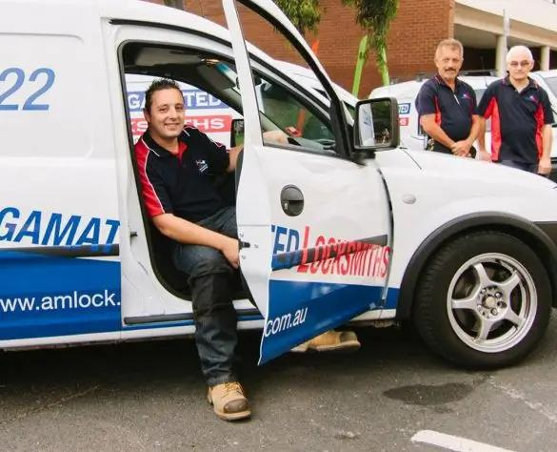
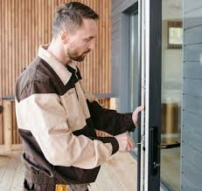

Expert 24 Hour Locksmith Support for Urgent Lock and Key Needs
www.amlock.au

Slide 2


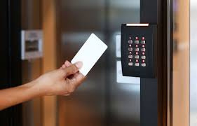
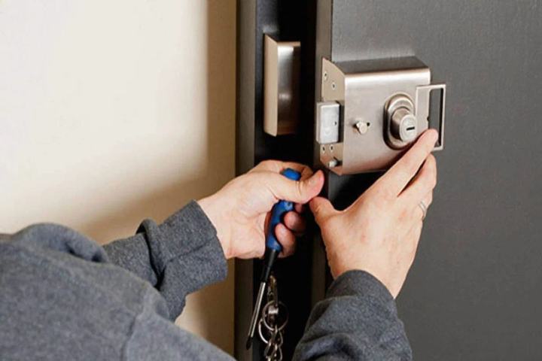
Why Choose Our 24 Hours Services?
  Immediate help during lockouts
  Available anytime – day or night
  Peace of mind with fast response
  Trusted experts in residential, commercial, and automotive security

Slide 3
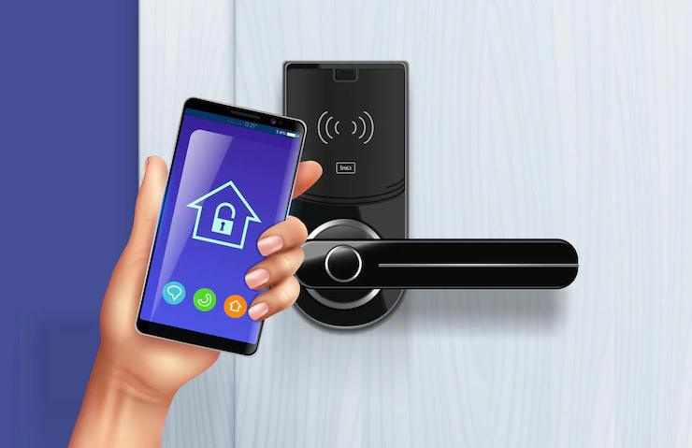
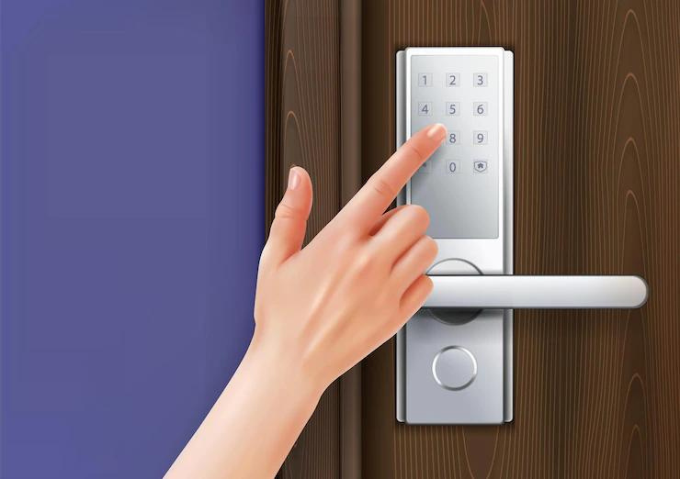
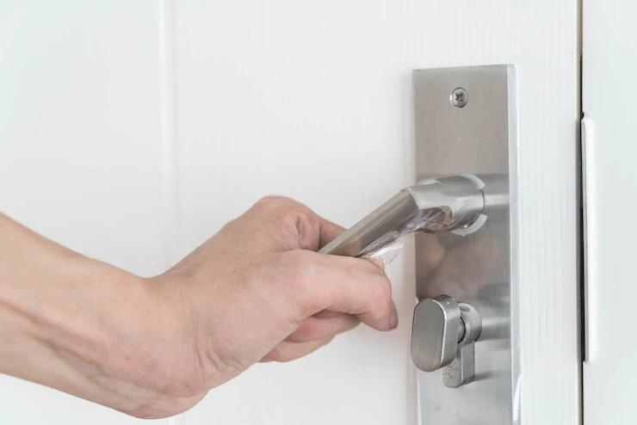
PROFESSIONAL SERVICES AT A GLANCE
  Trusted 24/7 Support for All Your Lock and Key Emergencies
  Complete Locksmith Solutions for Homes, Businesses, and Vehicles
  Expert Locksmith Support Designed for Your Safety and Convenience

Slide 4

YOUR TRUSTED SECURITY PARTNER
  Quick response when you need it most
  Comprehensive locksmith services
  Dedicated to your safety and convenience

Slide 5




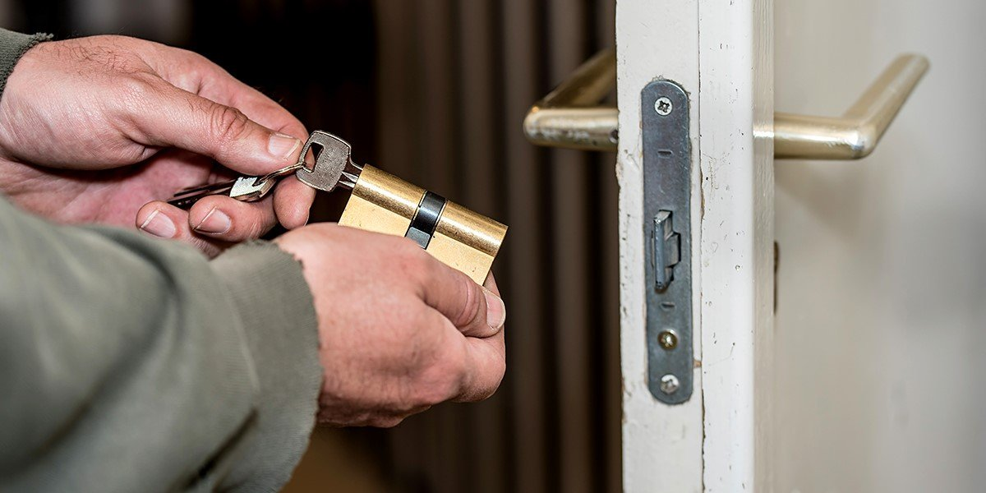
CONTACT
www.amlock.com.au
03 9419 6922
info@amlock.com.au
82 Smith Street Collingwood VIC 3066, Australia

