Slide 1
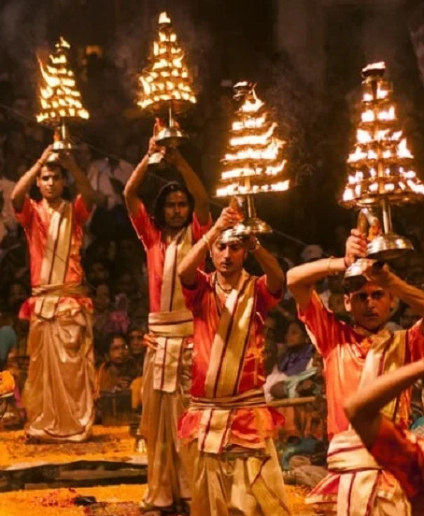
WELCOME TO VARANASI
Discover the Soul of Kashi
Boat rides, Ganga Aarti, Dev Deepawali and tour packages, planned for you by locals.
kashighoomo.in

Slide 2
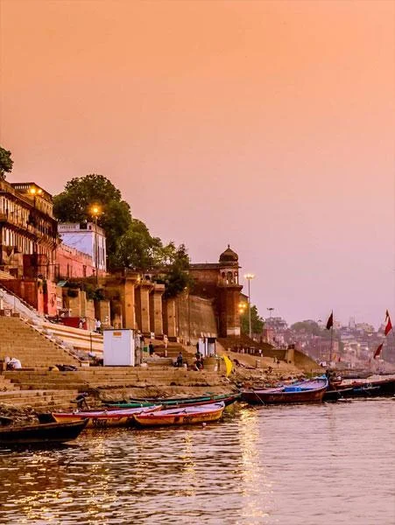




About Kashi Ghoomo
Based at Prahlad Ghat, we help travellers experience Varanasi the right way: on the river, at the ghats and in the temples.
Boat Rides
Tour Packages
Dev Deepawali Booking
Taxi Service

Slide 3
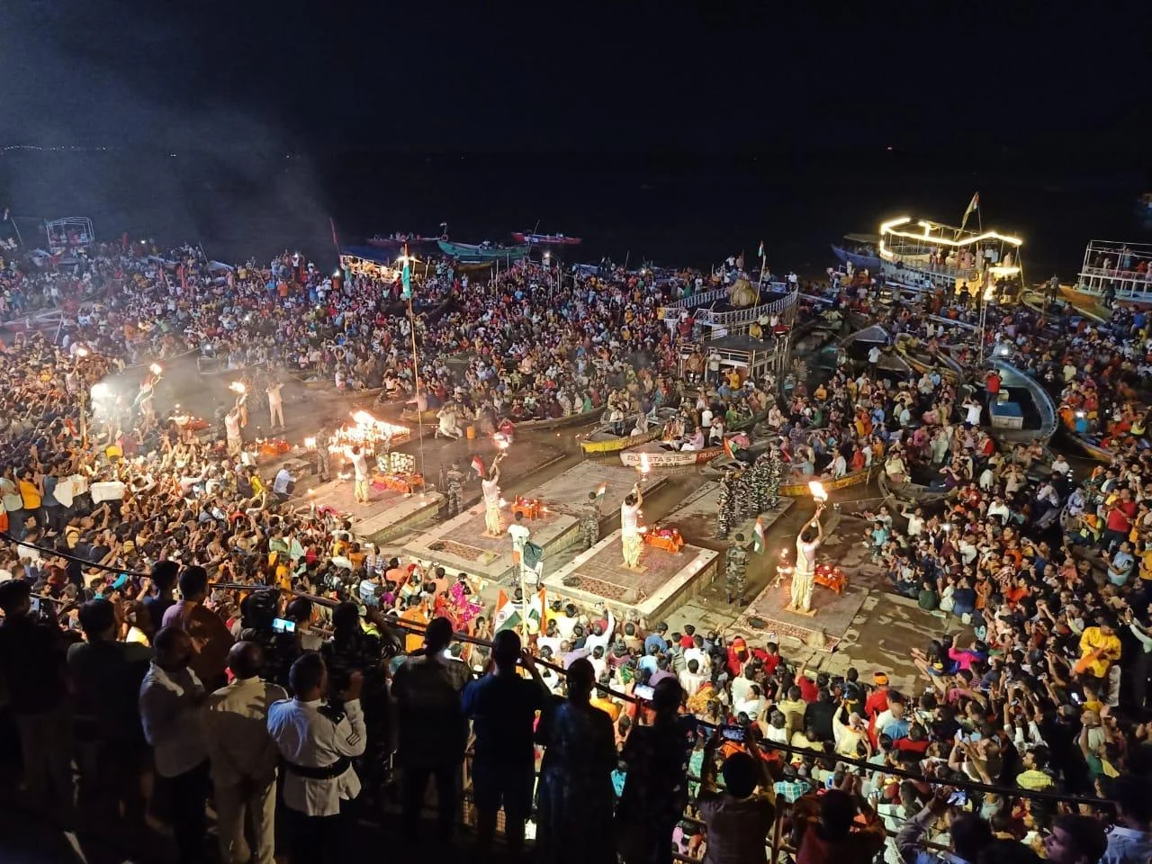
Evening Ganga Aarti
A grand riverside ceremony with lamps, chants and conch shells
Watch it from a boat for an open, unblocked view
Best experienced at sunset, when the ghats glow
Book your seat early on busy evenings.

Slide 4
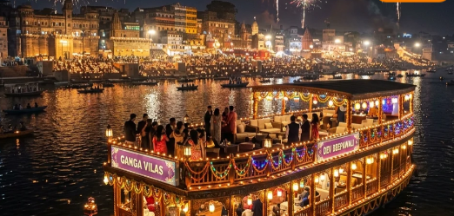

Boat Rides on the Ganga
Sunrise Boat Ride
Calm river, golden light on the ghats
Evening Boat Ride
Watch the Aarti from the water
Book online
kashighoomo.in
Dev Deepawali Boat Ride
The festival of lights, from the river

Slide 5
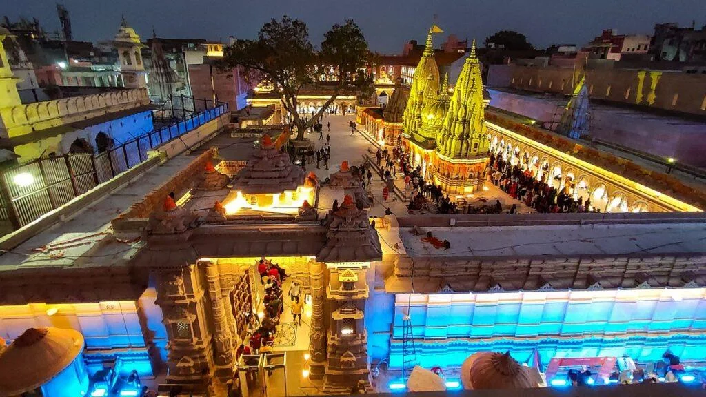
Kashi Vishwanath Darshan
Visit one of the most sacred Shiva temples in India
Walk the lit-up temple complex in the evening
We guide you through darshan so you can focus on the moment
Spiritual heart of Varanasi

Slide 6
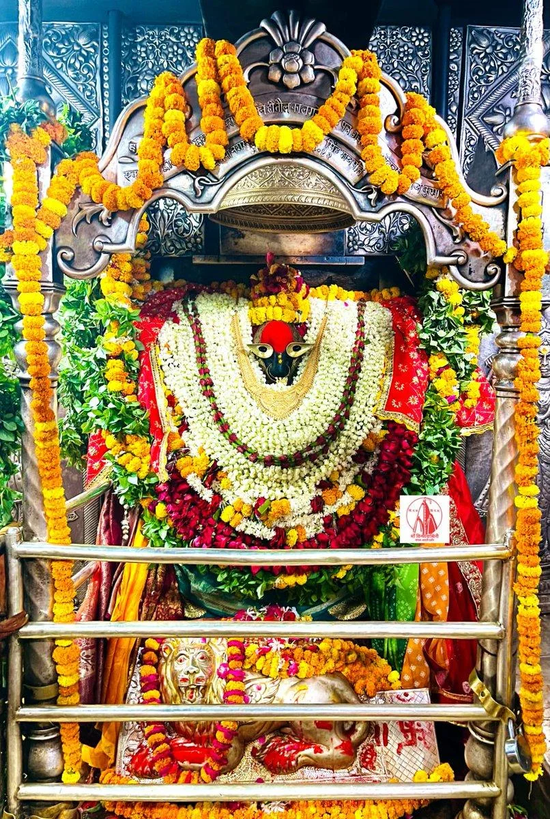



Tour Packages
Kashi (Varanasi)
Ayodhya
Prayagraj
Nepal
Taxi service and custom family packages available.

Slide 7


Why Travel With Us
Local Guidance
Family Friendly
Based at Prahlad Ghat, we know the city and its rhythm
Easy plans for families, elders and groups
Simple Booking
Memorable Moments
Book boat rides and packages online
Aarti, ghats and temples, done right

Slide 8
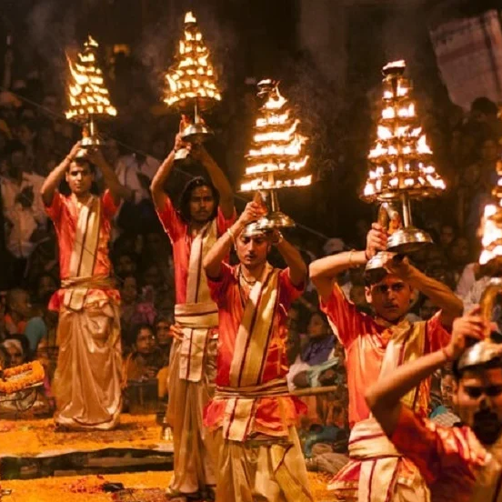


Contact Us
ADDRESS
A-13/5K, Prahlad Ghat, Varanasi, Uttar Pradesh, India
PHONE NUMBER
9214191918
BUSINESS MAIL
kashighoomo@gmail.com
WEBSITE
kashighoomo.in
Book your Varanasi experience today

