Slide 1
EXPLORE UNIǪUE WINE ACCESSORIES & GIFTS
support@thewinehouse.com

Slide 2


Introduction
A premier destination for wine enthusiasts.
Offering curated wine gifts & accessories.
Perfect for personal indulgence or thoughtful gifting.
Design Tip: Include a photo of the store or a display of wine gifts.
support@thewinehouse.com

Slide 3
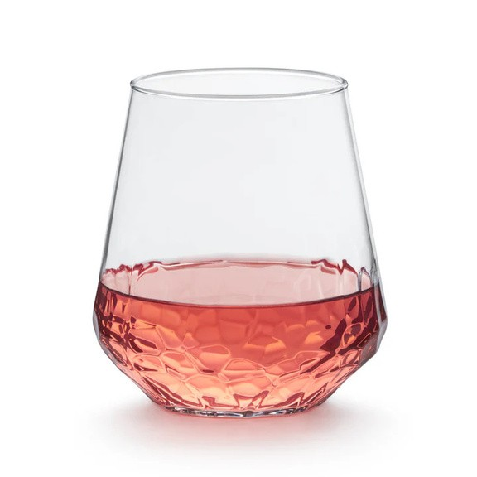


Elegant Wine Glassware
Hand-blown crystal wine glasses Stemless tumblers & aerating wine glasses
Branded glassware for a personal touch Visuals: Images of different glassware sets
support@thewinehouse.com

Slide 4

Unique Wine Openers & Tools
Electric wine openers & classic corkscrews Professional-grade wine keys
Foil cutters, pourers, and drip rings Visuals: Product shots with sleek, modern tools
support@thewinehouse.com

Slide 5

Customizable Gifts & Sets
Custom-labeled wine bottles Engraved gift boxes and accessories Pre-arranged gift sets for all occasions
Design Tip: Highlight customization options (photos of personalized items)
support@thewinehouse.com

Slide 6

Accessories for Storage &
Display
Elegant wine racks & holders Temperature-controlled wine coolers Decorative bottle stoppers and tags
Visuals: Photos of stylish storage solutions
support@thewinehouse.com

Slide 7


Discover the Perfect Gift Today
Visit us in-store or shop online
Gift wrapping and nationwide shipping available Find something for every wine lover
support@thewinehouse.com

