Slide 1
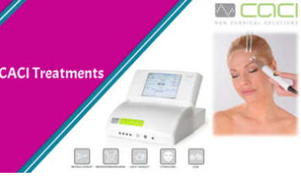
Laser Hair Removal West London
Achieve smoother skin with laser hair removal in west london for long-lasting reduction, precise results, & comfortable sessions tailored to various skin types.

Slide 2
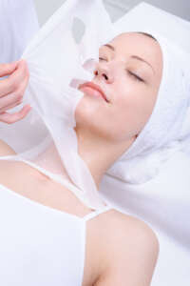
Vitamin Booster West London
Elevate energy vitality with targeted vitamin boosters in west london for essential nutrients that help improve wellness, clarity, hydration, & overall balance.

Slide 3
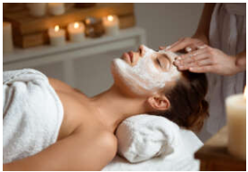
Beauty Salon Price List UK
View a clear beauty salon price list in UK, featuring skincare, body treatments, facials, or grooming options to suit diverse needs with client-focused details.

Slide 4

Contact Us
About : Beautiful World Is An Established Beauty Clinic Located On The High Street In Whitton, Twickenham. We Have A Passion And Flare For Beauty Therapy And Customer Care.
Address : 107 High Street, Whitton, Twickenham TW2 7LD, United Kingdom
Website : https://beautifulworld.uk.com/

