Slide 1
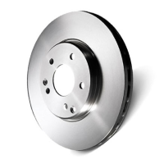

Automotive Parts Specialist
Rely on our automotive parts specialist for expert advice and premium products that keep your vehicle running smoothly with quality you can always count on.

Slide 2
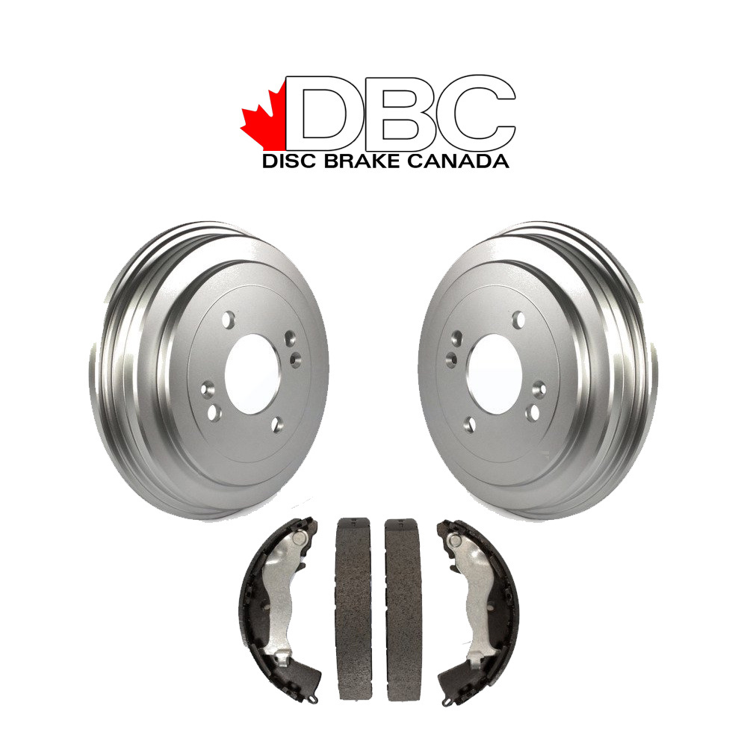
Brake Rotors Canada
Buy brake rotors in Canada drivers trust and upgrade with our Canadian-tested products built for smooth stops, longer life, and unmatched braking performance.

Slide 3
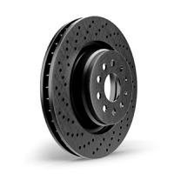
Truck Brake Parts
Do you need powerful truck brake parts for your next journey? Choose our parts that give your truck the grip, control, and stopping power it truly deserves.

Slide 4
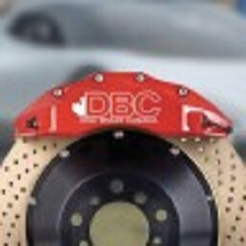
About Us
CrossDrilledRotors.ca is Canada's leading online destination for premium replacement and high-performance brake parts. Our mission is to provide you with top-quality components at unbeatable prices, ensuring your car, truck, or SUV performs at its best.
Address: 6995 Westbury Ave, Montreal, Quebec, Canada
Website: https://www.crossdrilledrotors.ca

