Slide 1

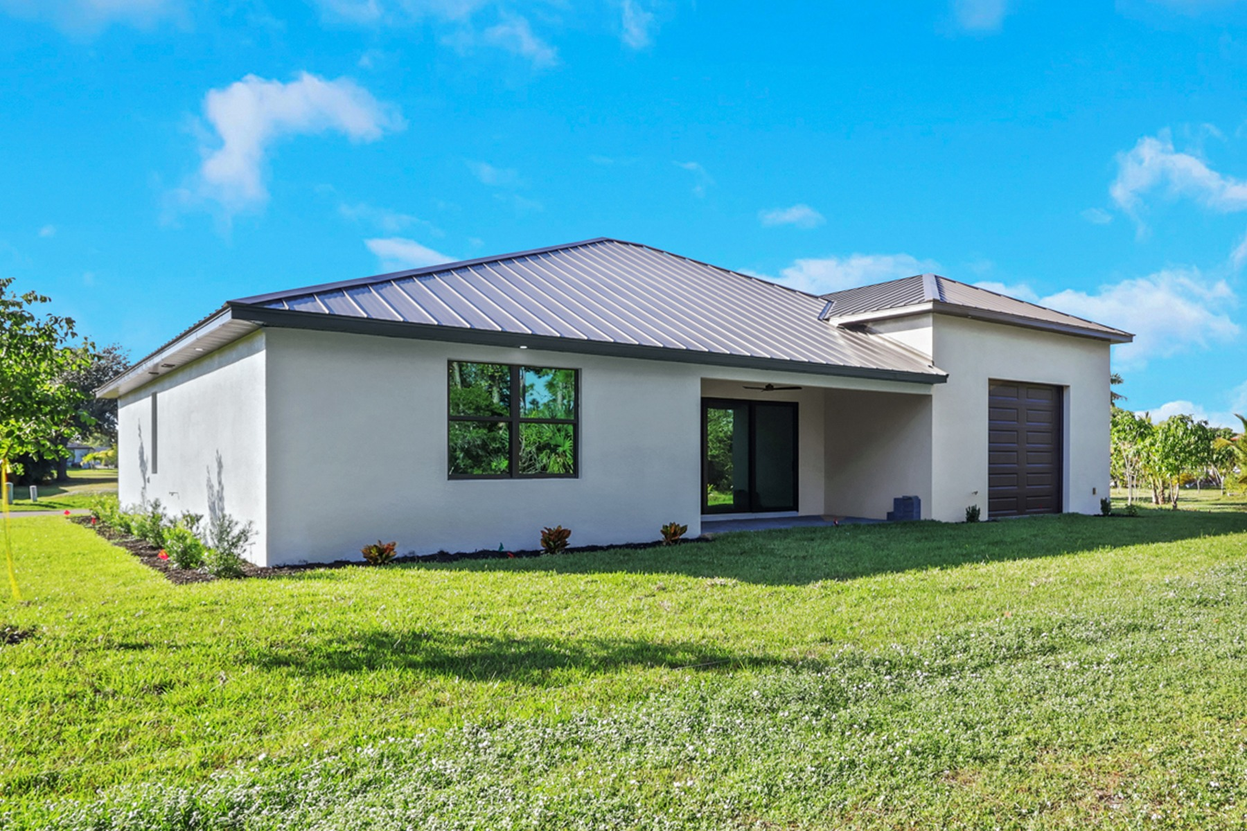
Smart Ways to Find Affordable Homes With Affordable Home Builders Cape Coral FL

Slide 2
Cape Coral is a great choice in terms of space, sunlight, and a strong community without sacrificing comfort. We often hear individuals claim that affordable homes restrict choices, but we disagree and show the opposite daily. The key is in how our approach can get you into a home that suits both your wallet and lifestyle.
Start With a Clear Budget and Real Priorities
Prior to viewing homes, you should make a definitive budget that includes payments, insurance costs, taxation, and maintenance. We recommend that you make a list of all that you need now, along with all that you would like to add later. Buyers who plan early often save more and avoid surprises during closing.
Explore Builders Who Focus on Value
Working with Affordable Home Builders Cape Coral FL grants you access to designs that consider the balance between cost and quality. The builders are familiar with land prices, permits, and materials in the locality, which helps keep the overall expenses under control. As we show options to our clients, we always stick to those floor plans that maximize the use of space without much wastage of square footage.
Choosing the right builder gives you pricing transparency. Clients prefer to have a clear understanding of the costs and not just an estimate of a part of the project. Good builders should provide ways of saving energy.

Slide 3
Plan Home Tours Before Making a Decision
Our method is to let you visit our Cape Coral Model Homes so that you can check the floor plans, room sizes, and every detail up close. We suggest exploring several model homes to land on the right choice by comparing what you see.
Model homes also show how design choices affect daily living. There is an opportunity to recognize the availability of storage space, kitchen functionality, and lighting effects. Such visits always help buyers make informed choices about their designs, eliminating upgrades that are not required.
Picking The Right Neighborhood Early
Location influences long-term real estate value and convenience. Some locations are associated with lower house pricing but higher commuting costs. Other locations provide an equal trade-off between pricing and proximity to education facilities, shopping centers, and recreational parks. We help buyers compare locations so they can find value without compromise.
Work With a Builder Who Knows Cape Coral
Sposen Signature Homes prides itself on the construction of the highest-quality homes that also manage to stay in budget. Our knowledge of the area also prevents any setbacks and expensive errors that a person could encounter due to ignorance.

Slide 4
This knowledge will instill confidence in you when you explore Cape Coral Model Homes.
They aid in:
Effective Smart floor plan design.
Cost-effective material choices.
Zoning & Building Regulations.
Final Thought
"Affordable" does not necessarily mean "cheap." A well-designed house will support a family growing up, home offices for working at home, or even a possible resale down the road.
Finding an affordable housing solution in Cape Coral can become much simpler if proper planning and the right builder are involved. With the right assistance from Affordable Home Builders Cape Coral FL, you can rest assured that your home will meet your budget requirements as well as your lifestyle.

Slide 5

For More Details Contact Us :
Name: Sposen Signature Homes
Address: 2311 Santa Barbara Blvd, Suite 112, 33991 Cape Coral, Florida, USA
Telephone: 239-244-8886
Email id: hello@sposenhomes.com
Website: https://sposenhomes.com

