Slide 1
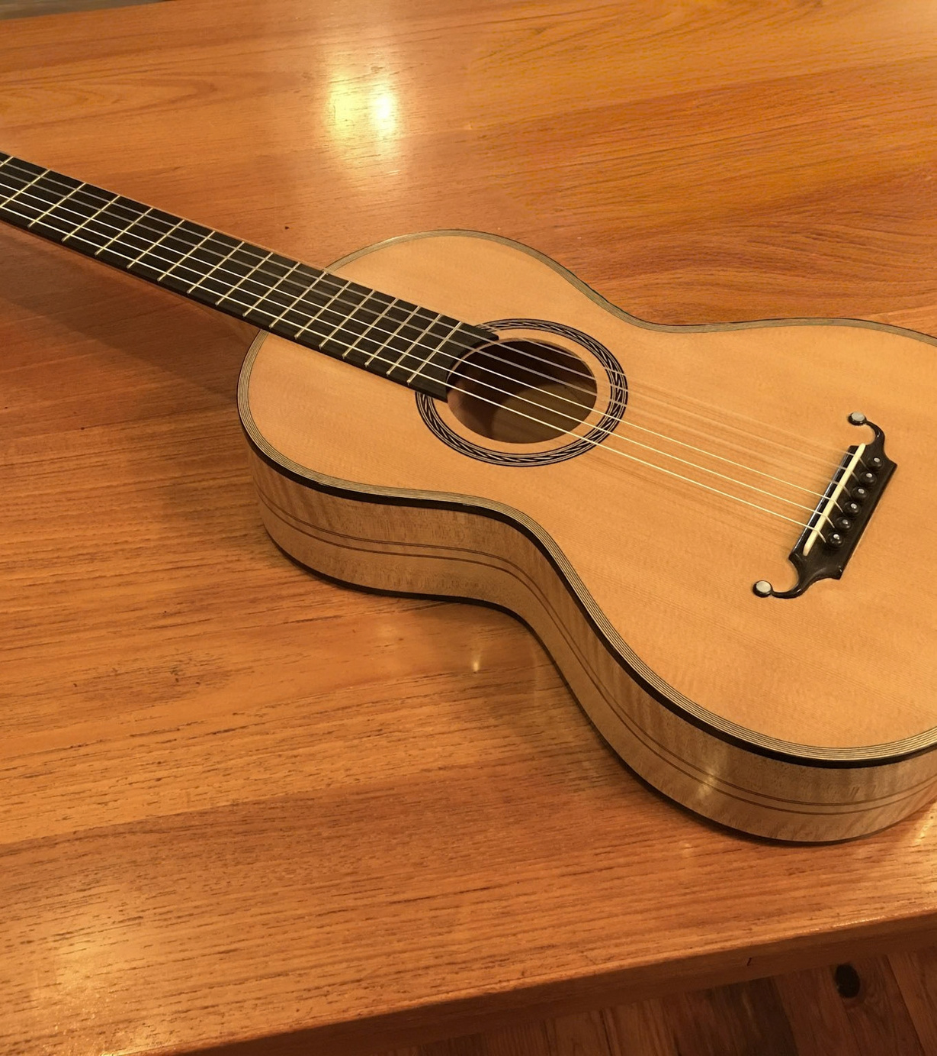

Finding Your Perfect Classical Guitar
7 Signs You’ve Found the Right Kremona Concert Classical Guitar
A friendly guide to trusting your hands, your ears, and your instincts.
Notes:
1

Slide 2
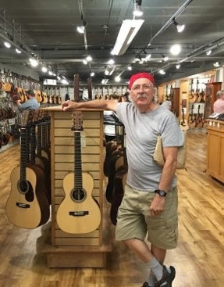
That Little Moment Matters
Buying a classical guitar feels strangely personal. You walk in thinking you’ll try a few, then one makes you stop. The neck feels familiar, a chord rings beautifully, and you play the same passage twice just to hear it again.
When choosing among Kremona Concert Classical Guitars, the real question isn’t “Is this a good guitar?” It’s “Does this guitar feel right for the way I play?”
Notes:
2

Slide 3
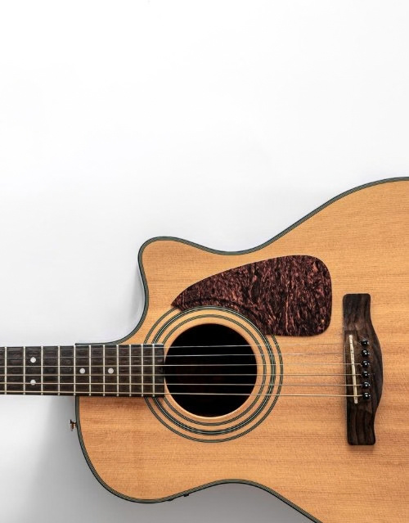

Signs 1 & 2: Comfort and Clarity
1
Your Right Hand Feels at Home
Your hand should settle naturally over the strings. Fingerstyle patterns feel controlled and arpeggios flow. If you keep adjusting your wrist, pause.
2
The Treble Has a Voice of Its Own
Play a simple melody on the higher strings. Each note should speak clearly while keeping the warmth of a classical instrument.
Notes:
3

Slide 4
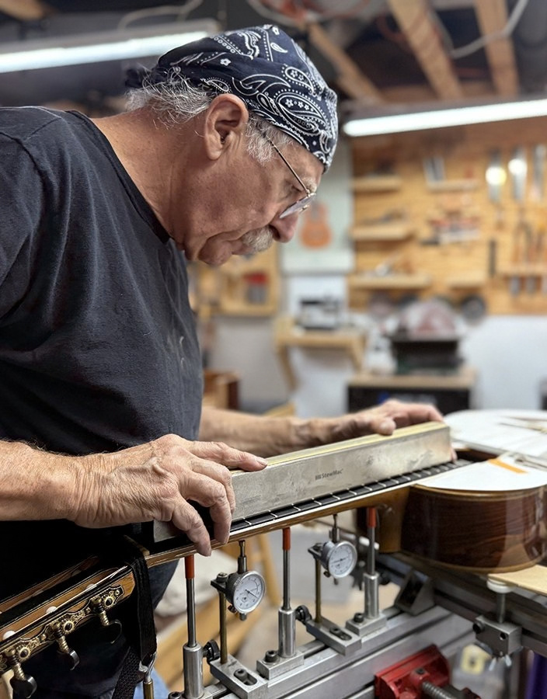
Signs 3 & 4: Balance and Feel
3
The Bass Supports the Music
Try a slow chord progression. You want depth in the bass without it overpowering the trebles. Can you hear both?
4
The Neck Invites You to Keep Playing
Shift positions, try barre chords, play the upper frets. Look for low, comfortable action without fret buzz.
Notes:
4

Slide 5
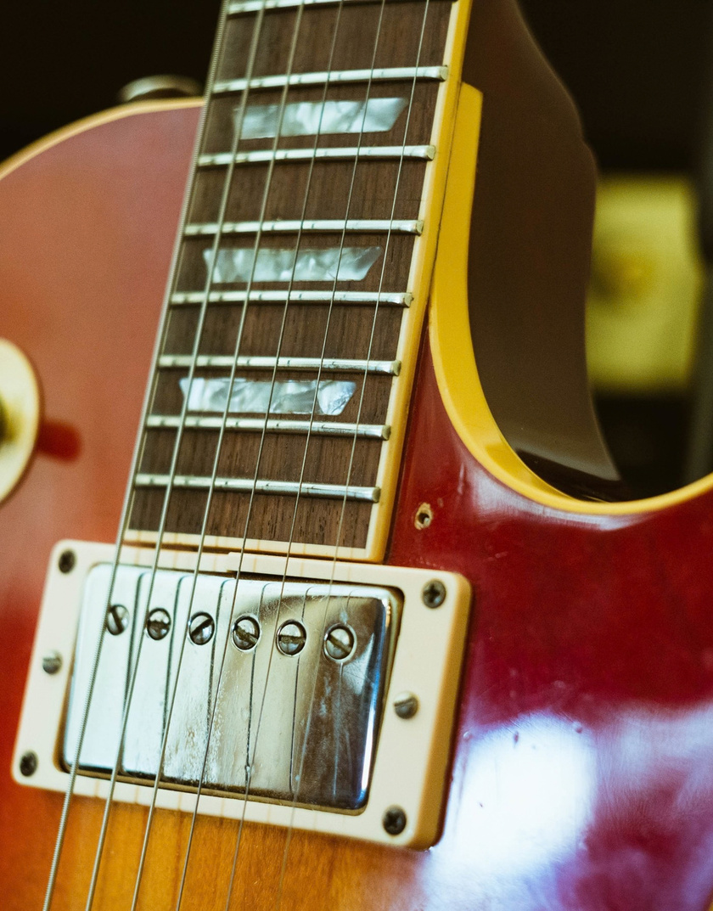
Signs 5 & 6: Clean and Expressive
5
Open Notes Ring Cleanly
Listen for buzzing, rattling, or notes that die away quickly. Wood, construction, and setup shape each guitar’s character.
6
It Responds to Your Touch
Play softly, then with more attack. A great guitar stays expressive, so look for color, not just volume.
Notes:
5

Slide 6
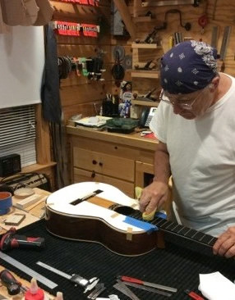
Sign 7: The Comparing Stops
7
You Stop Comparing It to Everything Else
After trying several Kremona classical guitars, you may have a shortlist. One might be brighter, another different under the fingers. Eventually, one makes comparison unnecessary.
You play. You listen. You smile.
“Yes. This is the one.”
Notes:
6

Slide 7






Before You Buy: Check the Basics
Neck
Frets
Bridge
Finish
Intonation
Overall setup
Once the practical checks are done, trust the connection. The right concert classical guitar becomes part of how you phrase a melody, shape a chord, and tell a musical story.
Notes:
7

Slide 8




Thank You
Contact us for more information:
Website: https://marfioneguitars.com/
Phone: 8286529210
Email: cs@marfioneguitars.com
Address: 255 Asheville St, Morganton, NC 28655, North Carolina
Notes:
8

