Slide 1


STUDENT TRAVEL • 2026
Do college students get discounts on American Airlines?
Travel smart, save big with your student status!
CALL +1-888-212-0809
AIRFLY POLICY / STUDENT TRAVEL GUIDE
01 / 10

Slide 2
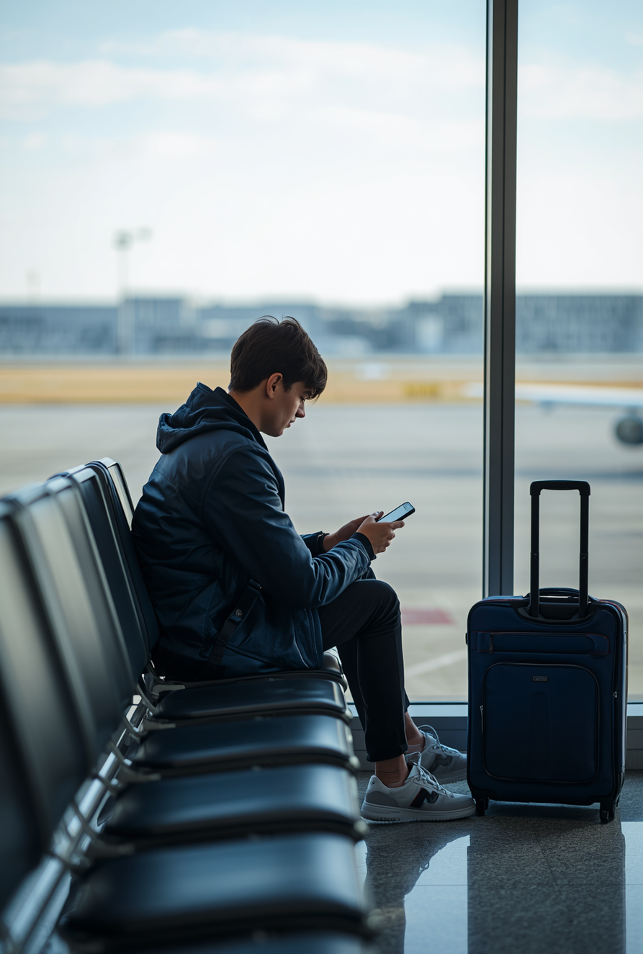
WHY THIS MATTERS
Student travel can cost less.
Traveling as a college student can be expensive, but there are ways to save. Many wonder about American Airlines student discounts and whether they unlock special fares or perks. This guide explores current programs, eligibility, discount codes and practical ways to maximize savings—without compromising flexibility on your next journey.
AIRFLY POLICY / STUDENT TRAVEL GUIDE
02 / 10

Slide 3
CURRENT LANDSCAPE
American Airlines student discount 2026
Direct programs may vary, but partner platforms and education travel sites can provide exclusive deals. The strongest offers combine verified student status with flexible booking terms.
— Partner student travel agencies
— Student status verification
— Flexible ticket options
— Domestic + international routes
— Academic-calendar promotions
— Student-focused support
AIRFLY POLICY / STUDENT TRAVEL GUIDE
03 / 10

Slide 4

20%
discount opportunities
Up to 20% offers are usually limited-time promotions or partner-platform deals—not a guaranteed universal fare. Read the conditions before booking.
SELECT ROUTES • STUDENT VERIFICATION • ADVANCE BOOKING • FARE EXCLUSIONS MAY APPLY
AIRFLY POLICY / STUDENT TRAVEL GUIDE
04 / 10

Slide 5

FLEXIBILITY + VALUE
American Airlines student fares
Student-oriented fare structures can make travel more affordable and flexible. Look for reduced prices, change-friendly terms and booking windows timed around semester breaks.
— Reduced fares on eligible routes
— Flexible changes or cancellations
— Possible baggage savings
— Semester-break booking windows
— Availability varies by date
— Online partner booking portals
AIRFLY POLICY / STUDENT TRAVEL GUIDE
05 / 10

Slide 6
BOOKING TOOL
AA student discount code
STUDENT20
Codes may be distributed through student agencies, university programs or airline promotions. Apply them at checkout and confirm eligibility, route limits and expiration dates first.
— Use official partner portals
— Enter code during checkout
— Check route and date limits
— Verify with ID or student email
— Review the expiration date
— Ask support if a code fails
AIRFLY POLICY / STUDENT TRAVEL GUIDE
06 / 10

Slide 7

ELIGIBILITY
How to qualify
Access starts with valid student status. Requirements vary by offer, so verify before payment.
— Enrolled at an accredited institution
— Student ID or transcript
— Typical age range: 18–26
— Full-time status may be required
— Student email may be accepted
— Partner-site registration may apply
AIRFLY POLICY / STUDENT TRAVEL GUIDE
07 / 10

Slide 8
SMARTER BOOKING
6 ways to maximize savings
A proactive booking strategy can stretch a student budget further. Start early, compare official partner offers and keep your eligibility documents ready.
01
Book early
02
Use authorized agencies
03
Join fare-alert newsletters
04
Add loyalty benefits
05
Travel off-peak
06
Verify before booking
AIRFLY POLICY / STUDENT TRAVEL GUIDE
08 / 10

Slide 9

THE TAKEAWAY
Verify. Compare. Book smart.
American Airlines student savings often require research, verification and the right booking channel. Use official partners, understand fare conditions and plan ahead to access affordable flights and flexible options for student journeys.
Questions? +1-888-212-0809
AIRFLY POLICY / STUDENT TRAVEL GUIDE
09 / 10

Slide 10
READY FOR TAKEOFF?
Plan your next student trip.
WEB
airflypolicy.com
EMAIL
info@airflypolicy.com
CALL
+1-888-212-0809
AIRFLY POLICY / STUDENT TRAVEL GUIDE
10 / 10

