Slide 1
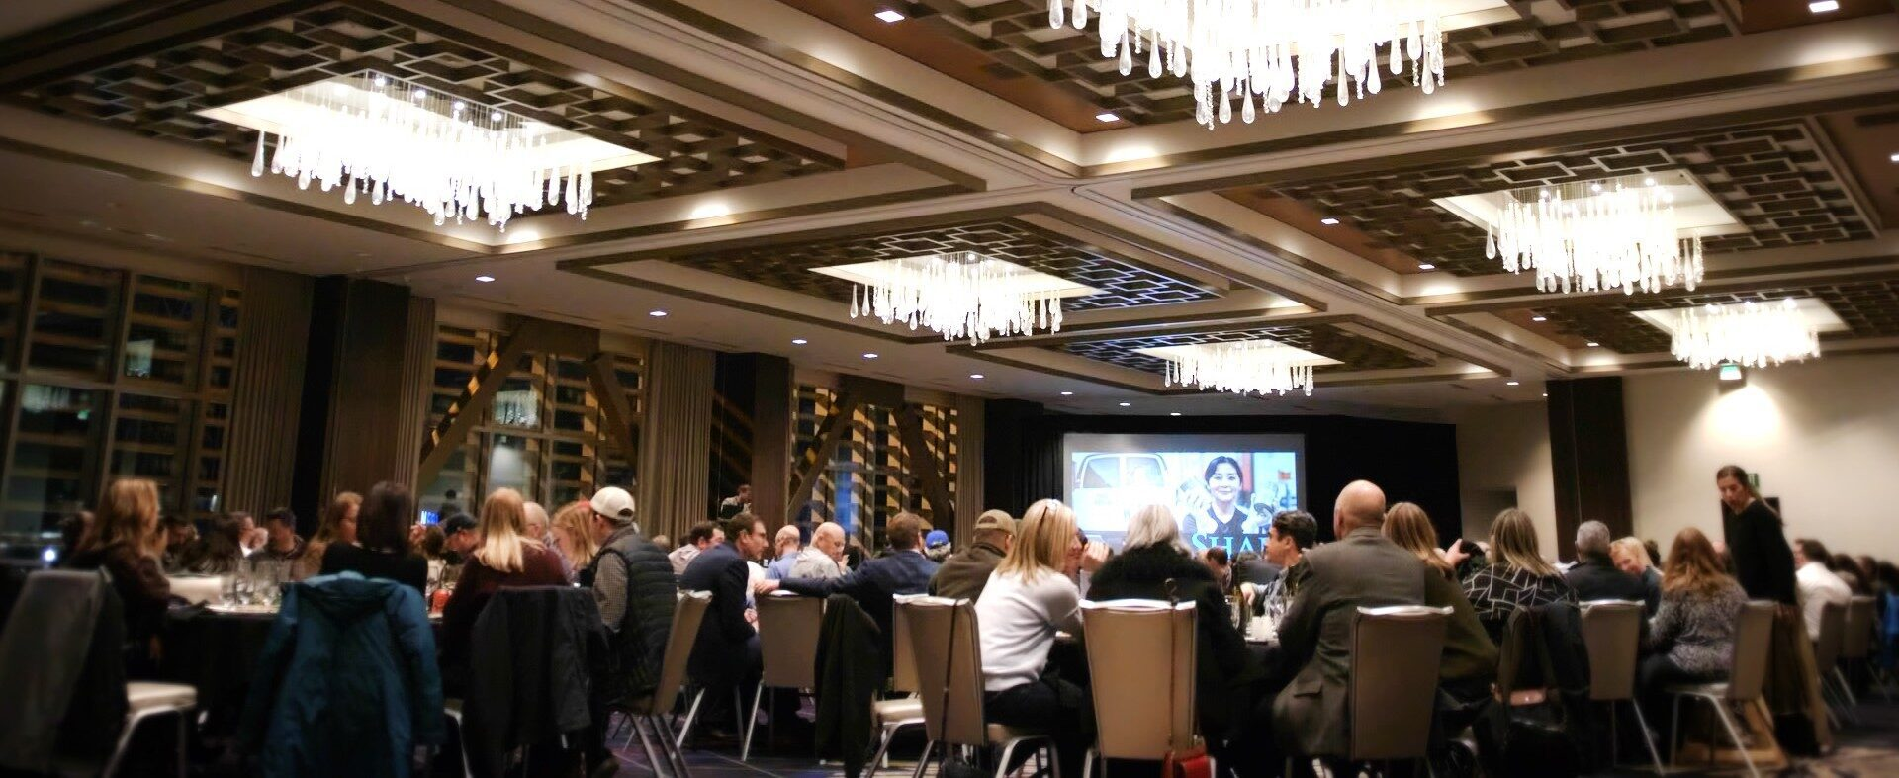
Professional Event Planning Seattle
Achieve event success using professional event planning in Seattle, providing expert coordination, budget management, & creative ideas for corporate gatherings.

Slide 2

Seattle Corporate Holiday Event
Plan office celebrations with Seattle corporate holiday event services, creating memorable, well-organized gatherings to impress employees, clients, & partners.

Slide 3
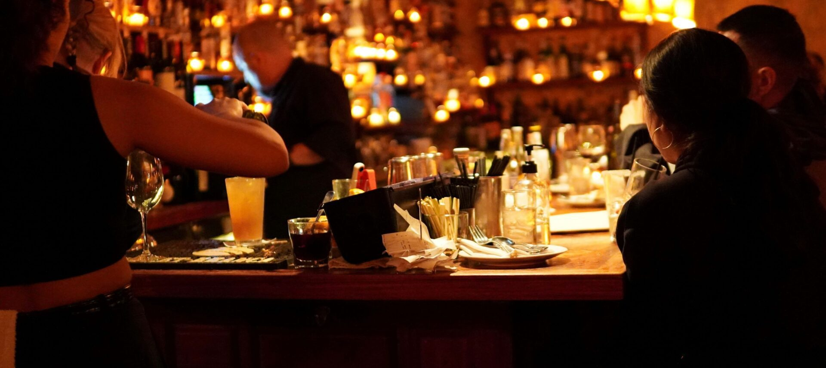
Top Seattle Restaurants Open Late
Discover dining options with our top Seattle restaurants open late for diverse menus, convenient hours, & exceptional experiences for event attendees or guests.

Slide 4

Contact Us
About: Event Experience is a Seattle-based event production agency with a working studio and logistical and creative planning teams. Let us make your event seamless and successful!
Address: 34303 Pacific Hwy S, Federal Way, WA 98003, United States
Website: https://eventexperience.com/

