Slide 1


Compassionate and Quality Aged Care in Georges Hall
Discover exceptional aged care services in Georges Hall that prioritize dignity, comfort, and quality of life. Our trusted local providers offer comprehensive care solutions designed to support seniors and their families through every stage of life.

Slide 2







Why Choose Compassionate Aged Care?
Personalized Care
Specialized Support
Care plans that respect dignity, independence, and cultural diversity. Every individual receives attention tailored to their unique needs, preferences, and background.
Expert care for complex conditions including dementia, palliative care, and chronic health management with trained professionals.
Family Environment
A warm, nurturing atmosphere where every resident is valued as part of the family, fostering genuine connections and community.

Slide 3
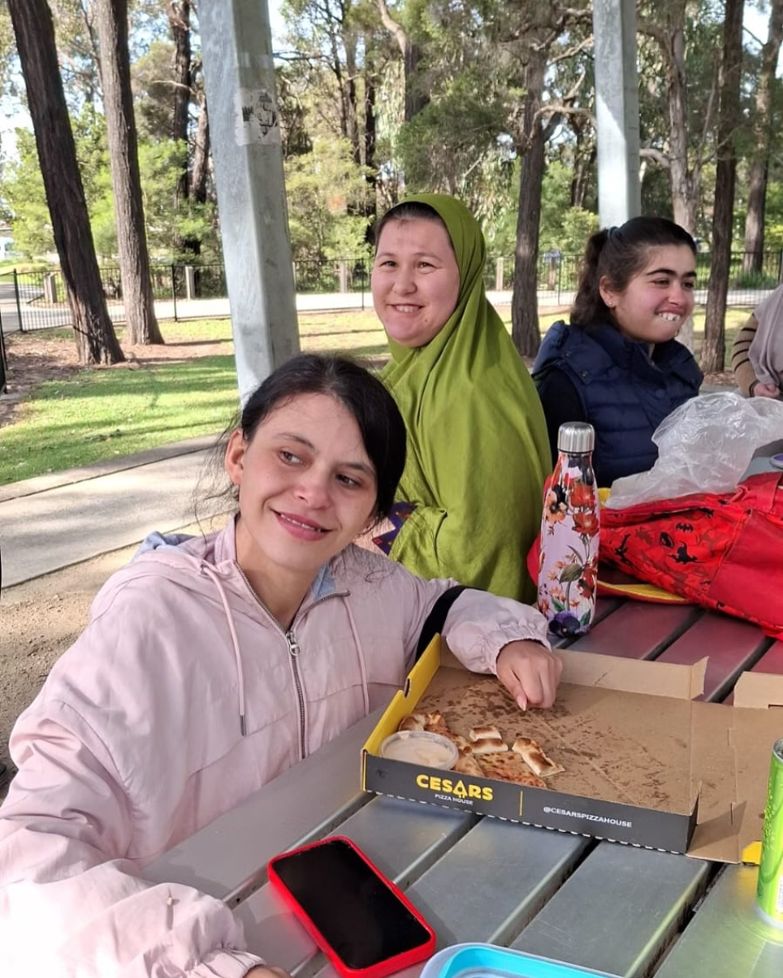
Trusted Local Providers: Circle of Hope Services
Government Approved Excellence
Circle of Hope Services operates under the Australian Government's My Aged Care Home Care Packages, ensuring compliance with national standards and quality assurance.
Comprehensive In-Home Care
Personal care assistance with daily living activities
Clinical support and medication management
Mobility assistance and physiotherapy
Domestic services and meal preparation
Social support and companionship
Available 24/7 with culturally sensitive, multilingual staff who understand diverse community needs and preferences.

Slide 4



Georges Estate: Premium Residential Care
Luxurious Living Spaces
World-Class Wellness Centre
Engaging Social Activities
Purpose-built facility featuring lush gardens, comfortable communal areas, and private accommodations designed for dignity and comfort.
Comprehensive wellness facilities offering physiotherapy, hydrotherapy, occupational therapy, and specialized clinical care programs.
Rich program of activities including pet therapy, live concerts, scenic drives, arts and crafts, and community outings that promote joy and connection.

Slide 5

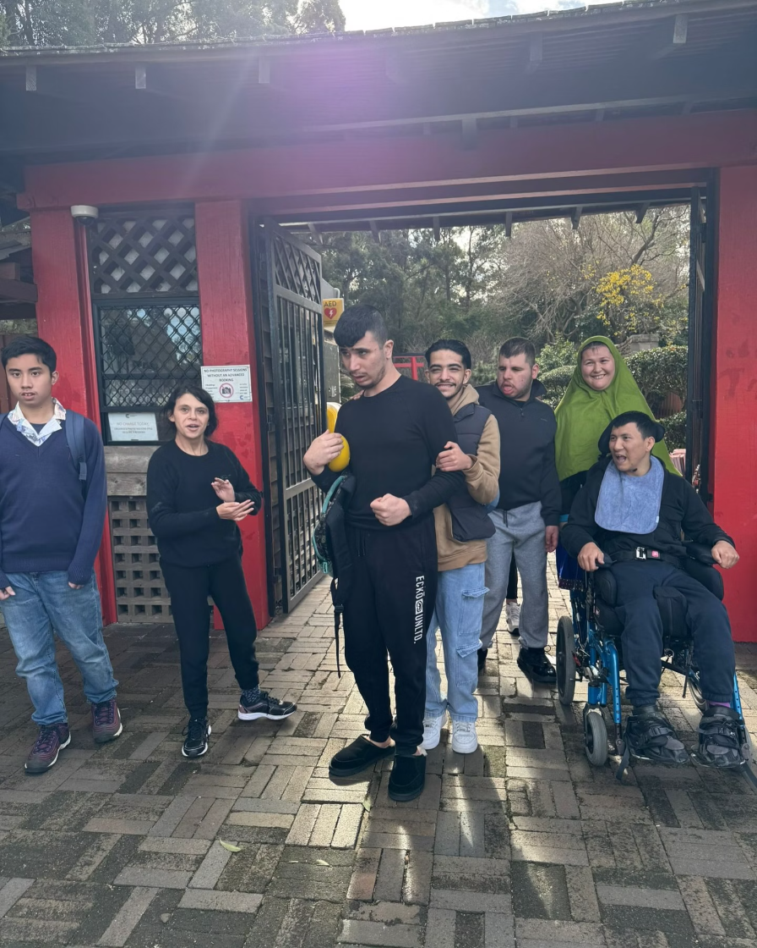
Real Stories of Care and Joy
My father loved the activities and was cared for like family. The staff went above and beyond to make him feel at home and valued every single day.
The kindness and professionalism exceeded our expectations. We felt confident leaving our mother in their care, knowing she would receive compassionate attention.
– Kathy Smith
– The Meredith Family
Peace of Mind for Families
Families consistently express gratitude for the peace of mind that comes from knowing their loved ones are safe, happy, and receiving exceptional care. Our commitment to transparency and regular communication ensures families stay connected and informed about their loved one's wellbeing.

Slide 6

Innovative and Empowering Care at Caura Aged Care
01
02
Empowerment Focus
Personalized Support Plans
Dedicated to empowering seniors to live independently with dignity, maintaining autonomy while providing necessary support.
Compassionate, transparent, and individually tailored care plans that evolve with changing needs and preferences.
03
Experience-Driven Approach
Founded on lived experience to create a safe, understanding environment where seniors feel heard, respected, and valued.
Caura Aged Care represents a new generation of aged care providers, built on the principle that quality care should enhance rather than diminish personal autonomy and dignity.

Slide 7


Building a Supportive Community in Georges Hall
Inclusive Community Programs
Social engagement activities that combat isolation
Mental wellness programs and counseling support
Cultural celebrations and community events
Intergenerational programs connecting with local schools
Volunteer opportunities for active community participation
Clinical Excellence
Our skilled nursing teams provide comprehensive clinical care tailored to individual health needs, including chronic disease management, medication support, and coordination with healthcare providers.
Georges Hall's aged care community is built on the foundation of mutual respect, where every individual contributes to a vibrant, supportive environment that celebrates life at every stage.
Our Commitment Respect, empathy, and continuous improvement in all aspects of care delivery and community building.

Slide 8
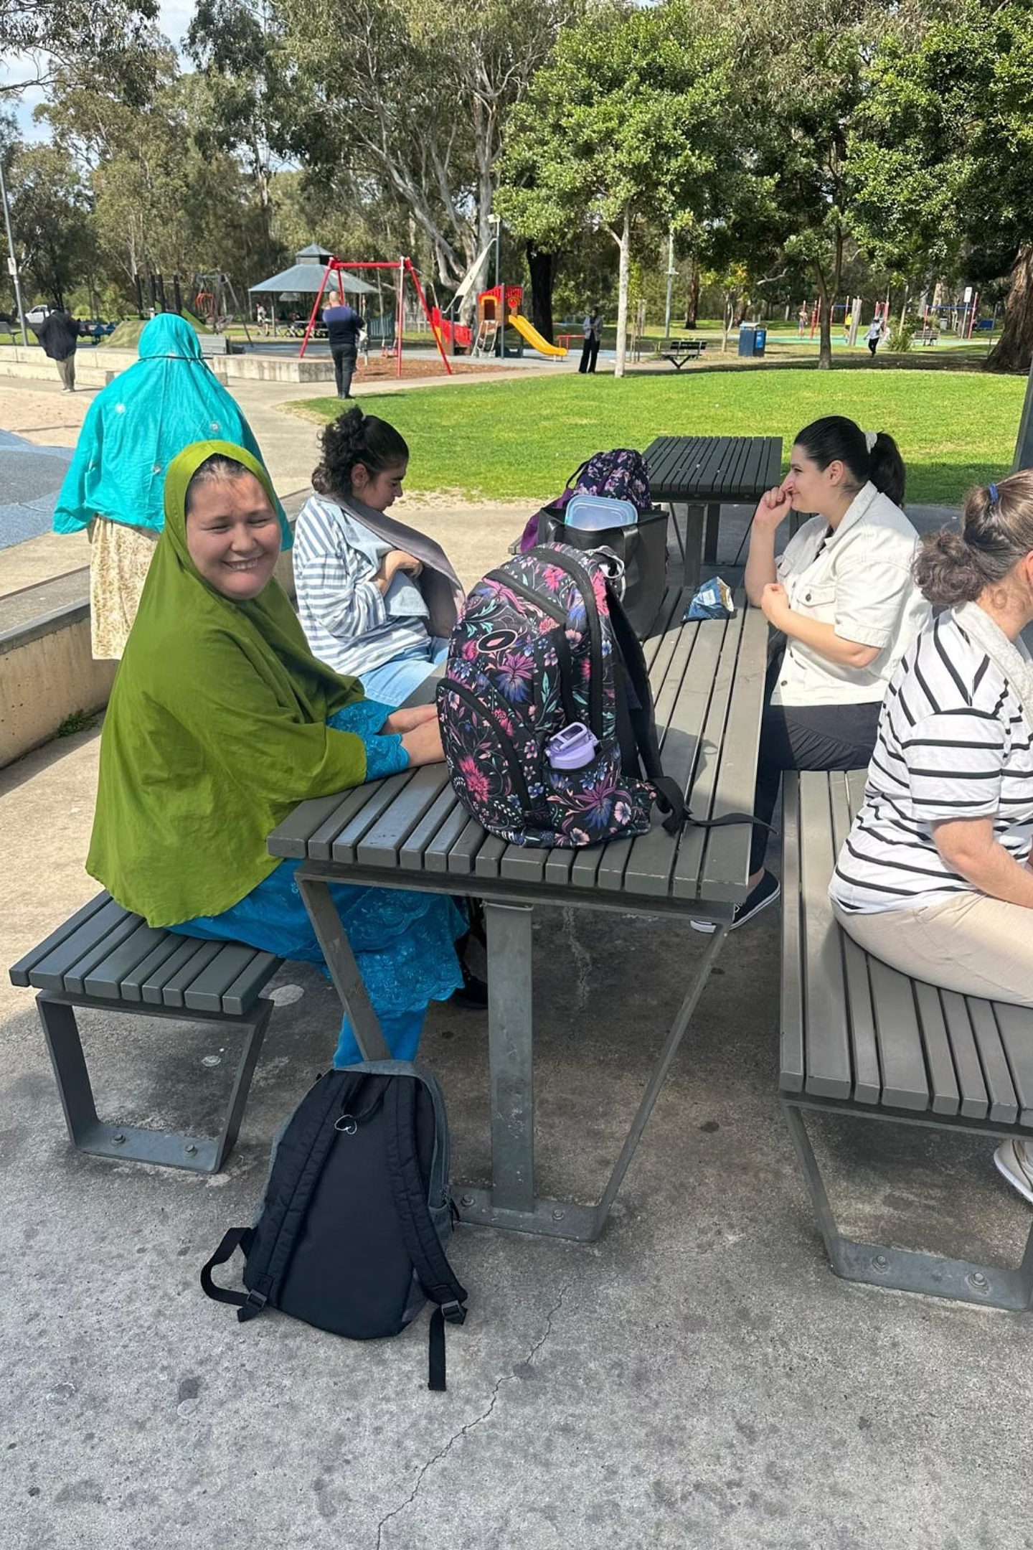
Contact Us: Start Your Journey to Quality Care Today
Circle of Hope Services
Phone: +61 452 445 445
Website: https://circleofhope.com.au/aged-care/
Government approved home care packages and in-home support services.
Take the next step toward quality care by scheduling a personal tour or calling to discuss your care options with our compassionate experts. We're here to support you and your family through this important decision with understanding, patience, and professional guidance.

