Slide 1

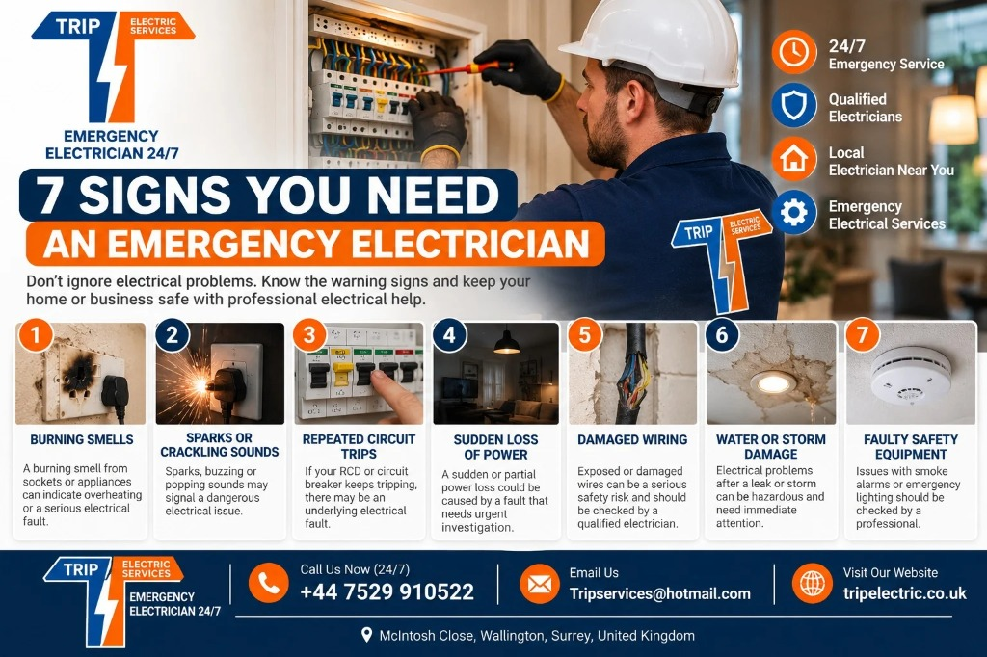
7 Signs You Need an Emergency Electrician

Slide 2
Electrical problems can appear without warning. A socket may start sparking, a circuit breaker may repeatedly trip, or part of your property may suddenly lose power. While some electrical issues can wait for a scheduled appointment, others need prompt professional attention.
Knowing when to contact a qualified electrician near me can help you avoid unsafe DIY repairs and reduce the risk of further electrical damage. Trip Electric provides 24/7 emergency electrical services for urgent faults across London, Surrey, Kent and West Sussex.
7 Warning Signs That Require Professional Electrical Help
1. Burning Smells From Sockets or Electrical Equipment
A persistent burning or unusual electrical smell should never be ignored. It can indicate overheating, damaged wiring, a faulty connection or an electrical component becoming excessively hot.
2. Sparks, Popping or Crackling Sounds
Sparks from a socket, switch, plug or electrical appliance can indicate a fault that requires professional attention. Crackling and popping sounds may also suggest an issue with an electrical connection.
This is a situation where searching for a local electrician near me and arranging professional assistance is safer than attempting to investigate the wiring yourself.

Slide 3
3. Repeatedly Tripping Circuit Breakers
Circuit breakers, RCDs and related protective devices are designed to disconnect electrical circuits when certain faults occur. If a breaker repeatedly trips after being reset, there may be an underlying electrical problem.
Trip Electric specifically lists fuseboard, MCB, RCD and RCBO tripping among the emergency faults it handles.
A qualified electrician near me can investigate the cause instead of simply resetting the breaker repeatedly.
4. Sudden or Partial Power Loss
A sudden loss of electricity does not automatically mean you need an emergency electrician. The problem could be related to the wider electricity network.
However, if neighbouring properties have power and only your property is affected, an internal electrical fault may need investigation. Trip Electric provides power restoration and fault-finding services for emergency electrical problems.
5. Damaged Sockets, Switches or Wiring

Slide 4
Cracked sockets, loose switches, exposed cables and signs of melting should receive professional attention. Physical damage can leave electrical components unsafe to use.
Do not touch exposed conductors or attempt to repair fixed wiring yourself. Instead, keep the affected area clear and contact a qualified electrician near me.
A local electrician near me can inspect the affected installation and determine whether repair or replacement is required.
6. Electrical Problems After Water or Storm Damage
Water and electricity are a dangerous combination. Flooding, leaks, heavy rain or storm damage can affect electrical equipment and wiring.
If electrical components have been exposed to water, avoid touching them. Even if the electricity appears to be working normally, an inspection may be appropriate before the affected equipment is used again.
Searching for a local electrician near me can help you find professional assistance for urgent electrical concerns following property damage.

Slide 5
7. Faulty Emergency or Safety Equipment
Electrical faults involving smoke alarms, emergency lighting or other safety-related equipment should not be overlooked. These systems can play an important role in protecting people inside residential and commercial properties.
Trip Electric lists smoke alarm installation and testing, as well as emergency lighting and related electrical services, among its available services.
If a safety system develops an electrical fault, contact a qualified electrician near me rather than attempting an unfamiliar repair.
Source URL:– https://tripelectric.co.uk/7-signs-you-need-an-emergency-electrician/

Slide 6
Trip Electric Services— Business Details
Business Name: Trip Electric Services
Address: McIntosh Close, Wallington, Surrey
Phone: +44 7529910522
Email: tripservices@hotmail.com
Website: https://tripelectric.co.uk/

