Slide 1

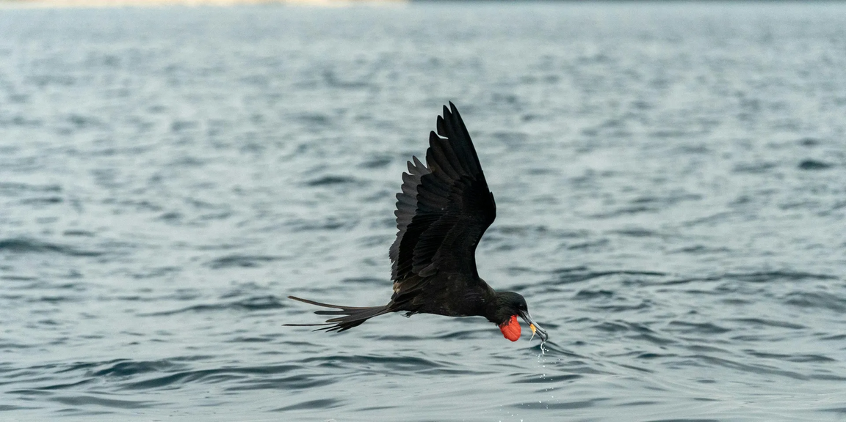

BIRDERS on the ROAD
By: BIRDERS on the ROAD

Slide 2
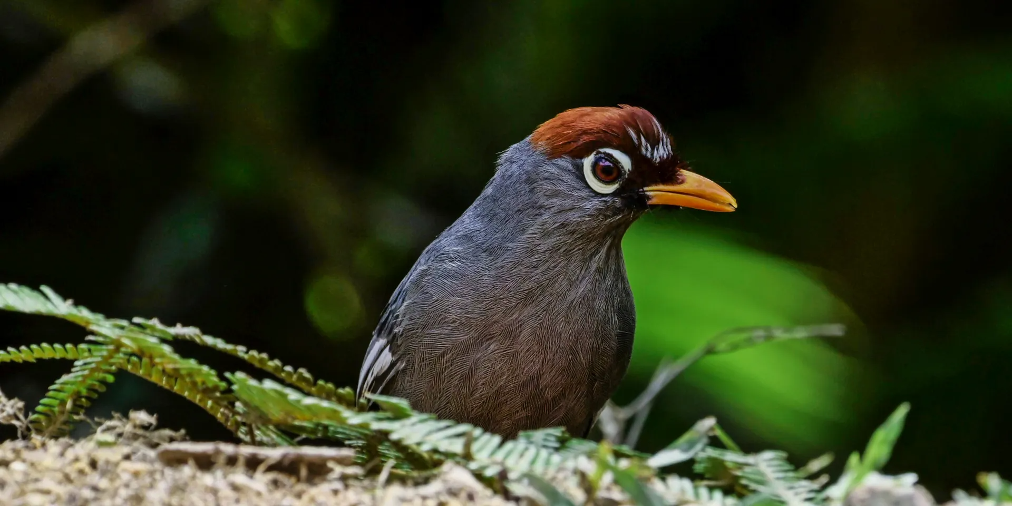
Introduction to Rare Texas Birds
Texas is a birdwatcher’s paradise, home to over 600 species. Among them are elusive, rare birds that thrill even seasoned birders. At BIRDERS on the ROAD, we specialize in helping you find these rare treasures.

Slide 3
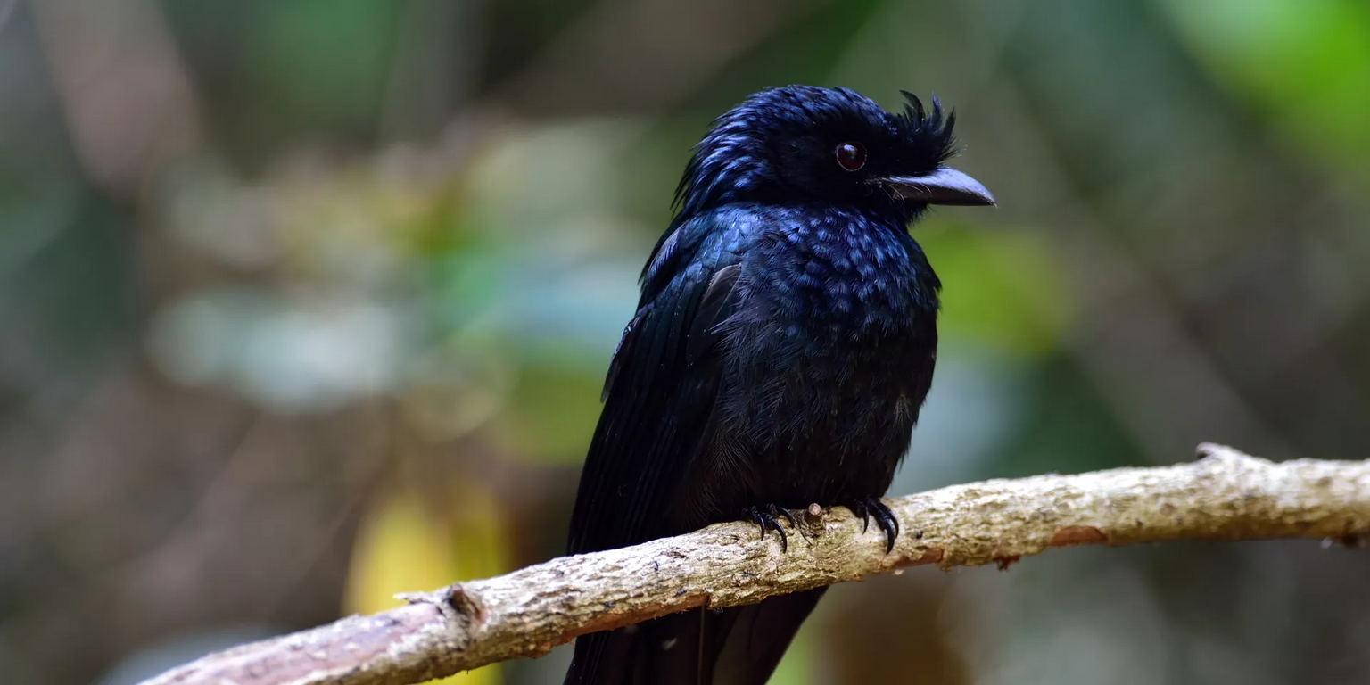
Whooping Crane
Once nearly extinct, the majestic Whooping Crane is a rare sight in Texas, especially in Aransas National Wildlife Refuge. Standing nearly 5 feet tall, it captivates birders with its elegant stance and haunting calls.
Golden-cheeked Warbler
Endemic to central Texas, the Golden-cheeked Warbler nests exclusively in Ashe juniper woodlands.

Slide 4
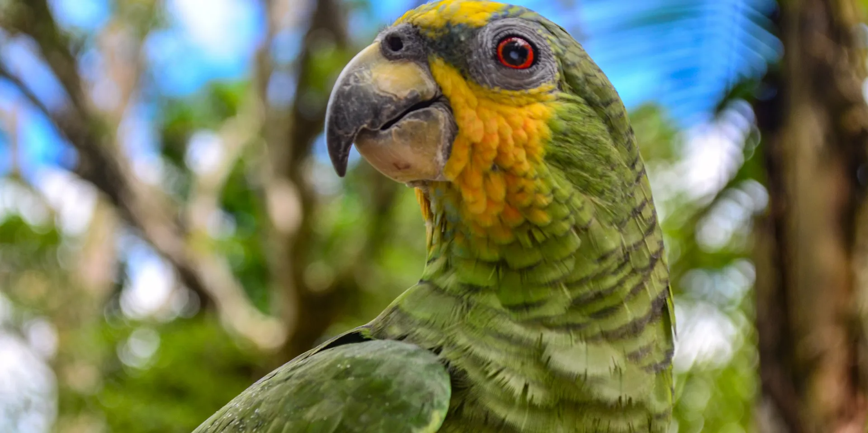
Ferruginous Pygmy Owl
Tiny but fierce, this rare owl is occasionally spotted in South Texas brushlands. The Ferruginous Pygmy Owl is active during the day and known for its rapid flight and sharp gaze—an exciting find for any birder.

Slide 5
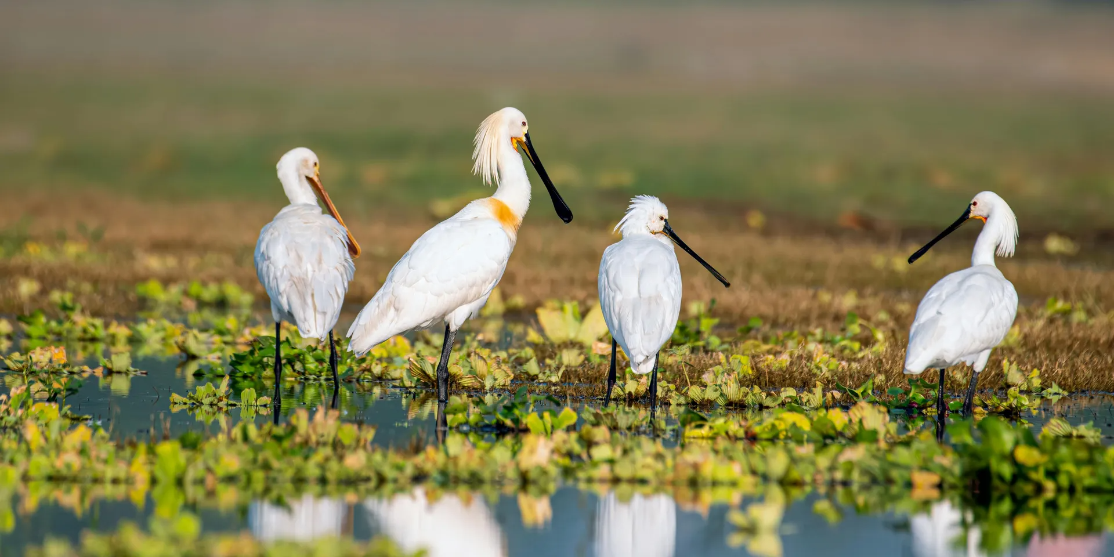
Explore with BIRDERS on the ROAD
Whether you’re chasing warblers or cranes, BIRDERS on the ROAD guides you to Texas' rarest birding experiences. Join our expert-led tours and discover the untamed beauty of birdlife across the Lone Star State.

Slide 6
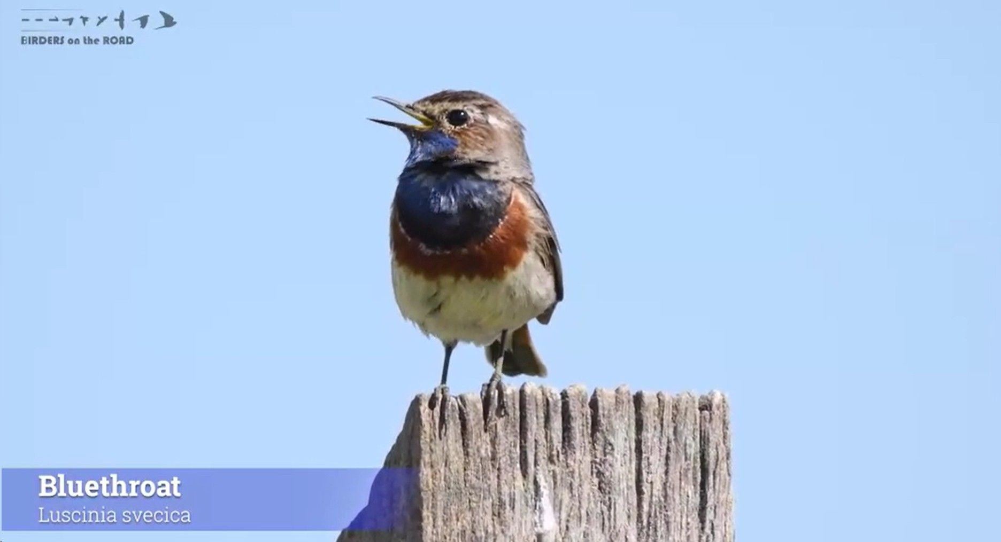
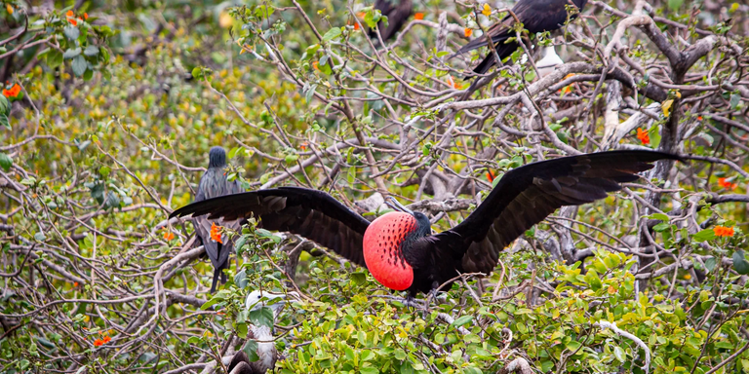


THANK YOU!
  www.birdersontheroad.com
  100 Alamo, TX 78516

